Slide 1
Super-Resolving Any MRI
Yunxiang Li
Medical Artificial Intelligence and Automation (MAIA) Laboratory
Department of Radiation Oncology
Yunxiang.li@UTSouthwestern.edu

Slide 2
Patient-Specific MRI Super-Resolution via Implicit Neural Representations and Knowledge Transfer
Yunxiang Li, Yen-Peng Liao , Jing Wang , Weiguo Lu, You Zhang
in Physics in Medicine and Biology

Slide 3
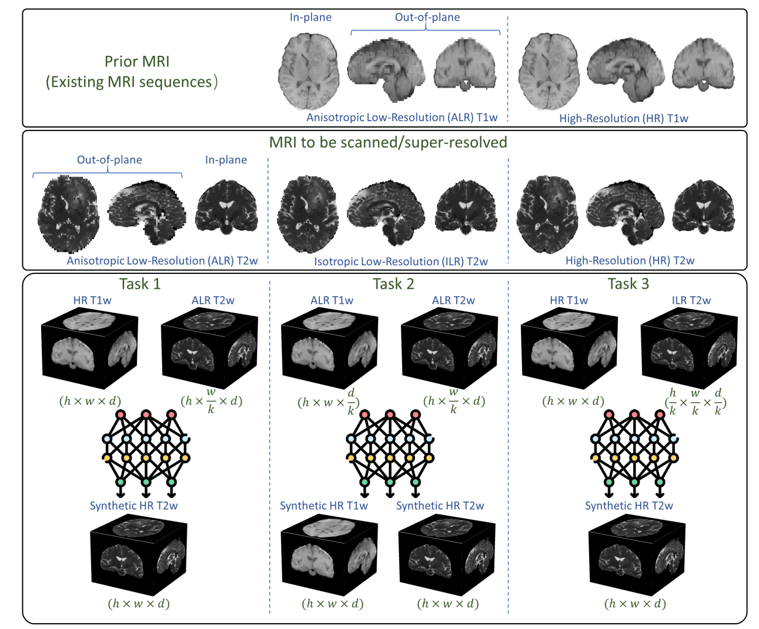
Clinical Task

Slide 4
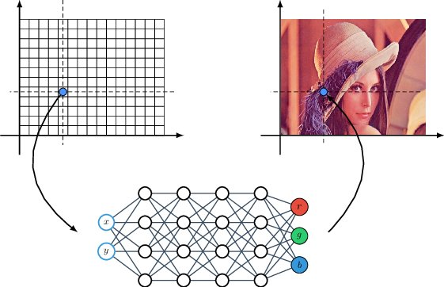
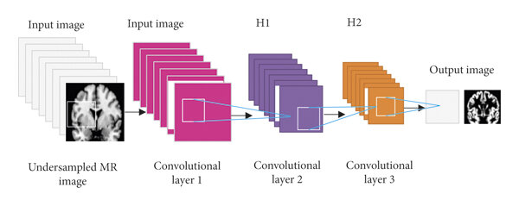
What is Implicit Neural Representations (INR)
The input is the coordinate value, and the output is the corresponding intensity value.

Slide 5
Why INR is suitable for Super-Resolution?
High resolution
Low resolution
Unknown
The coordinate value is a continuous value, so sparse coordinates can be used during training, and complete/full coordinates can be used directly for prediction.

Slide 6
Why INR is suitable for Super-Resolution?
High resolution
Low resolution
Unknown
Training: (0,0), (4,4), (8,8)
Inference: (0,0), (1,1), (2,2), (3,3), (4,4)……

Slide 7
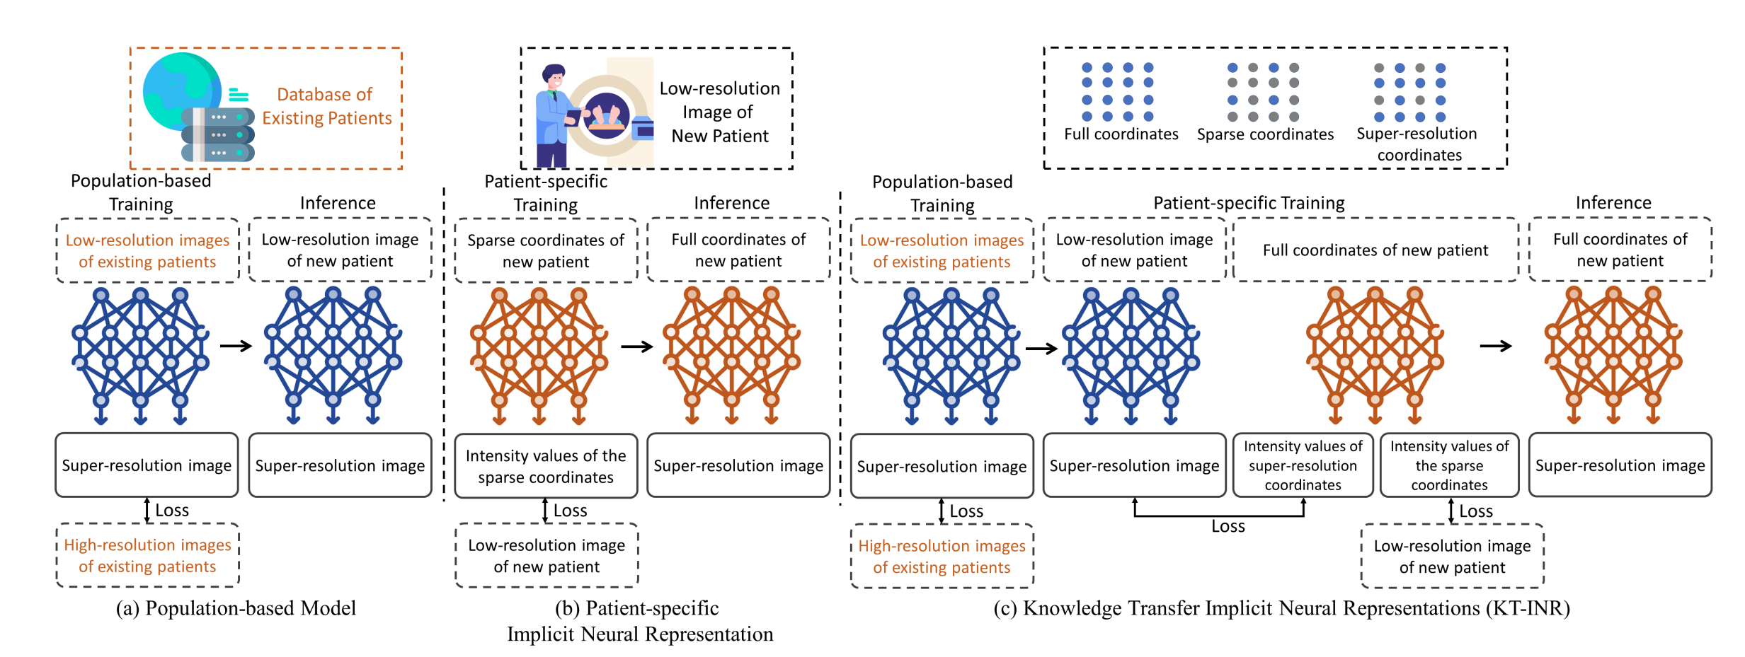
Model Overview (Difference between INR and population-based model)

Slide 8
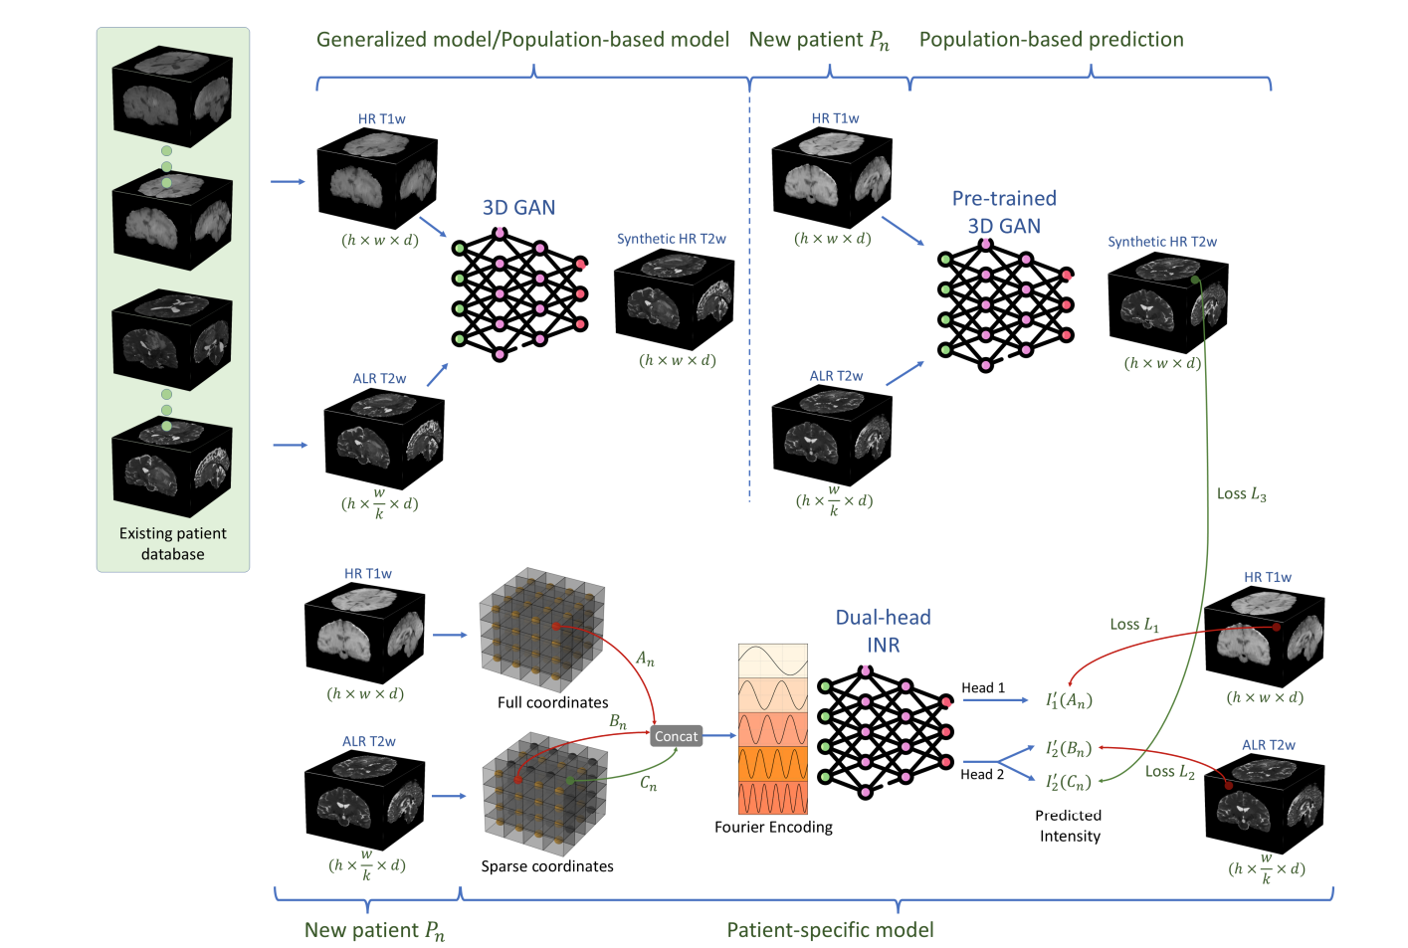
Model Structure

Slide 9
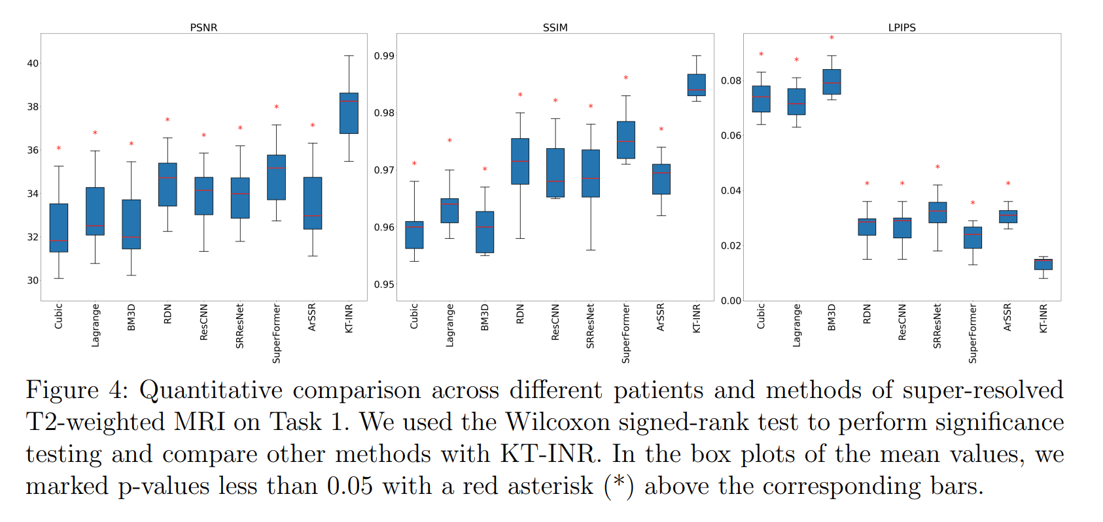
Task 1

Slide 10
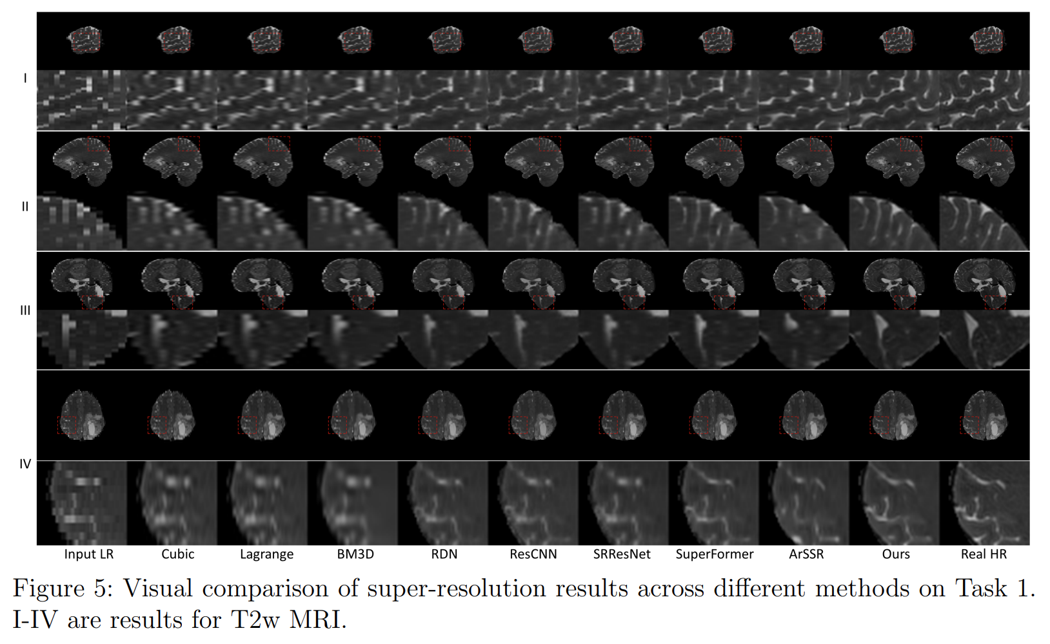
Task 1

Slide 11
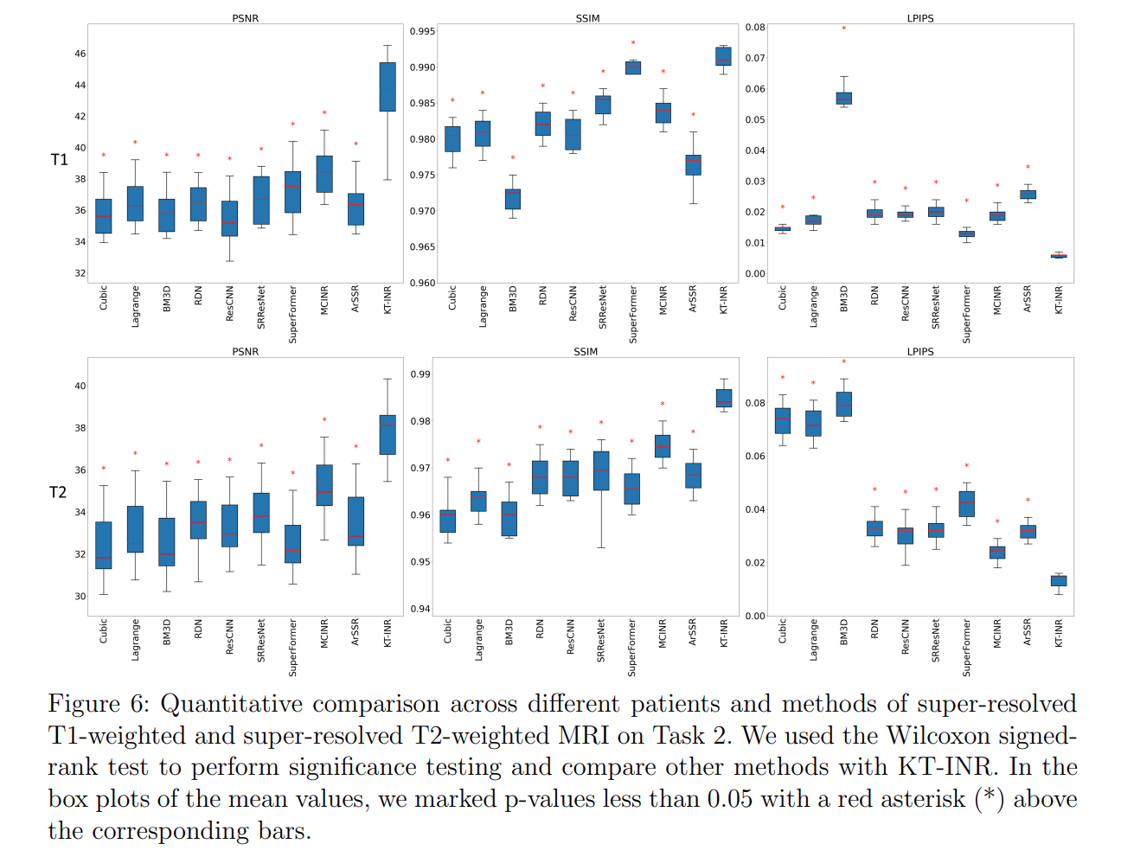
Task 2

Slide 12
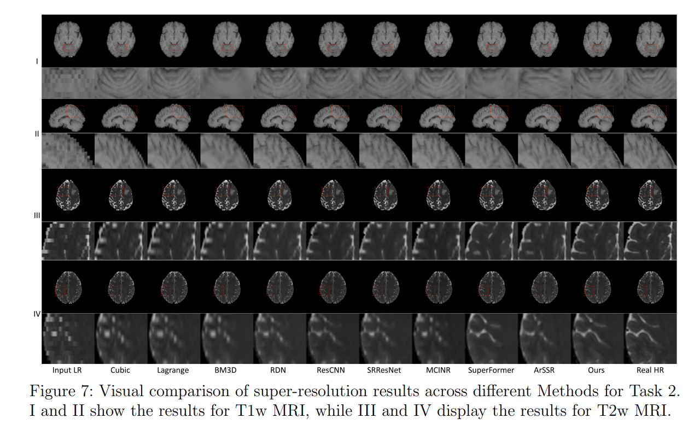
Task 2

Slide 13
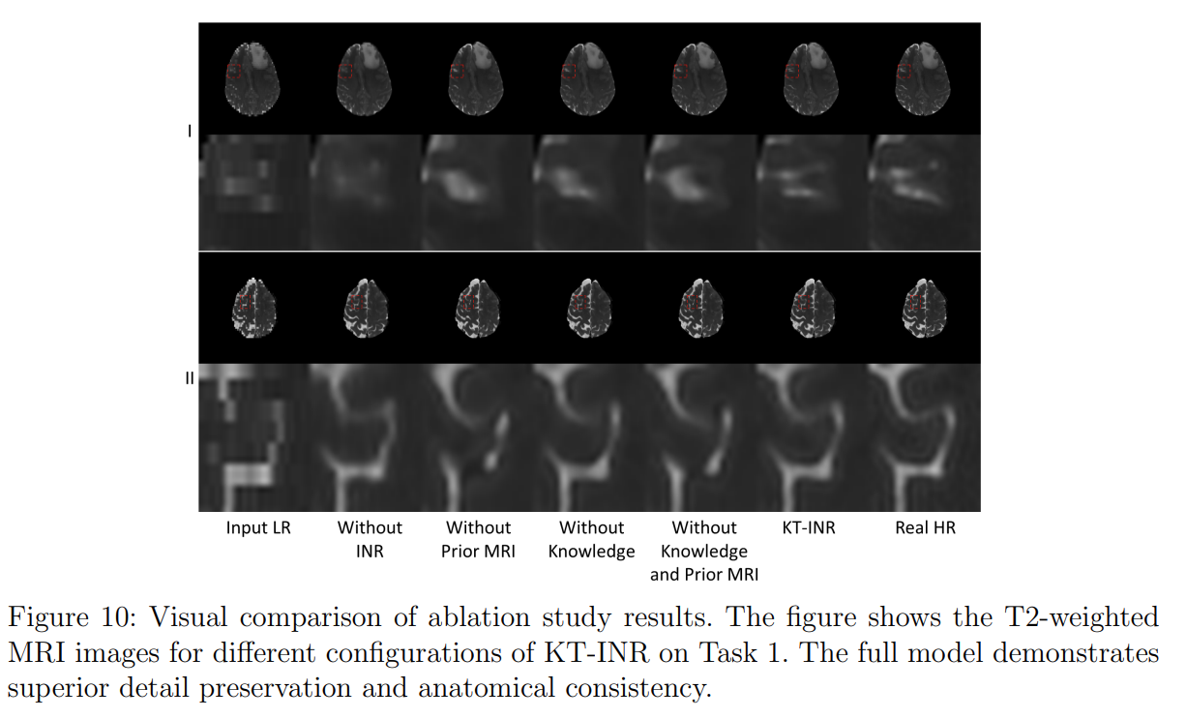
Ablation study

Slide 14
Parameters study

Slide 15
Universal Mapping and Patient-Specific Prior Implicit Neural Representation for Enhanced High-Resolution MRI in MRI-Guided Radiotherapy
Yunxiang Li, Jie Deng, You Zhang
Major revision in Medical Physics

Slide 16
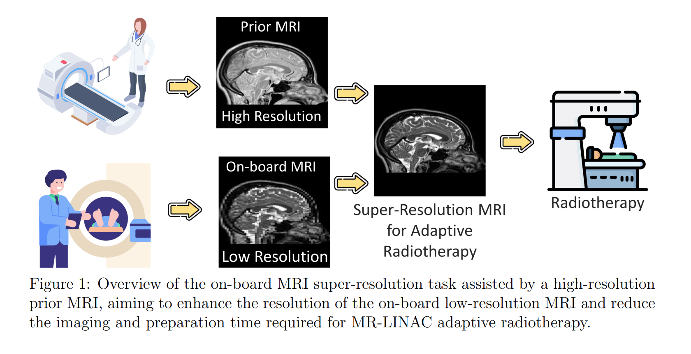
Clinical Task

Slide 17
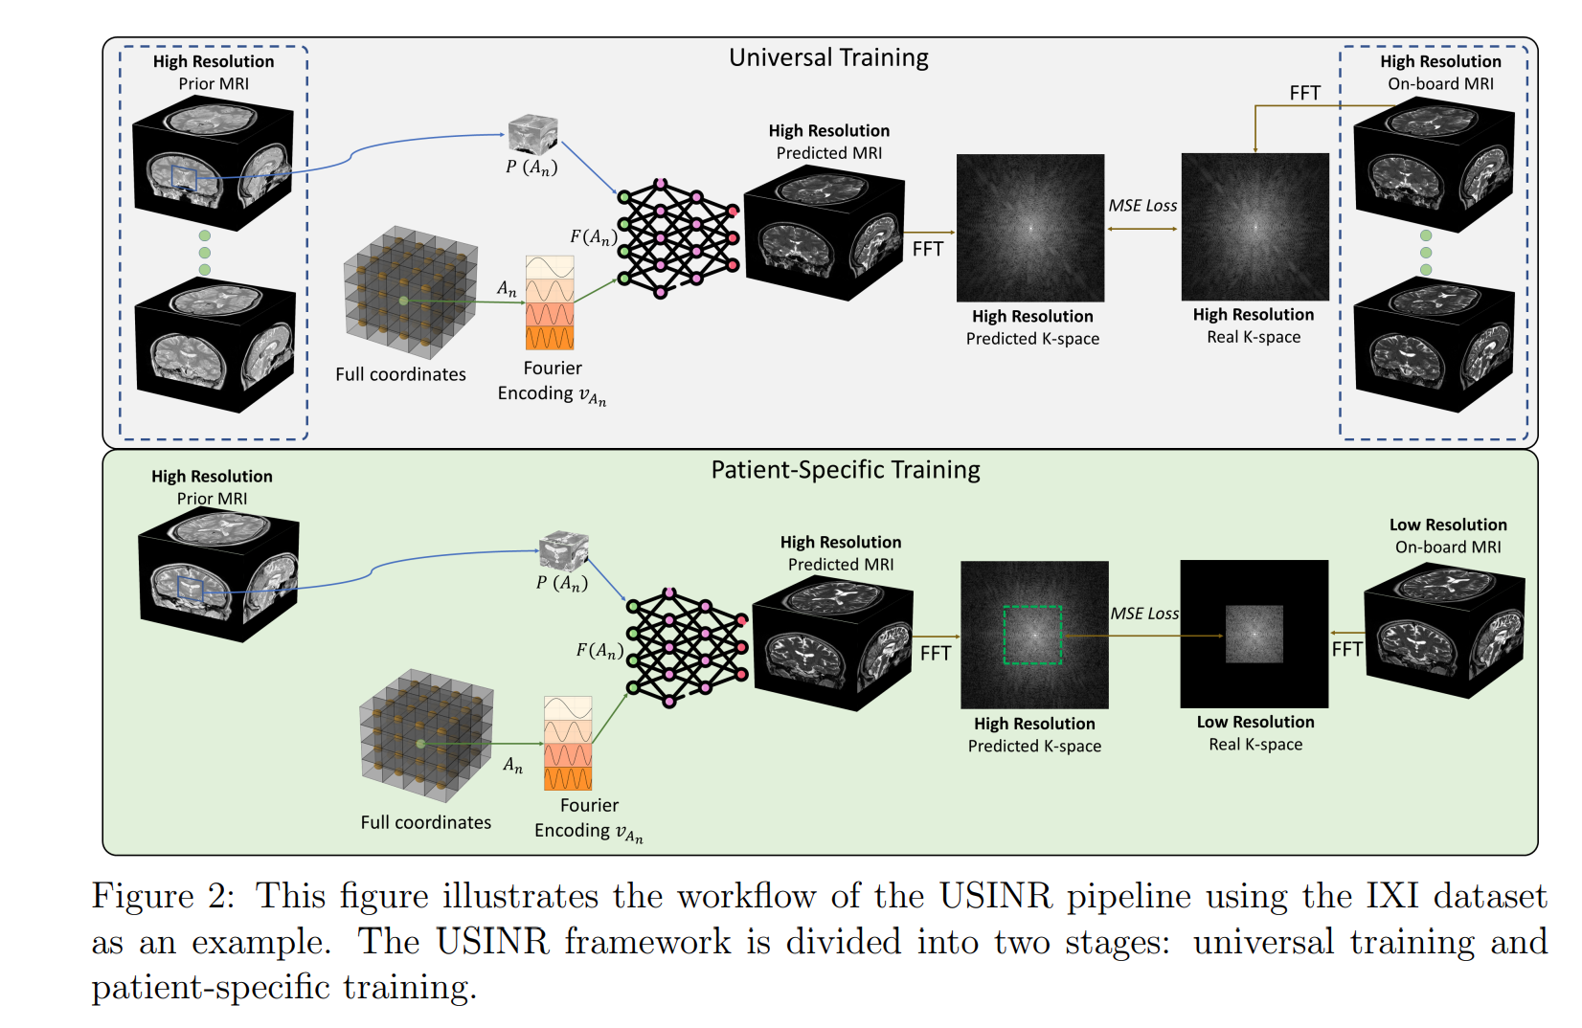
Clinical Task

Slide 18
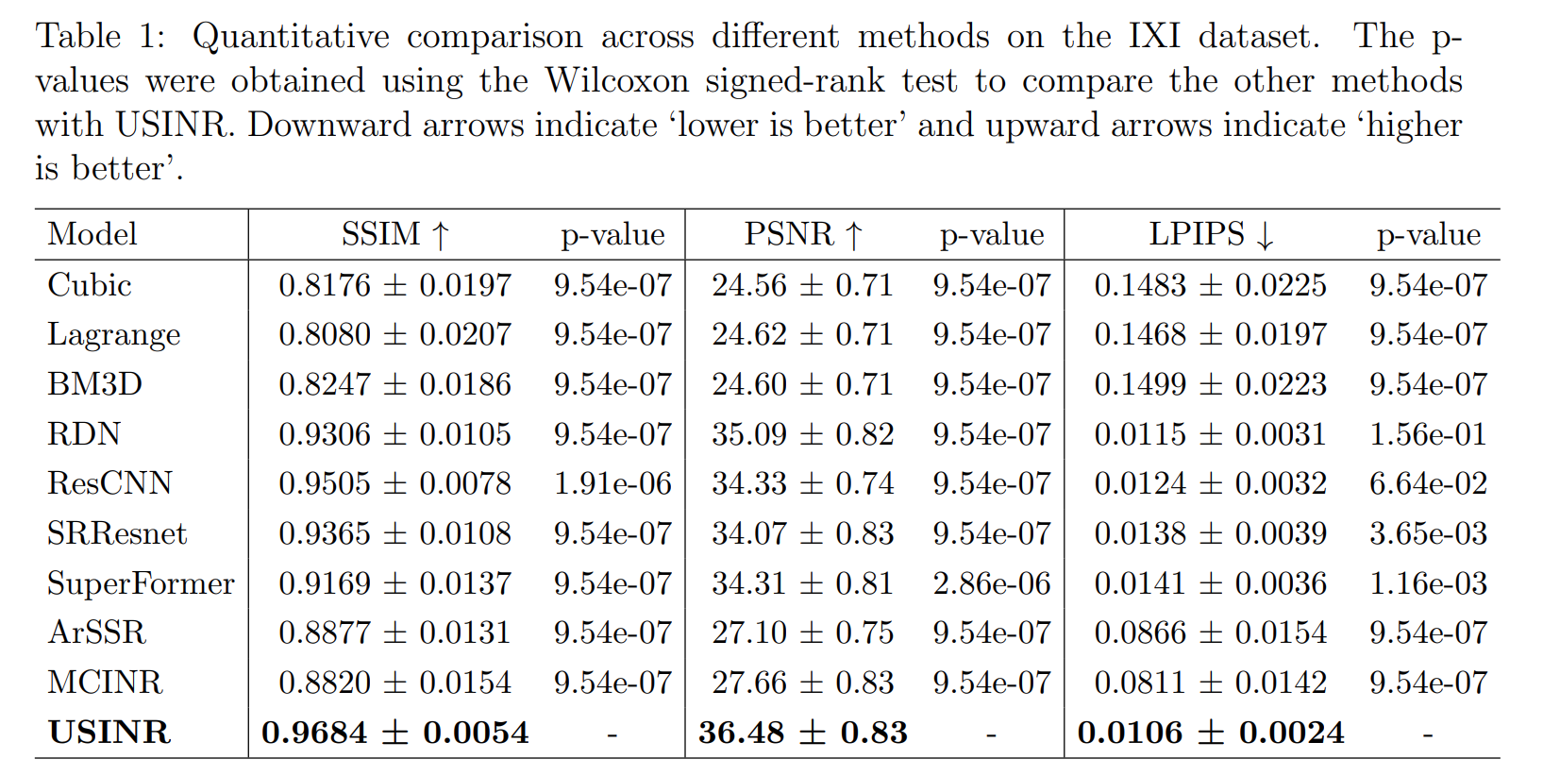
Result

Slide 19
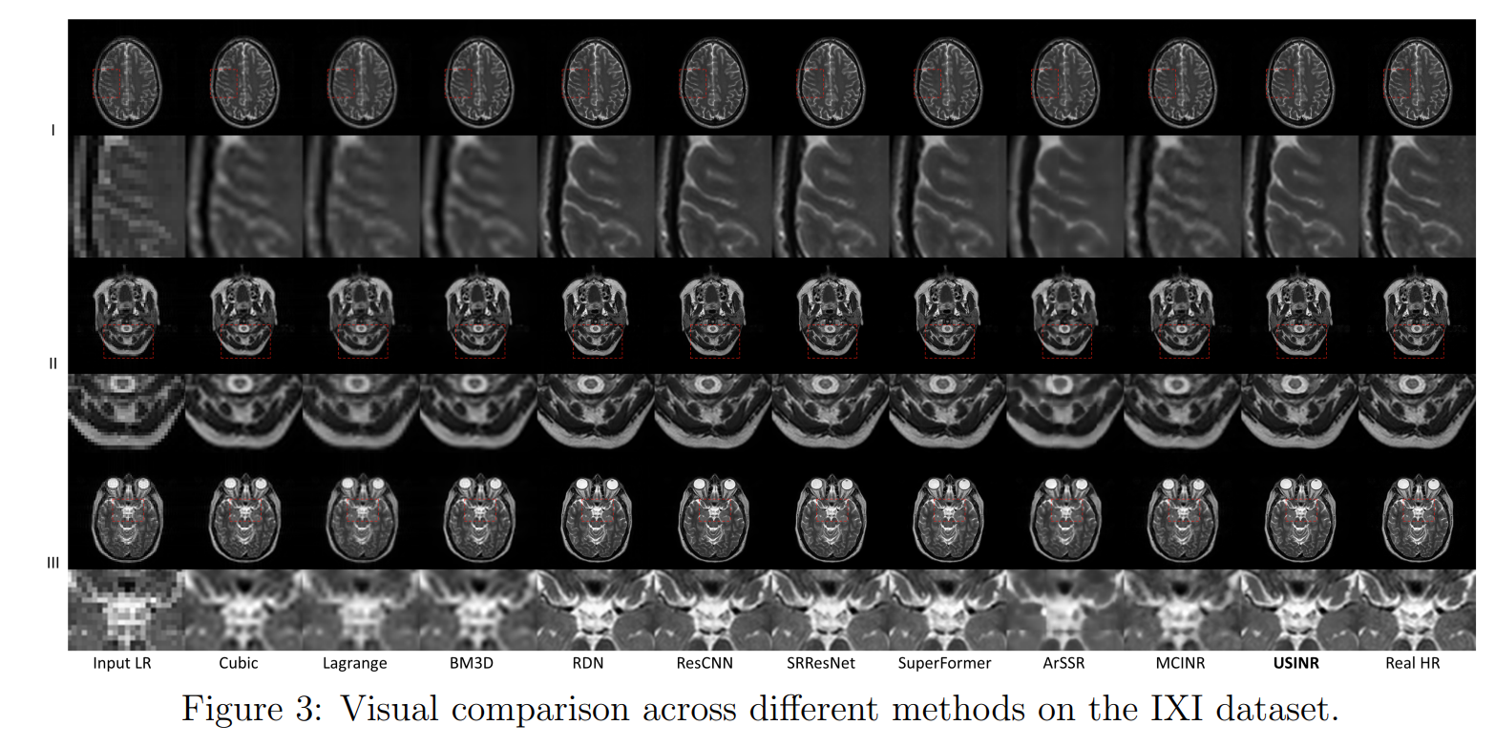

Slide 20
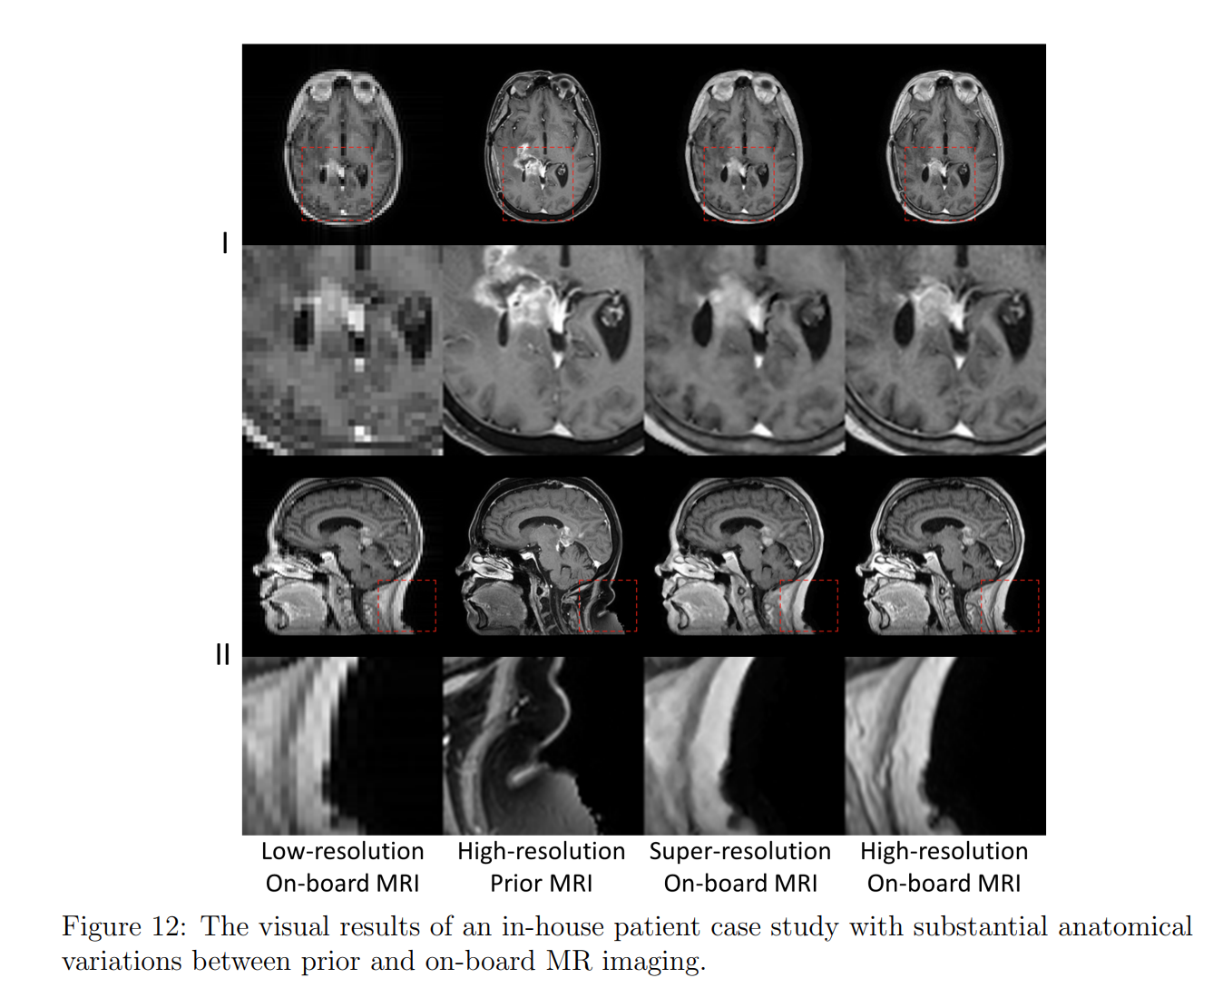
Case study

Slide 21
Super-Resolving Any MRI
Ongoing, Initial version has been submitted to ASTRO

Slide 22
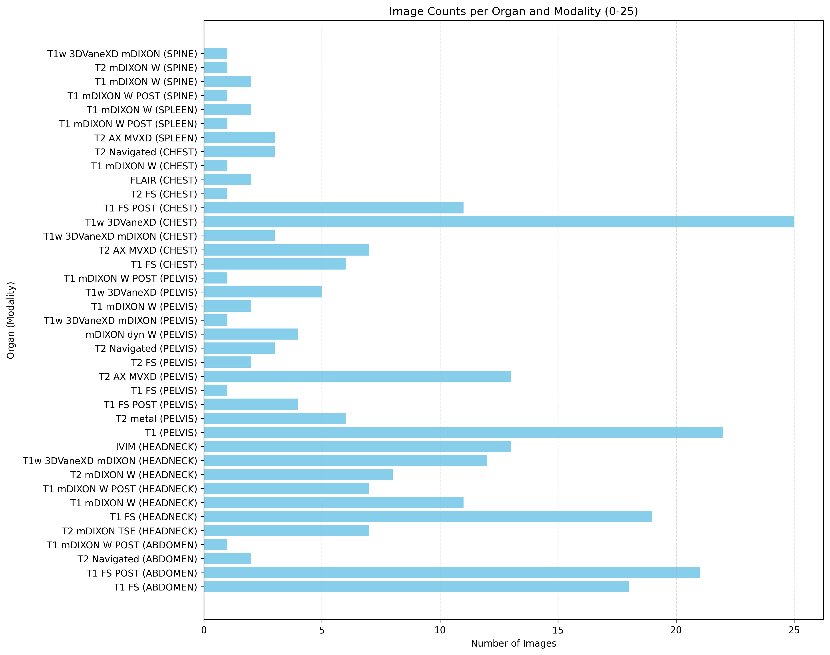

Slide 23
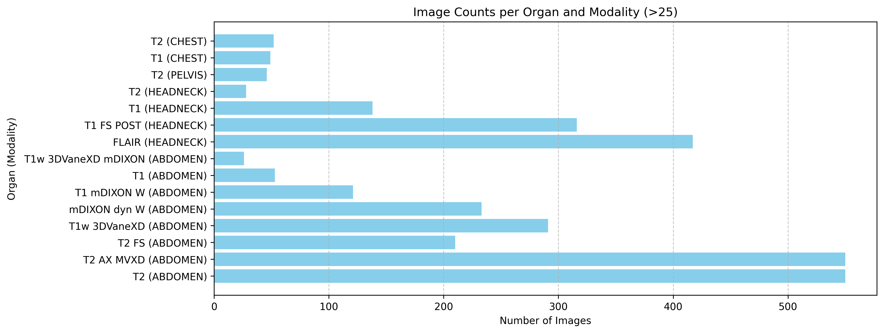
We have collected nearly 50 different types of MRI.

Slide 24
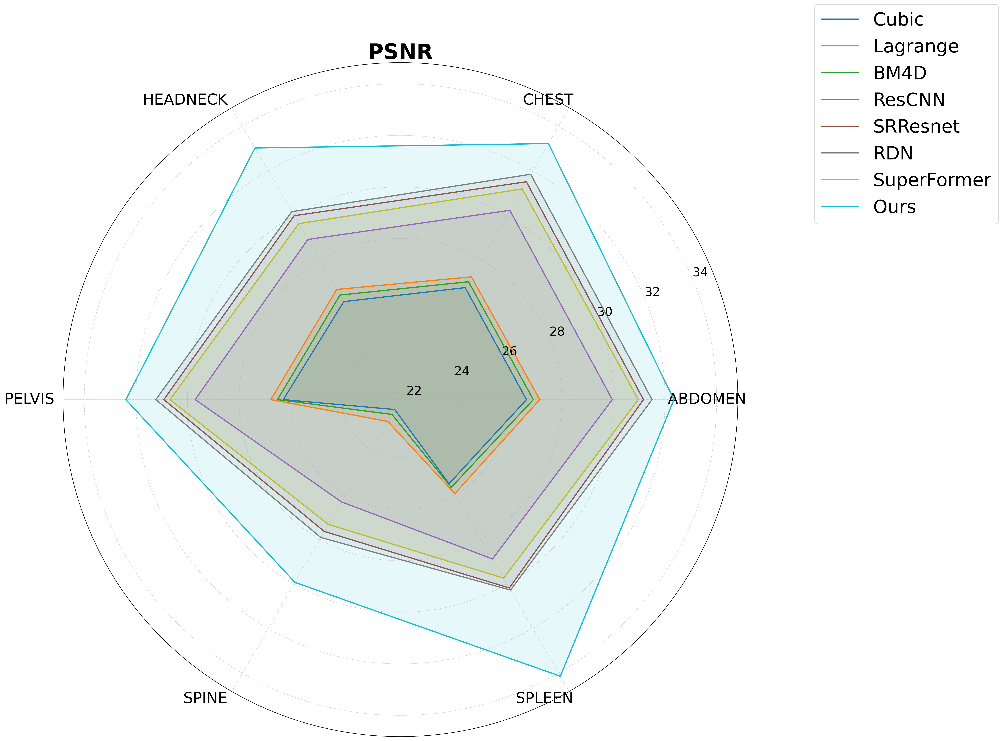

Slide 25
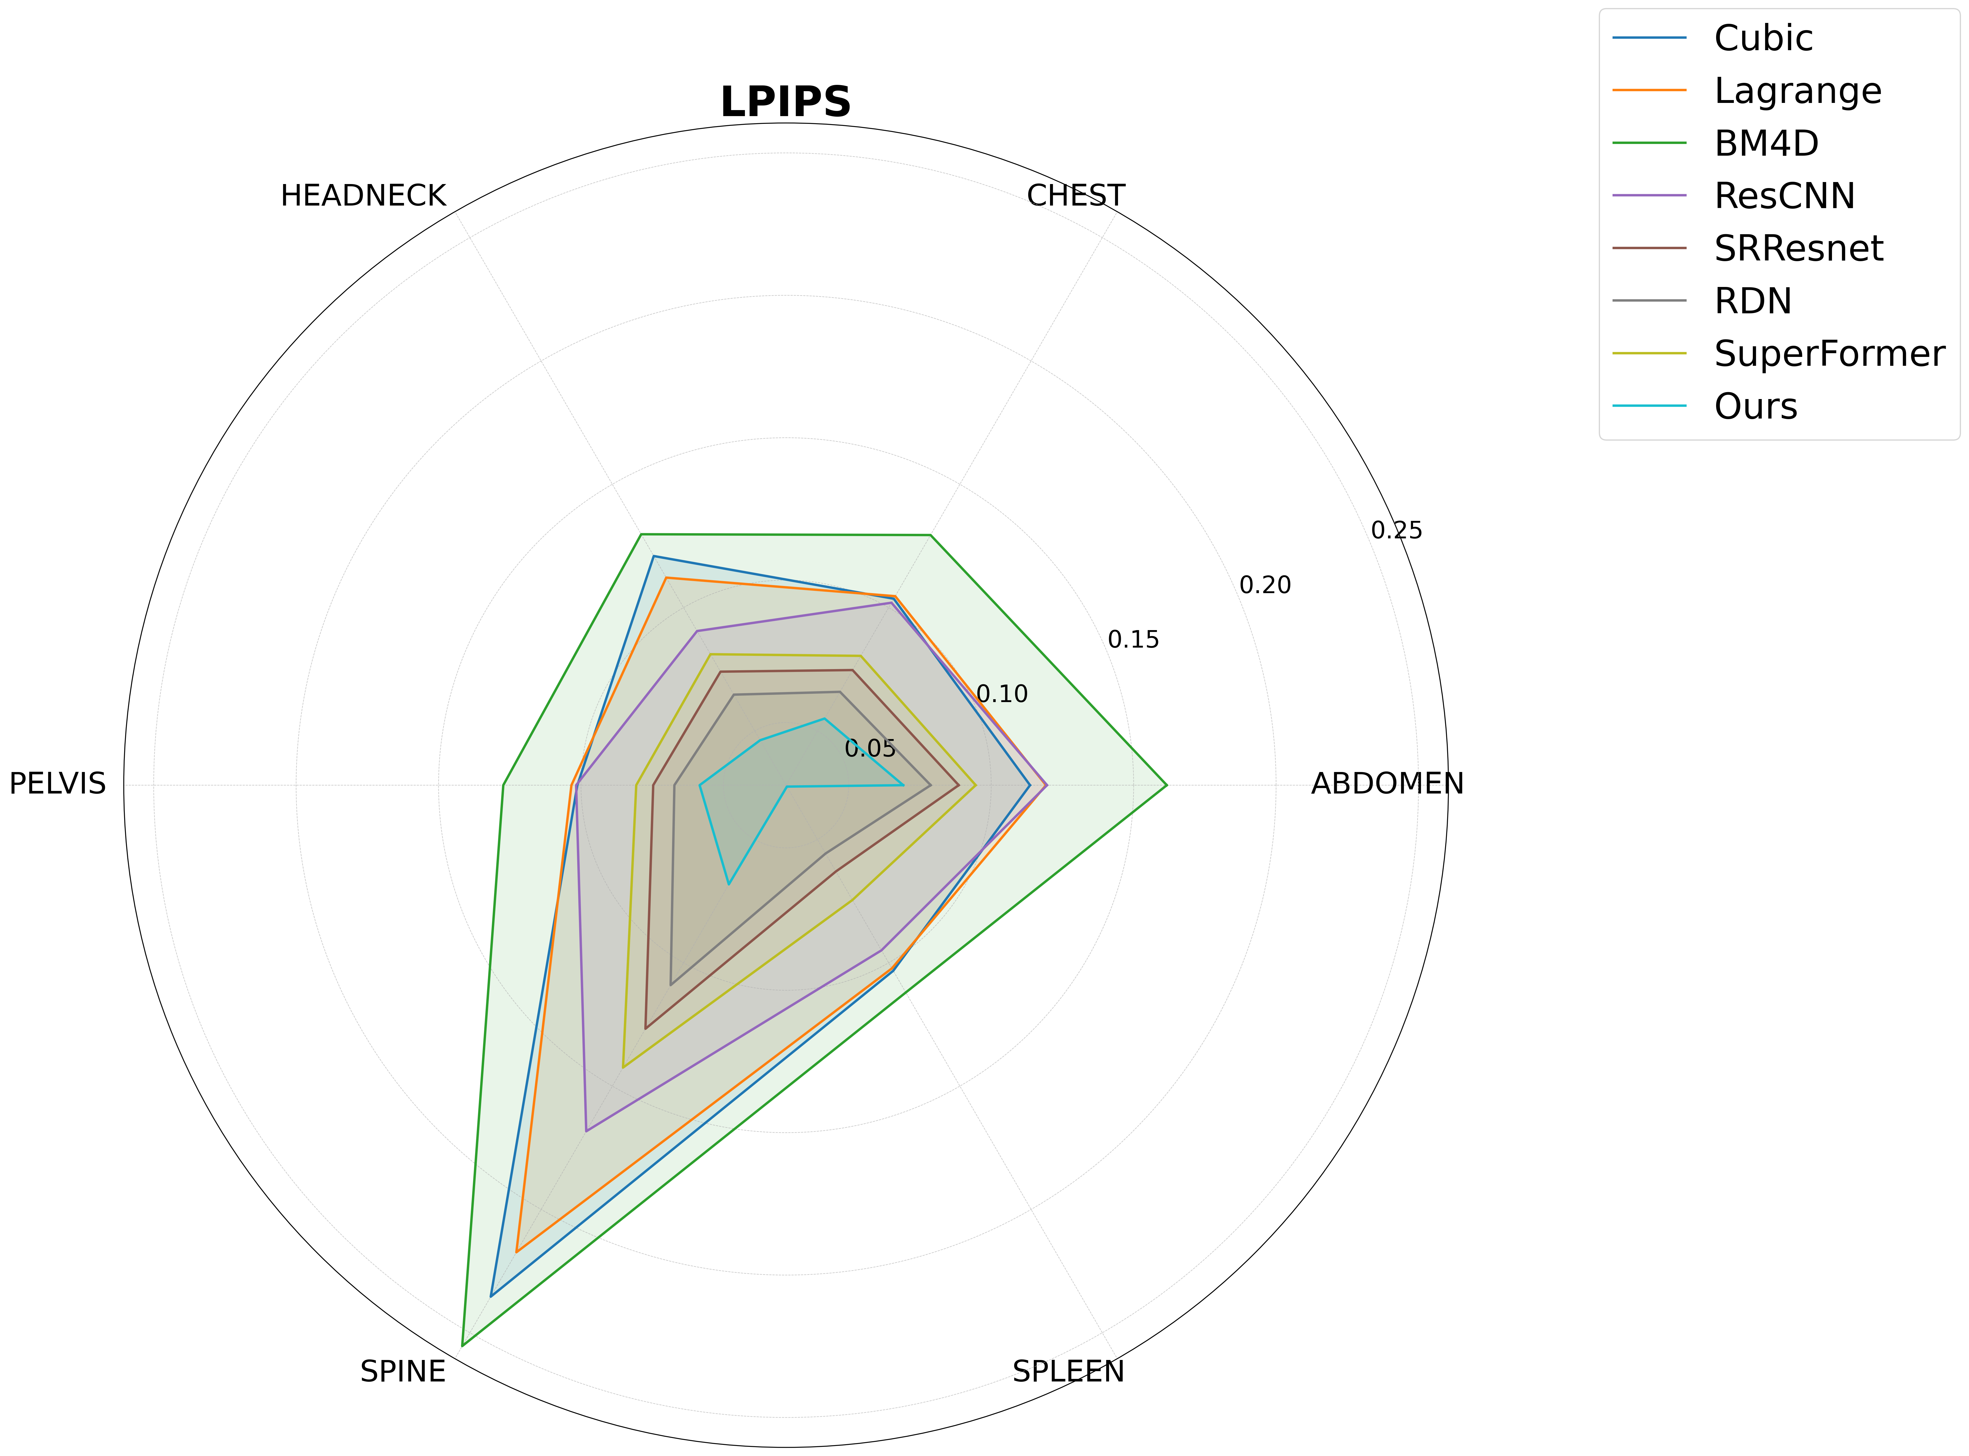

Slide 26
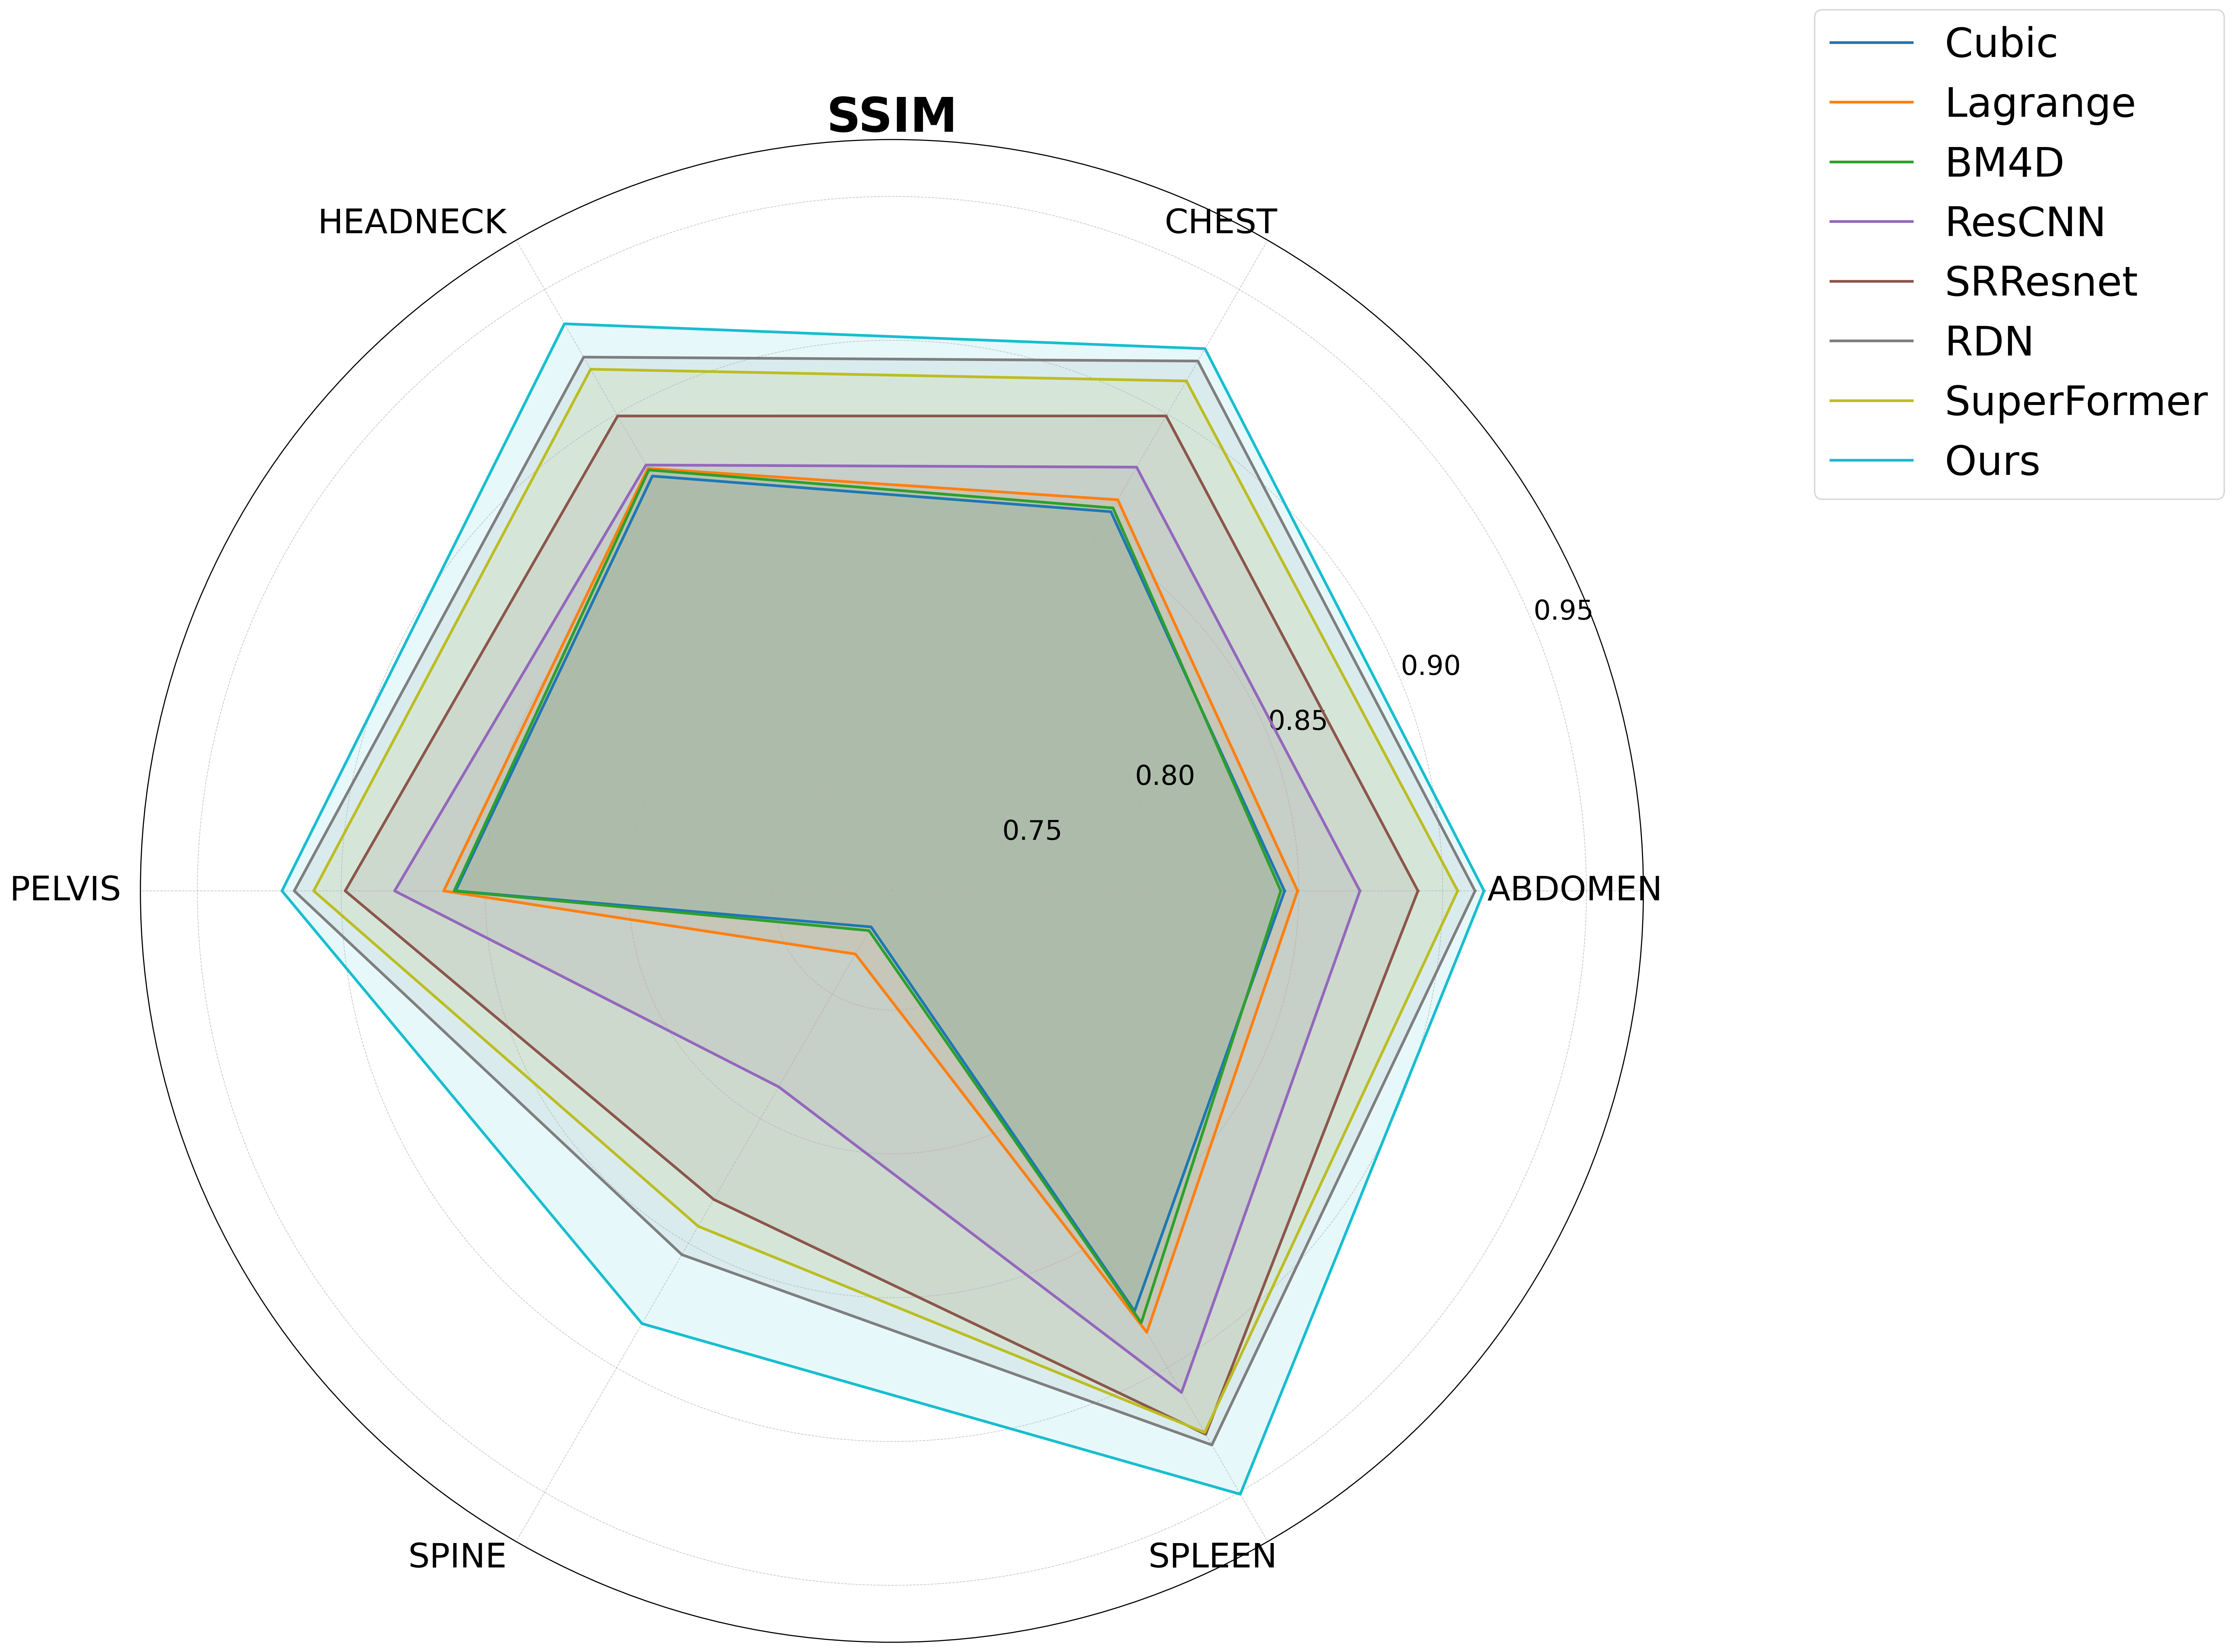

Slide 29
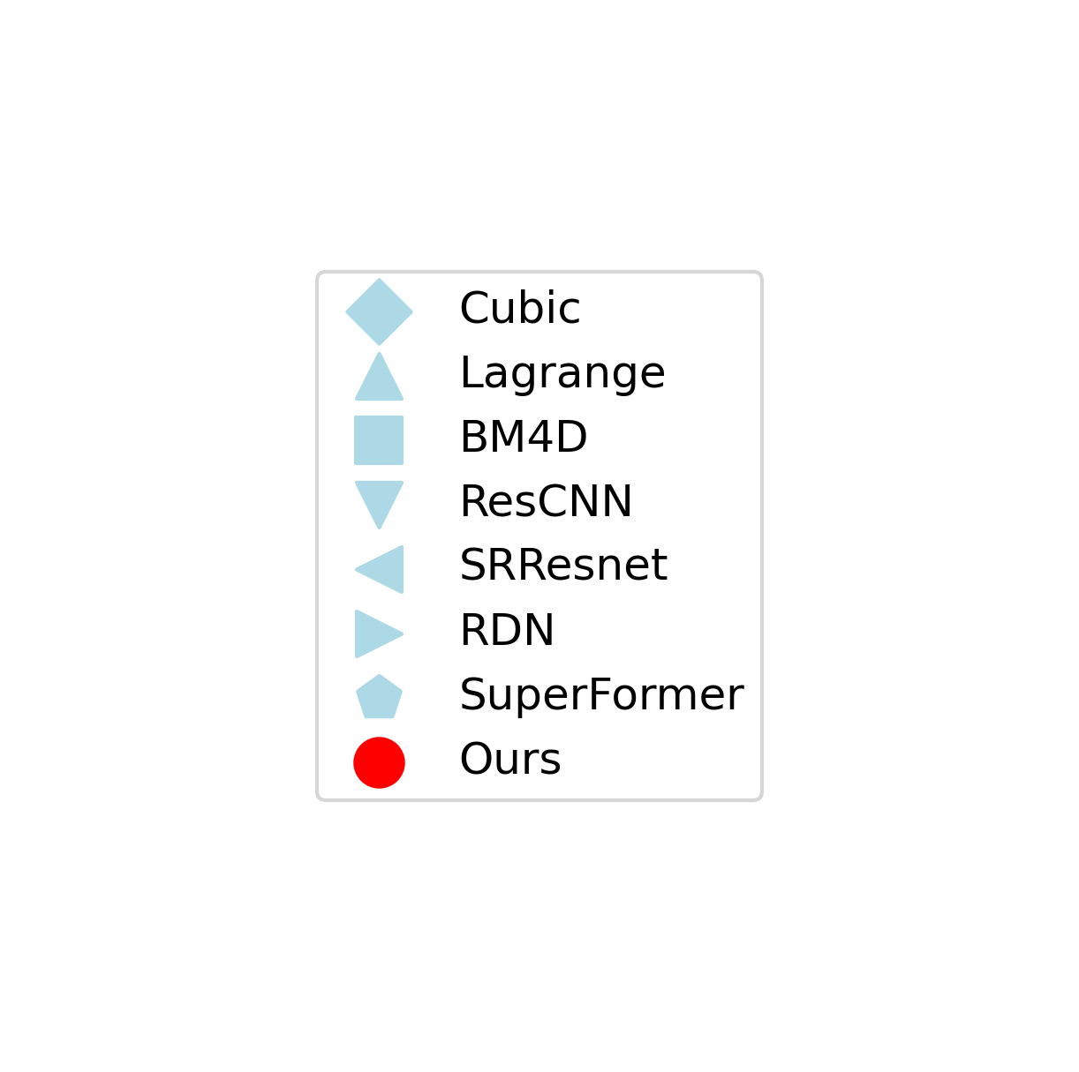
Result

Slide 30
Performance on head and neck

Slide 31
We test our model on approximately 200 different tasks and our model performs best on almost all of them compared to 7 other baselines.

Slide 33
Patch size study

