Slide 1
Predicting the Recurrence of Head and Neck Cancers
Yu Hu, Ph.D.
Postdoctoral Researcher
Medical Artificial Intelligence and Automation (MAIA) Laboratory
Department of Radiation Oncology
Email@UTSouthwestern.edu

Slide 2
Head and Neck Cancers
What are cancers of the head and neck?
Cancers of the head and neck can form in the:
Oral cavity 口腔
Throat (pharynx) 咽喉
Voice box (larynx) 喉頭
Paranasal sinuses and nasal cavity 鼻竇和鼻腔
Salivary glands 唾液腺
Cancers of the brain, the eye, the esophagus, the thyroid gland, and the skin of the head and neck are not usually classified as head and neck cancers.

Slide 3
Head and Neck Cancers
How are head and neck cancers treated?
Head and neck cancer treatment can include surgery, radiation therapy, chemotherapy, targeted therapy, immunotherapy, or a combination of treatments.

Slide 4
Recurrent Head and Neck Cancers
Recurrent squamous cell carcinoma of the head and neck is a major cause of morbidity and portends poor survival outcomes. Locoregional recurrence, which is seen in 15 to 50 percent of patients with squamous cell carcinoma of the head and neck, is a major factor contributing to mortality from head and neck cancer.

Slide 5
Print Overlay

Slide 6
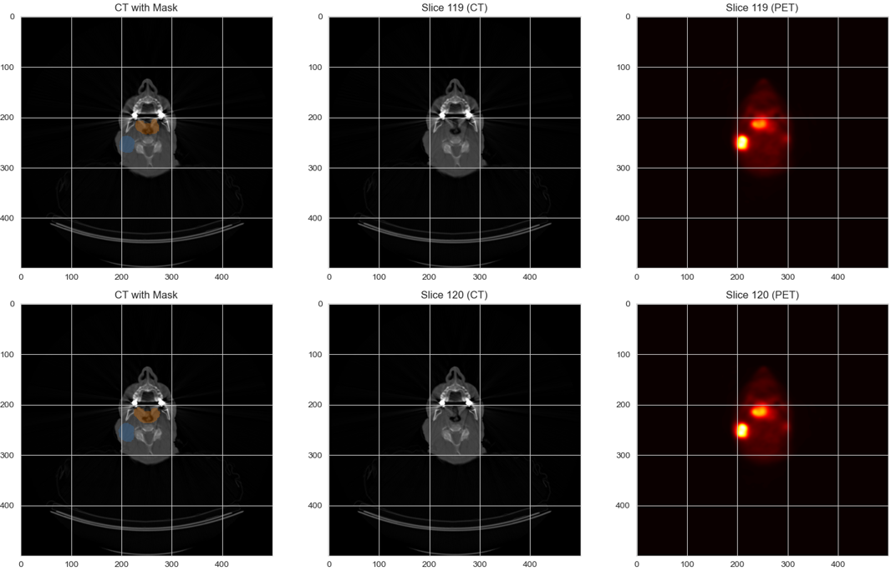
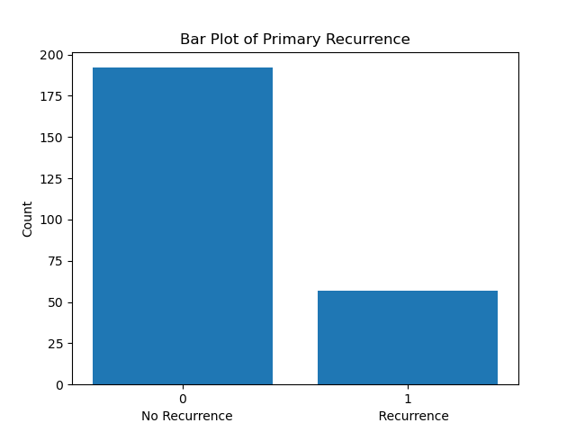
Unbalanced Data

Slide 7
Workflow
Statistical
Learning
Models
Pyradiomics
Radiomic Features
Predictions
data
CNN Models
Predictions
ViT Models
Predictions

Slide 8
Statistical Models

Slide 9
Results

Slide 10
CNN Input

Slide 11
CNN Models
Simple CNN
ResNet(18, 34, 50, 101)
Pretrained ResNet from MedicalNet
DenseNet

Slide 12
Architects and Hyperparameter tuning
Batch Size
Number of Epochs
Regularization
Early Stopping
Learning Rate Scheduler
Optimizer
Loss Function
Gradient Clipping
…
Architecture
Dropout Rate
Activation Functions
Kernel Size and Stride
Pooling
Batch Normalization
…
AUC: 0.65

Slide 13
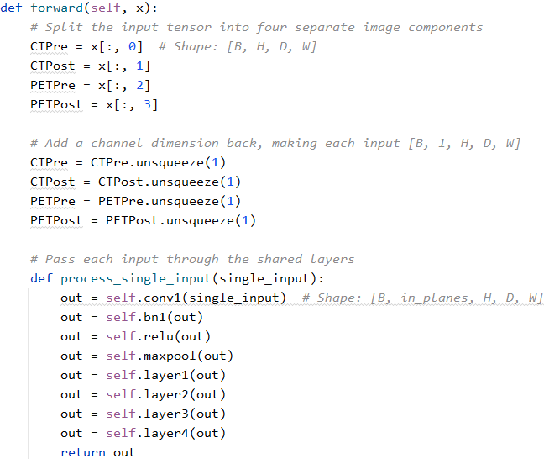
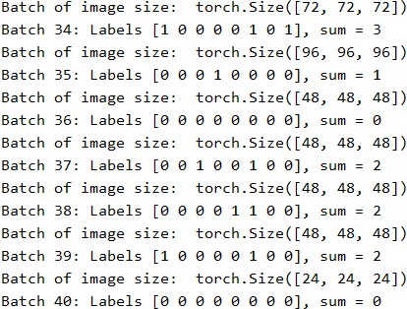
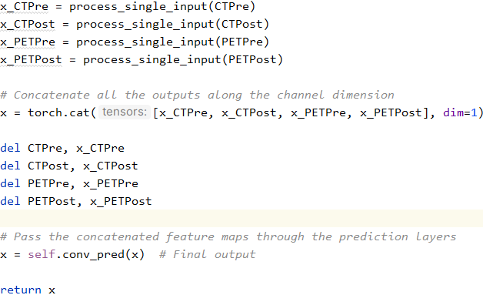
Four Inputs and Varying Image Sizes
[Pre_CT, Pre_PET, Post_CT, Post_PET], label

Slide 14
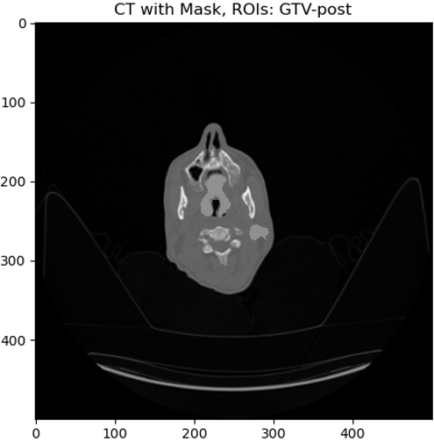
Primary Site and Lymph Node

Slide 15
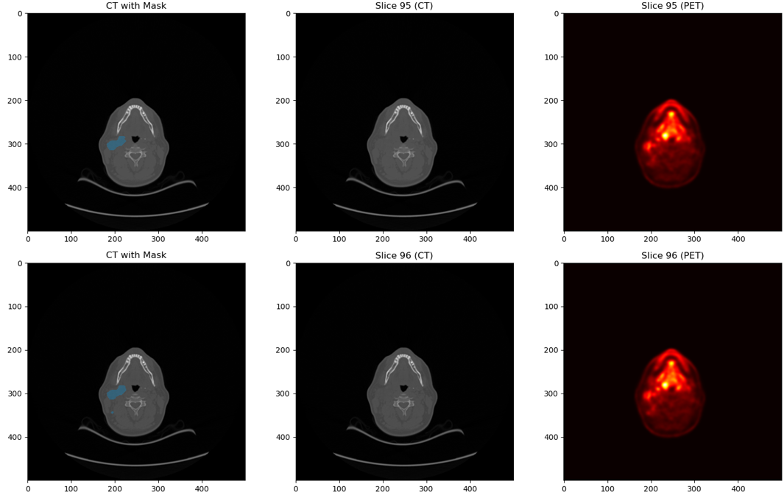
Lymph Node Only

Slide 16
Primary Site and Lymph Node Fused

Slide 17
SAM-Med3D

Slide 18
SAM-Med3D

Slide 19
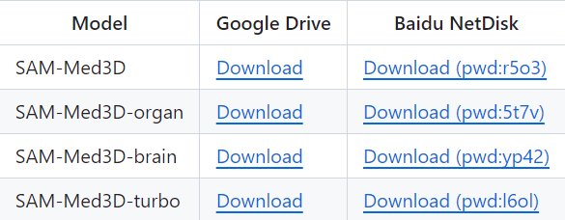
SAM-Med3D

Slide 20
SAM-Med3D

Slide 21
Results

Slide 22
Test-Time Augmentation

Slide 23
Conformal Prediction

Slide 24
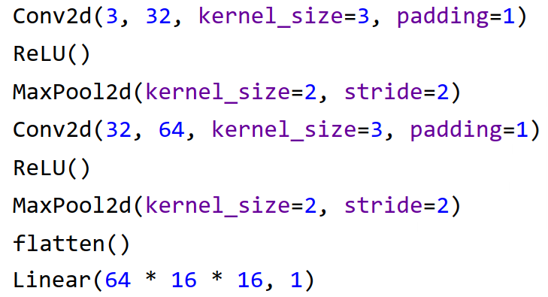
An Investigation on Memory Consumption
Simple CNN
Input image size: (3, 64, 64), number of parameters: 35777

Slide 25
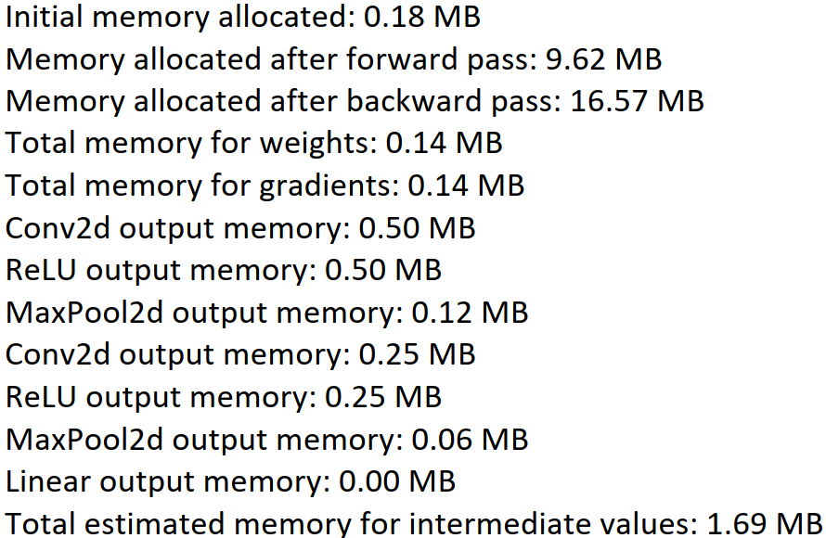
An Investigation on Memory Consumption
After processing one image
Total memory cost = Memory allocated after backward pass + Total memory for weights + Total memory for gradients + Total estimated memory for intermediate values = 16.57 + 0.14 + 0.14 + 1.69 MB = 18.54 MB

Slide 26
An Investigation on Memory Consumption
Using a for loop to call the model 10 times
Memory after forward pass: 9.62 MB
Memory after forward pass: 10.94 MB
Memory after forward pass: 12.25 MB
Memory after forward pass: 13.56 MB
Memory after forward pass: 14.87 MB
Memory after forward pass: 16.19 MB
Memory after forward pass: 17.50 MB
Memory after forward pass: 18.81 MB
Memory after forward pass: 20.12 MB
Memory after forward pass: 21.44 MB
Increment = 1.31 MB

Slide 27
An Investigation on Memory Consumption
The cost of memory is divided into two parts
1. The increment between initialization and first forward pass (9.44MB)
2. Between two consecutive forward passes (1.31 MB)

Slide 28
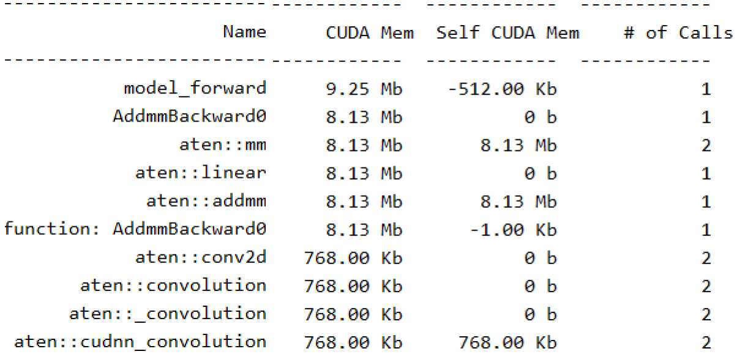
The Increment between Initialization and the First Forward Pass
In the MedSAM training case, this part is as big as 9.423G.

Slide 29
The Increment between Initialization and the First Forward Pass
Addmm: add matrix multiplication
This function is typically involved in the backward calculations of layers like nn.Linear (fully connected layers) or other layers where matrix multiplications are integral to their operations
AddmmBackward0
Is related to the backward pass of a matrix multiplication operation using the addmm function.
Matrix Multiplication in Forward Pass: During the forward pass, when you use
layers like nn.Linear, they perform a matrix multiplication between the input
features and the weight matrix of the layer, plus an addition of the bias if it's not
None. This operation is commonly represented as y = xA^T + b in PyTorch, where
x is the input matrix, A is the transposed weight matrix, and b is the bias.
Backward Pass of Addmm: In the backward pass, PyTorch computes the gradients
with respect to the inputs and weights involved in this matrix multiplication.
AddmmBackward0 refers to this gradient computation.

Slide 30
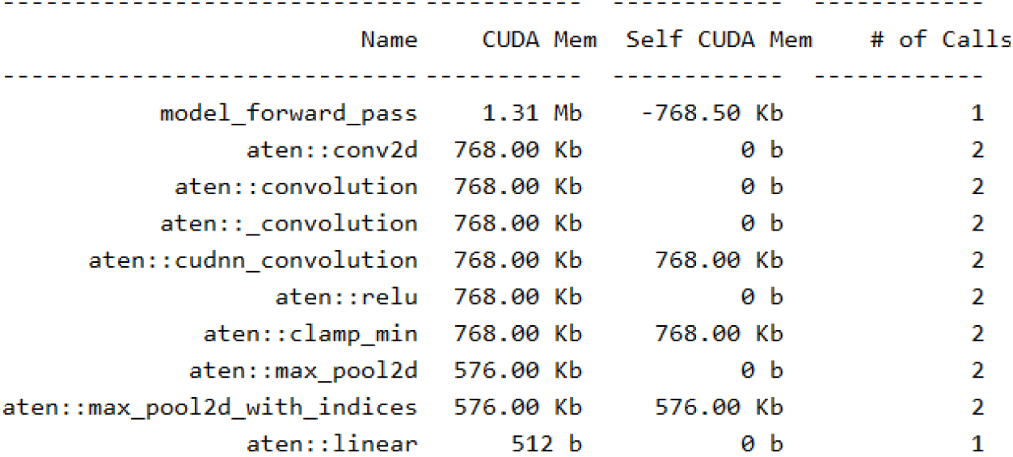
Between Two Consecutive Forward Passes
In the MedSAM case, this part is as big as 6.083G per step.
model_forward_pass
includes all tensor operations, activations, and intermediate calculations done within the model's forward pass.

Slide 32
A
T

