Slide 1
Zen and the Art of Parameter Estimation in Systems Biology
Christopher R. Myers¹
¹Department of Physics and Center for Advanced Computing, Cornell University, Ithaca, NY 14853, USA.
Invited chapter in Systems Immunology: An Introduction to Modeling Methods for Scientists, J. Das and C. Jayaprakash (eds.), CRC Press (2018).

Slide 2
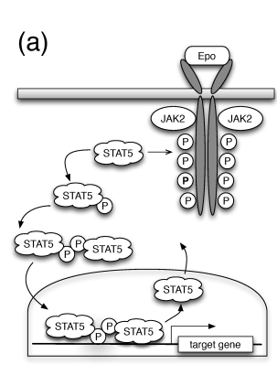
Introduction
Many models of interest in the field of systems biology have high-dimensional parameter spaces and complex structure that is not well understood.
Understanding such structure, and how it impacts the predictivity of models and the potential for the construction of alternative models, is an active area of research.
the concepts and techniques introduced here are broadly applicable to a wide range of models relevant not just to immunology and systems biology, but to other fields as well
e.g. The quantitative biomarkers guiding radiotherapy

Slide 3


Parameter estimation and the Optimization problem
MIN
MAX
The specific form of a mathematical model is irrelevant as the numerical optimization of the cost function is concerned, as long as it can evaluate the least-squares deviation of a model from data for a given set of parameters θ

Slide 4
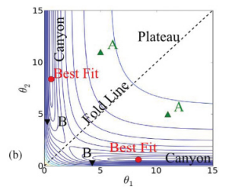
Parameter estimation and the Optimization problem
Complication in finding a global minimum arise from a near degeneracy in the cost function near the minimum

Slide 5
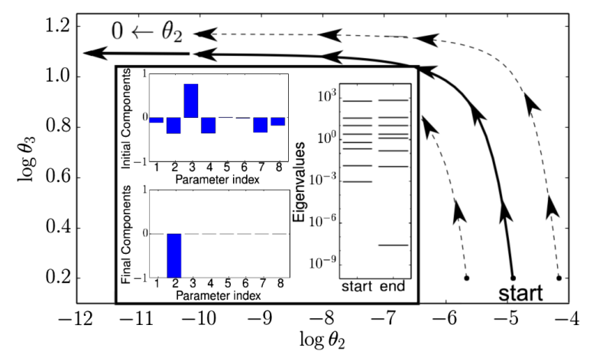

Sensitivity analysis
It shows the “stiffest” parameter combination associated with the fit of model to the experimental data

Slide 6

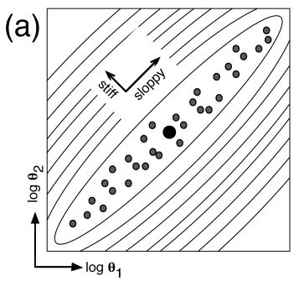
Parameter identifiabilit
Markov Chain Monte Carlo (MCMC) sampling can be used to explore parameter space, sampling from the posterior distribution to identify an ensemble of parameter sets that fit the data within the experimental uncertainty

Slide 7
Model sloppiness
A few stiff modes that determine system dynamics
A large space of sloppy modes that do not impact system behavior
Such long, thin canyons in high-dimensional parameter spaces, and collective interactions among parameters in the sensitivity of model predictions to parameter variation are related to a phenomenon termed “sloppiness”, and are seen in a number of complex, multiparameter, nonlinear model.

Slide 8
Parameter estimation and the process of modeling
parameter estimation is not an end in itself, but a means to an end of making predictions about new behaviors or analyzing the structure of existing behaviors

Slide 9
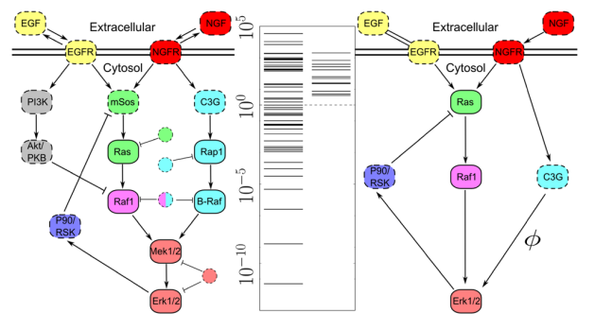
Model refinement and reduction
Model sloppiness indicates the hierarchical structure of model manifolds;
Simplified models with better-identified parameters can be constructed.

Slide 10
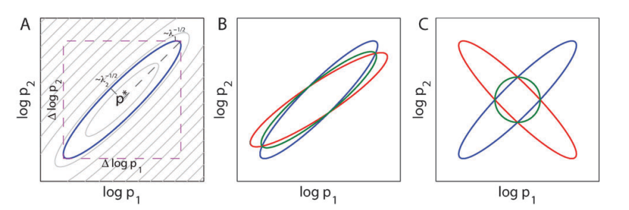
Experiment design optimization
Appropriate design of experiments can also reduce the uncertainty in parameter estimates observed in sloppy models

Slide 11
Prediction uncertainties
These parameters are practically nonidentifiable, but it is possible for a model with a set of widely divergent parameter estimates to nonetheless show well-constrained model predictions

Slide 12
Summary
Appreciating both the mechanics of parameter estimation and its place in the larger realm of modeling, experimental design, and interpretation of data are keys to making further.

Slide 13


Acknowledgement
MAIA Lab

