Slide 1
Shared paper:
Large-scale correlation network construction for unraveling the coordination of complex biological systems
Yajun Yu, PhD
Research scientist
Medical Artificial Intelligence and Automation (MAIA) Laboratory
Department of Radiation Oncology
February 7, 2025
Email@UTSouthwestern.edu

Slide 2
Basic information of the paper

Slide 3
Introduction
Modern technologies, including single-cell and multiomics approaches, wearable devices, and integrated electronic health records, regularly produce datasets with hundreds of thousands of variables (or features).
Correlation analysis is typically the first step to gain insights into a complex system.
Despite diverse applications, the construction of correlation networks for large datasets remains a major computational challenge. Computation time and memory requirements for constructing correlation networks grow rapidly and quickly exceed computational resources as the dimensionality of the datasets increases.

Slide 4
Introduction
Investigating full correlation matrices may not be necessary, as often only the most prominent correlation structures are of interest.
Correlation analysis is often focused on the strongest correlations in a study, that is, by selecting the top-k correlations.
This paper proposed a framework for high dimensional correlation analysis, enabling efficient correlation computation, as well as top-k and differential correlation network approximations

Slide 5
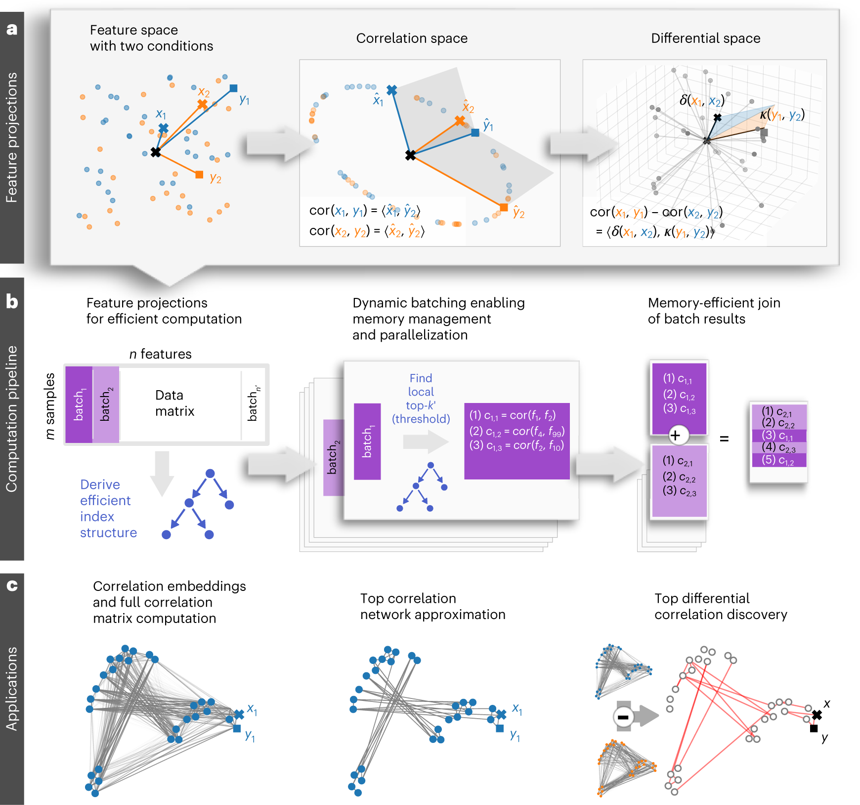
Overview of the CorALS framework
CorALS: Correlation Analysis of Large-scale (biological) System)

Slide 6
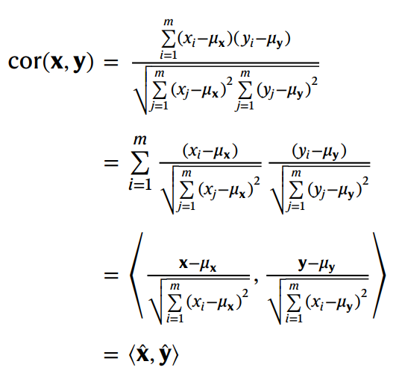
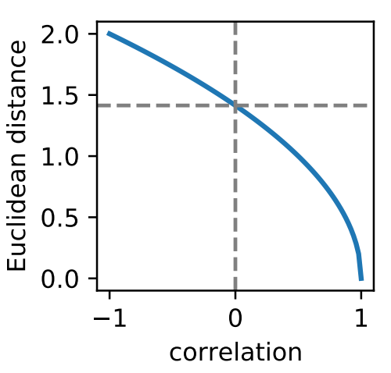
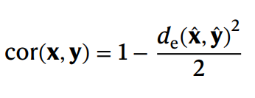
Features projected onto correlation space
Notes:
Inner product

Slide 7
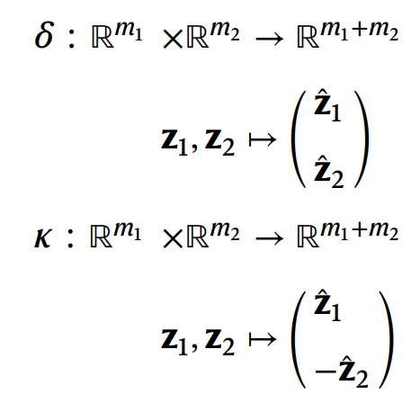
Features projected onto differential space

Slide 8
Computation pipeline
Ball Tree is a data structure used for fast nearest-neighbor searches. It organizes data points in a hierarchical tree structure based on metric distances.
Example:
1,000 features: ~500,000 pairs
100 features×10 batches: ~5,000×10 pairs

Slide 9
Large-scale correlation analysis

Slide 10
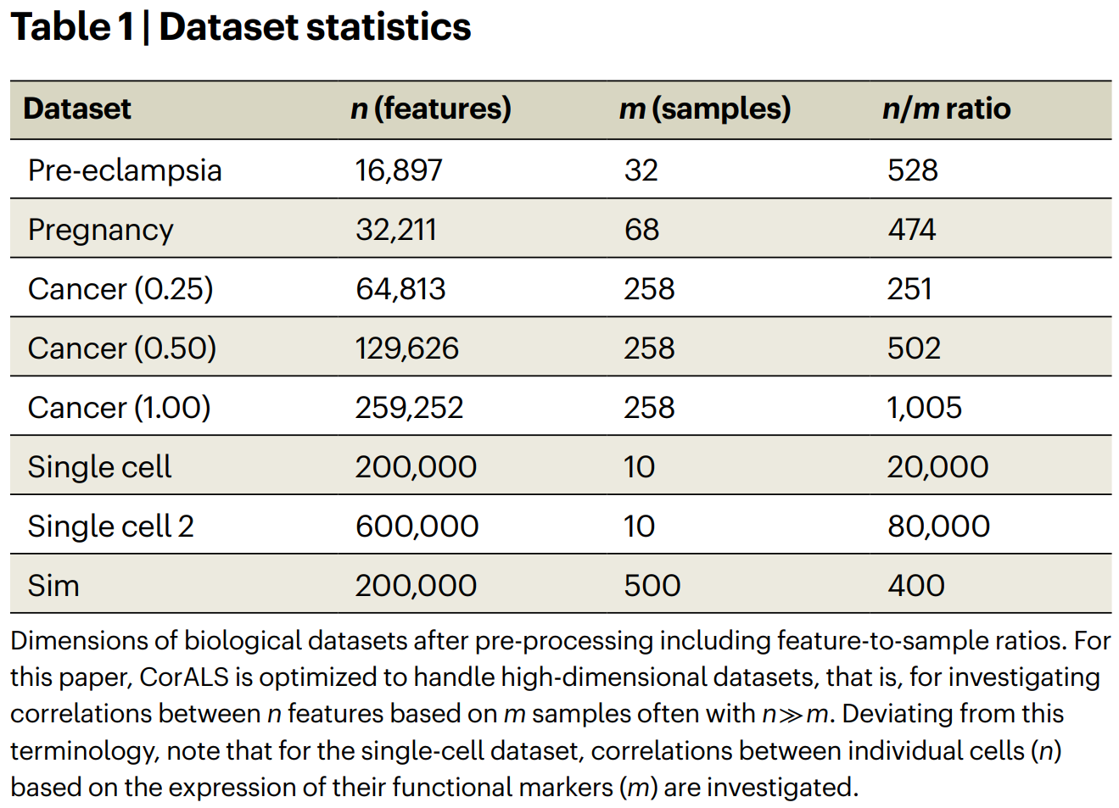
Dataset statistics
Example:
n = 1,000 features
at least 499,000 pairs of correlation to be computed

Slide 11
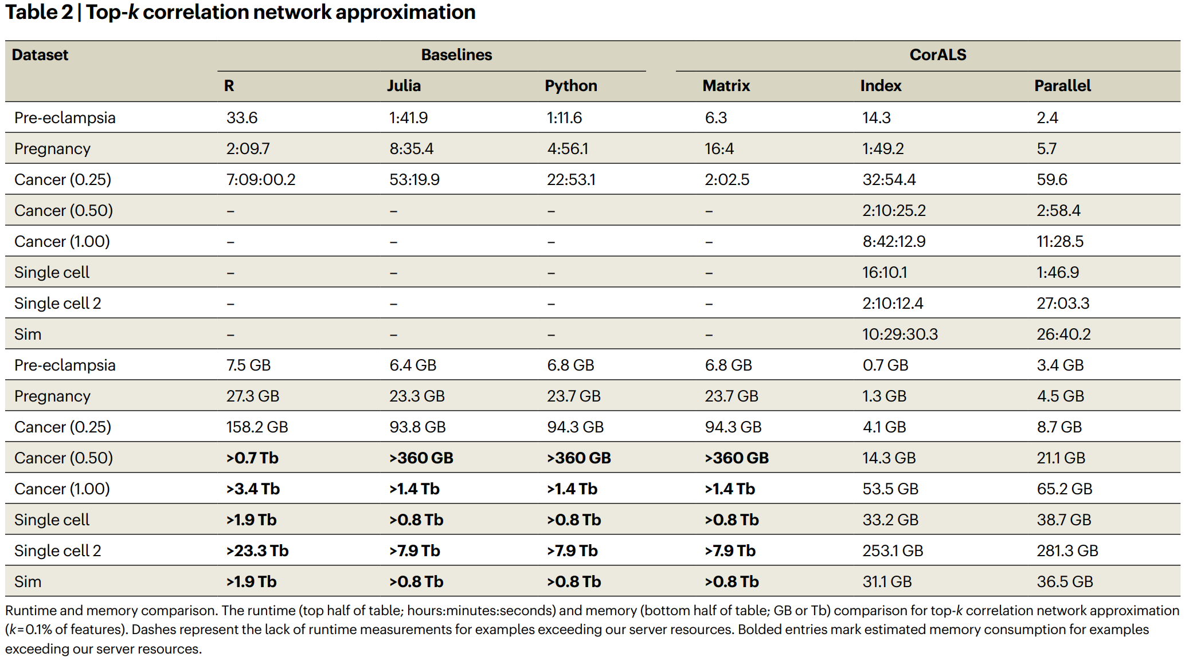
Runtime and memory comparison

Slide 12
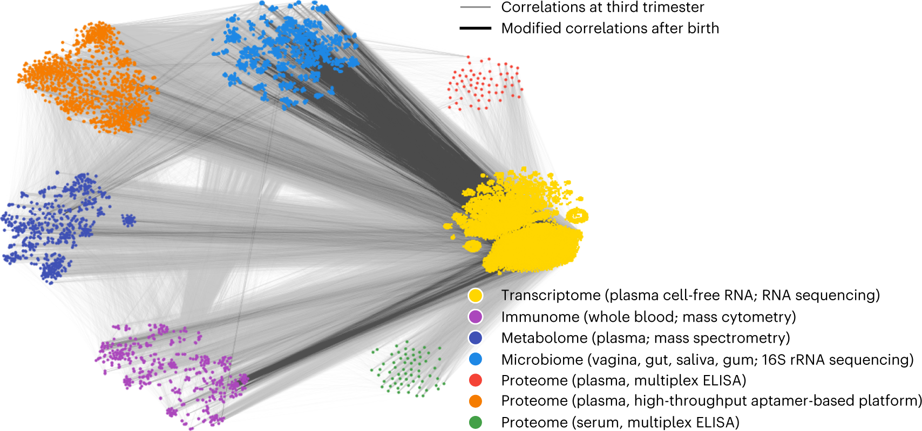
Example: Multiomic measurements before and after birth
Features visualized using t-distributed stochastic neighbor embeddings (t-SNE)
Top-10% correlations in the third trimester (light-gray lines)
Top 0.01% of correlations that change the most from third trimester to postpartum (dark lines in the foreground).
Notes:
The pregnancy dataset
Each sample contains immunome, transcriptome, microbiome, proteome and metabolome measurements obtained simultaneously

