Slide 1
Histogram Matching-Enhanced Adversarial Learning for Unsupervised Domain Adaptation in Medical Image Segmentation and Uncertainty Estimation
Xiaoxue Qian
Program Advisor: Dr. You Zhang

Slide 2
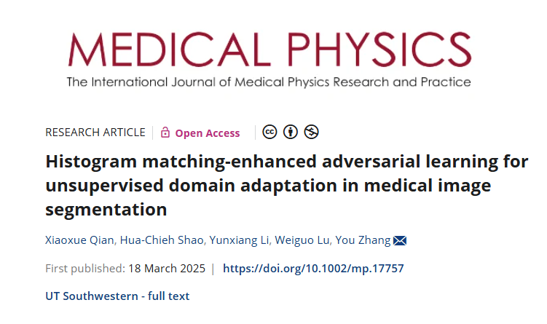

Slide 3
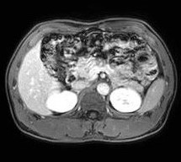
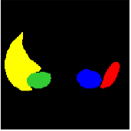
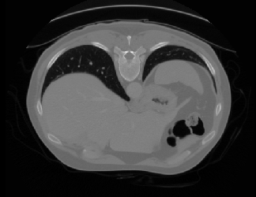
Background
Unsupervised domain adaptation (UDA)
UDA seeks to mitigate the performance degradation of deep neural networks when applied to new, unlabeled domains by leveraging knowledge from source domains.
Source domain (labeled)
Target domain (unlabeled)
Notes:
During segmentation, when the source domain has labels but the target domain without lable, we hope to capture knowledge from source domain to improve the performance of target domain, that’s the scenario of UDA.
The purpose of the UDA is to combine labeled source-domain and unlabeled target-domain to train a model to generalize well to the target domain.
The main challenge of this problem is the huge domain gap and the out of distribution

Slide 4
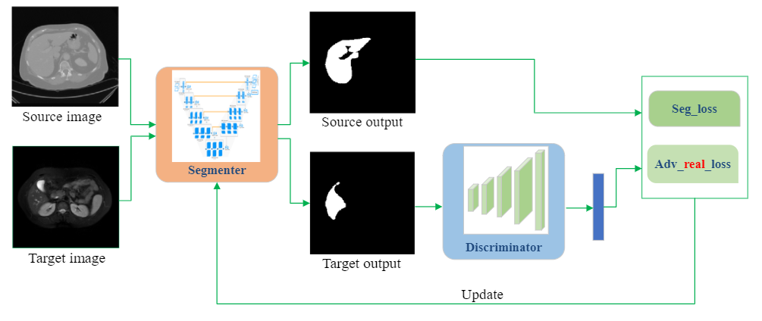
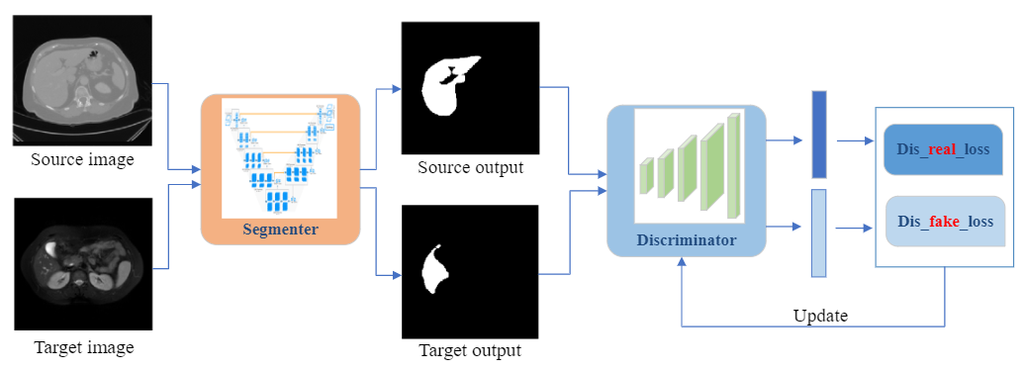
Background
Adversarial learning
Training the model to fool a discriminator by making source and target domain features indistinguishable in the generator, thereby reducing domain gap.
Step1: train the Generator/ Segmenter to fool the discriminator (focus on domain-invariant features).
Step 2: train the Discriminator to distinguish the features between source and target data.
Notes:
The AL is one of the effective method to reduce the domain gap and align the different domain distribution.
There two steps
After training, the discriminator can not identify the source and the target domain.
So the generator learned the domain-invariant features.

Slide 5
Background
Uncertainty Estimation
Most segmentation studies focus on model performance evaluation, ignoring the confidence or uncertainty of model predictions.
It can be estimated from the distribution of the network's weights and predictions.
It can serve as an indicator of algorithmic robustness, reflecting the reliability of segmentation results in the absence of ‘ground-truth’ data.
Uncertainty Estimations
Segmentation
Notes:
So in our method, we not only improve the performance of model but also estimate its uncertainty.

Slide 6
Methodology
HMeAL-UDA (bridge the domain gap while reducing the model complexity)
We integrated a plug-and-play histogram matching strategy to mitigate domain-specific image style biases across modalities.
Histogram matching-enhanced adversarial learning to constrain the model in the prediction space, enabling it to focus on domain-invariant features during segmentation.
We quantified the model’s prediction confidence using Monte Carlo dropouts to assess two uncertainty estimates of the segmentation results.
Notes:
Most existing adversarial learning algorithm are more and more complex in models and loss functions.

Slide 7
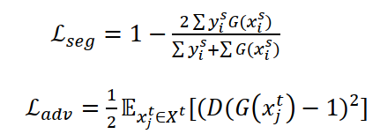
Methodology
Notes:
Here is the framework of our method. First use the HM to produce the Matched source volume, then put the matched source and target volume into the segmentation model.
In step2, the generator was frozen and the discriminator was update by the adversarial loss.
the target prediction in the two steps were different, in step1 it should be real but in step2 it should be fake. That’s the adversarial learning in our model.

Slide 8
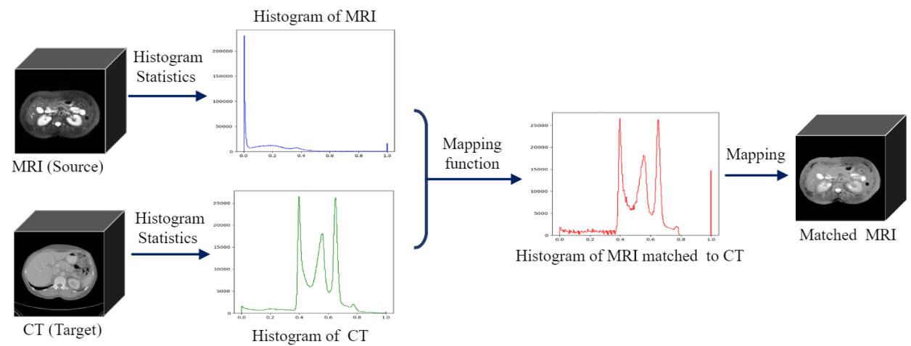
Methodology
Histogram matching
Notes:
We statistic the histogram of the source and target volumes, and use a map function to change the histogram of source volume to be similar as the target.
Then map it back to the source volume and generate the matched source volume.
We can see It has similar image style with the target but keep same structure with the source volume.
So the HM further reduce the domain gap among the different modality.

Slide 9
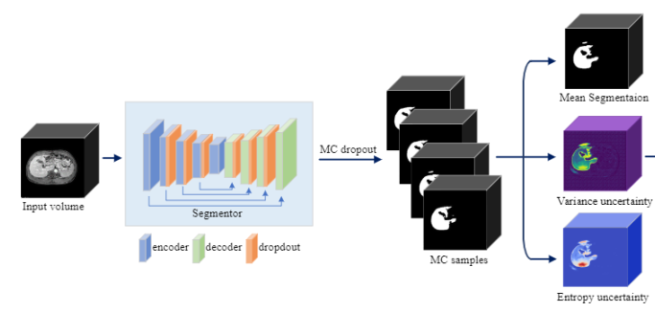
Methodology
Uncertainty estimation (MC dropout): variance, entropy uncertainties
Notes:
The MC dropout was used to measure the uncertainty of our model.
After training the model, MC dropout can produce multiple predictions, We calculate the variance of the different samples as one uncertainty estimation,
And calculate the entropy of the predictions as another estimations.

Slide 10
Experiments
Dataset
Three public datasets (CHAOS, BTCV, and AMOS) and one in-house clinical dataset (UTSW)
Notes:
Four dataset were used to verify the effectiveness of the proposed model.
Three public data and one inhouse data
There are two modality and two segmentation task: liver segmentaion and abdominal multi-organ segmentation.

Slide 11
Experiments
Ablation study
Validate the effectiveness of the two key components (adversarial learning and histogram matching)
1) W/o Adaptation;
2) AL-UDA: used adversarial learning for UDA;
3) HM-UDA: applied histogram matching to the source domain data, then trained with the resulting data;
4) HMeAL-UDA;
Notes:
For the ablation study, we validate the effectiveness of the two componemts:

Slide 12
Ablation results:
(a) DSC for MRI-to-CT
(b) HD95 for MRI-to-CT
(c) DSC for CT-to-MRI
(d) HD95 for CT-to-MRI
(a)
(b)
(c)
(d)
Notes:
Here are the results: first line is the results from MR to CT, second line is from CT to MR
Top left is the Dice of differents methods. We can see the tranditinal HM method and AL method all can reduce the domain gap between the MR and CT
And our method has the highest Dice and lowest HD95.
The results from CT to MR have the similar trends.

Slide 13
Experiments
Comparative methods
1) Supervision: Supervised training and testing within the same domain.
2) W/o Adaptation: Supervised training in the source domain, followed by testing in the target domain without adaptation.
3) SIFA : This method aligned both image and feature spaces using adversarial learning to drive UDA.
4) FS-UDA : It utilized frequency and spatial knowledge distillation with a multi-teacher architecture for UDA.
Notes:
Next, We use four comparative methods to evaluate the performance of the model.
Last two are state-of-the-art UDA methods.

Slide 14
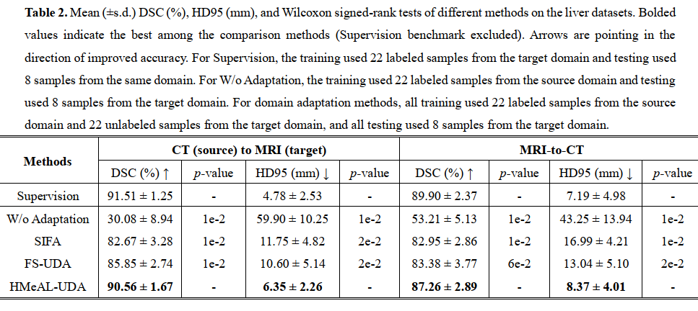
Experiments
Liver segmentation (quantitative results )
Notes:
The table shows the quantitative results of the five methods on liver segmentation.
We can see our results are much better than other methods.

Slide 15
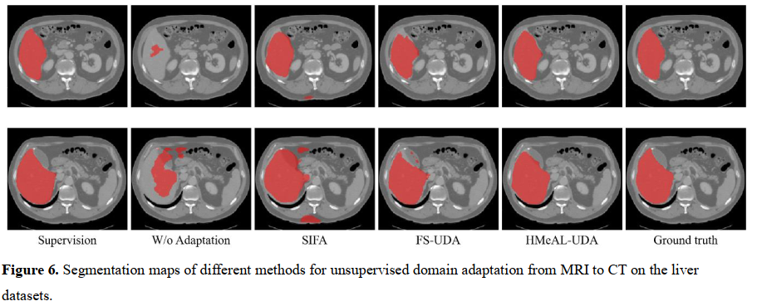
Experiments
CT-to-MRI
(b) MRI-to-CT
Notes:
Here are the segmentation map of different methods.
The first figure show the results form CT to MRI，and the second one is the results from MRI to CT.
Our methods are show in the red box, there are more close to the ground truth map.

Slide 16
Experiments
Abdominal multi-organ segmentation (CT to MRI)
Notes:
Here are the CT to MRI abdominal multi-organ segmentation results.
the results of our methods are higher than the supervised method in this scenario.

Slide 17
Experiments
Abdominal multi-organ segmentation (MRI to CT)
Notes:
Here are the results form MRI to CT

Slide 18
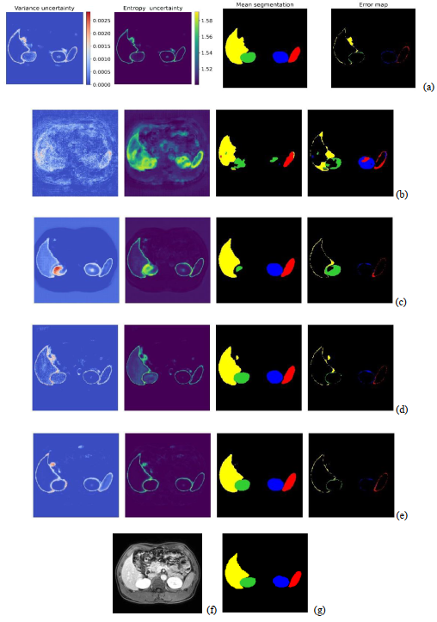
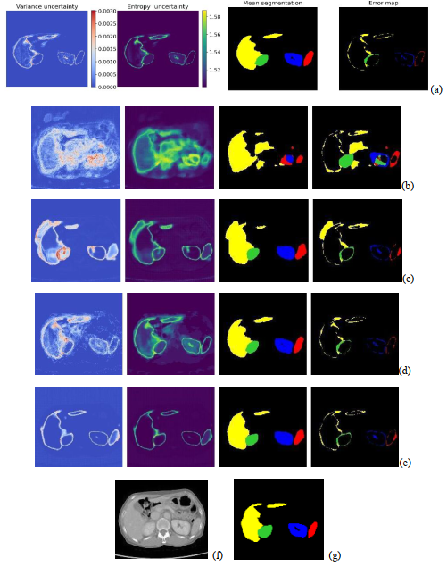
(a) Supervision
(b) W/o Adaptation
(c) SIFA
(d) FS-UDA
(e) HMeAL-UDA
(f) Image
(g) Ground-truth
Two uncertainty estimations
Notes:
These figures show the uncertainty estimation of the five methods.
First column is the variation uncertainty, second column is the entropy uncertainty, the third one is the mean segmentation and last column is the error map. We can see the uncertainty of our method is lower than other methods, and most uncertainty located in the edge of the organ.

Slide 19
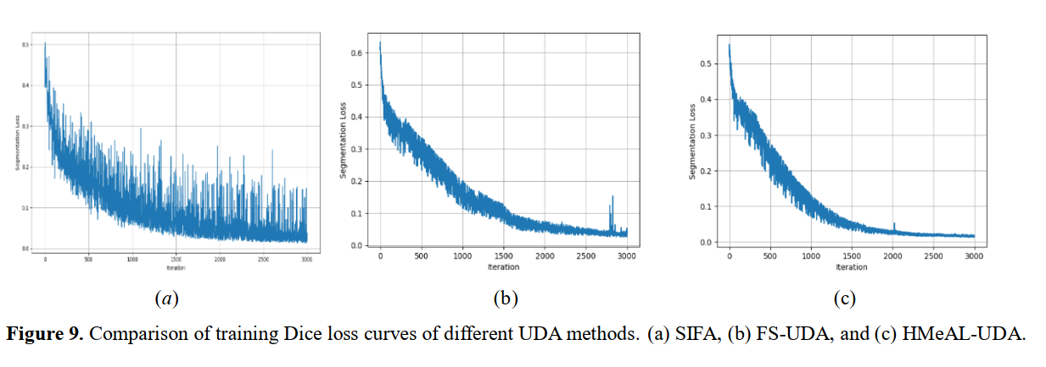
Experiments
Model complexity and convergence analysis
Notes:
Our method focus on reduce the domain gap and the complexity of model.
So we compare the parameters and training time of the three DA methods in our experiments.
We also show the convergence of the different models during training.

Slide 20
Summary and discussion
Summary
A simple yet effective framework for unsupervised domain adaptation by combining adversarial learning and histogram matching to reduce the domain diversity and improve the segmentation accuracy of the unlabeled target domain.
the results are much close to the supervised method.
We further estimate the uncertainty of different models.
Future Work
Use the information of uncertainty estimation to improve the performance of model.
The traditional HM could be learnable dynamically.
Notes:
Finally let’s have the summary. We use the HM and AL to reduce the domain diversity and improve the segmentation accuracy of the unlabeled target domain, the results are much close to the supervised method.
We further estimate the uncertainty of different models.
In the future, it is better to use the information of uncertainty estimation to improve the performance of model.
And also the traditional HM could be learnable dynamically.

Slide 21
