Slide 1
Notes:
The study focuses on tumor delineation in radiation therapy (RT), particularly in lung cancer, and explores how deep learning (DL)-based uncertainty maps can aid segmentation reliability.

Slide 2
Introduction
Automated contouring :
Complexity of contouring (GTV)
Model-based uncertainties
Variabilities in training data (physicians’ preferences)
Uncertainty estimation:
Monte-Carlo (MC) dropout: multiple inferences
Deep ensemble: multiple networks
Clinical validation:
Variance in real-world data
Miscalibration
Purpose:
A 3D probabilistic system that generates uncertainty maps for lung cancer CT segmentation using MC Dropout
Notes:
Tumour delineation is a critical step in RT planning, and it is typically performed manually by radiation oncologists (Ros). This can be labour-intensive, time-consuming and is prone to personal bias.
Now in clinics, we can use DL models to help automating contouring process of most OARs, but so not many used for GTV delination due to task complexity, lack of model robustness, and physicians preferences.
To improve the reliability of these systems, researchers have started to explore uncertainties quantification in DL models for contouring. Knowing the system’s confidence level can help to guide decision making. Two very common uncertainty quantification methods are shown here. 1) MC: In standard neural networks, dropout is only applied during training to prevent overfitting. MC Dropout applies dropout during inference, meaning neurons are randomly deactivated when making predictions. This process is repeated multiple times, and the resulting multiple outputs are aggregated to compute uncertainty maps or mean predictions. (2) Deep Ensembles: estimate uncertainty by training multiple independently initialized neural networks. Estimated by measuring the variance across the different models' predictions (both model & data uncertainty).
Although implementing these uncertainty estimation has gained good performance in lab settings, its practical implementation in clinic still remain unexplored. (1) Models are typically trained and validated on well-curated datasets, but in clinical settings:Patient anatomy differs. (2) If an uncertainty map is misleadingly confident, it could prevent necessary manual corrections, compromising patient safety.

Slide 3
Methodology - Dataset
422 non-small cell lung cancer (NSCLC) patients:
Pre-treatment CT + Manual GTV segmentation contours
Pre-processing:
Removed missing segmentation subjects
CT: (1) Normalization (2) Cropped with 1cm margin
Data split
Training (80%) Validation (10%) Testing (10%)

Slide 4
Methodology – Workflow
Training details:
Dice loss function
Batch size = 1
Dropout=0.2
Augmentation: flipping / rotation
Test-time=25
Normalized entropy
Probability of GTV region
Notes:
Dropout layers were added at key positions, i.e. after each pooling operation in the contracting path and after each up-convolution in the expansive path. An additional dropout layer was added at the final step. The dropout rate was set to 0.2 during both training and testing time.
The probability of a voxel belonging to the tumor was obtained as (probability map eq, p_rt=prediction of voxel r at t)
Normalized entropy was employed as a measure of uncertainty, therefore probability maps were converted into uncertainty maps by using equation H
Values range [0,1] where:
0 = Low uncertainty (confident prediction).
1 = High uncertainty (model is unsure).

Slide 5
Methodology – Clinical validation
Phase 1: RO’s classification of manual contours as baseline
For each test case, RO reviewed and classified manual segmentations into: (1) High uncertainty (2) Intermediate uncertainty (3) Low uncertainty
Phase 2: RO’s localization of high-uncertainty regions
For each test case, RO pointed the highest expected uncertainty areas
Evaluation Metrics:
Mean uncertainty (MU): $MU=\frac{1}{N}\sum_{n=1}^{N}{H_{n}}.$ → Evaluate overall confidence level
Relative uncertainty volume (RUV): RUV$=\frac{Vhigh uncertainty}{Vgroundtruth}$. → Identifies tumors requiring manual review
Notes:
To assess the clinical usefulness of the uncertainty maps, they conducted a two-phase clinical validation with an experienced radiation oncologist (RO). RO first evaluates the manual contours in the test set to establish a baseline uncertainty assessment. The RO reviewed and classified each patient into one of three categories based on their subjective assessment of the expected segmentation uncertainty.
In the second phase, the RO was asked to point the highest expected uncertainty areas for each patient. This clinical experiment allowed for a qualitative assessment of the model’s performance
To quantify the uncertainty levels, they proposed two new metrics: (1) MU Measures the average uncertainty across all tumor voxels.(N is total number of voxels in GTV) (2) RUV measures what percentage of the tumor volume is highly uncertain. Patient specidic threshold was defined by Otsu method: by minimizing the intra-class intensity variance between background and foreground voxels per each patient. Summation of each class’s weight and variance, minimize it to get threshold t.

Slide 6
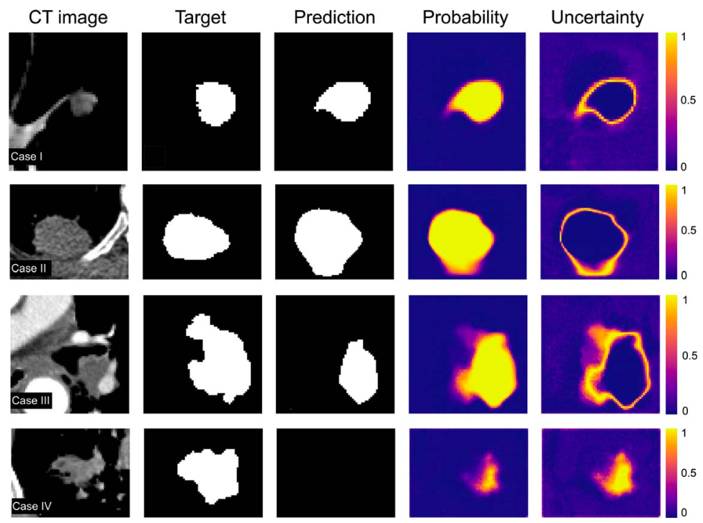
Results – Uncertainty maps
Ambiguous spike
Over contouring
Under contouring
Missed tumor
Notes:
Case I: Ambiguous spike– The segmentation model captured an ambiguous tumor region not contoured by the oncologist, but with high uncertainty.
Case II: Over-contouring – The segmentation model over-predicted the tumor boundary, and uncertainty maps correctly flagged the uncertain area.
Case III: Under-contouring – The segmentation model missed part of the GTV, and uncertainty was high in the missing region.
Case IV: Completely Missed Tumor – The model failed to detect a tumor, but probability and uncertainty maps highlighted the potential tumor region.

Slide 7
Results – Uncertainty maps
Notes:
As previously described, the clinician was instructed to point to the relative location where higher inter-observer uncertainties were expected based on their clinical expertise.

Slide 8
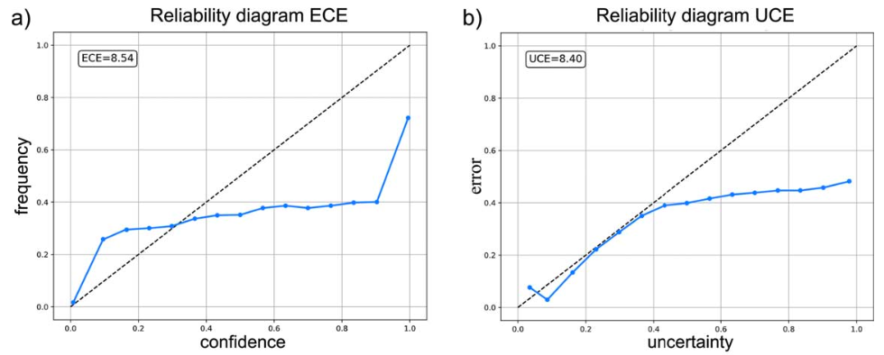
Results – Reliability analysis
Notes:
Does the model's predicted probability reflect actual segmentation accuracy?
(a) Expected calibration error (ECE) Assess reliability of segmentation model: X-axis: Predicted confidence level (e.g., if the model predicts a voxel is tumor with 90% probability).Y-axis: Actual frequency of correct tumor segmentation (how often a voxel is actually tumor across 25 inferences).Ideal Case: The points should lie on the diagonal line (perfect calibration).The results of their segmentation model shows overconfidence: the model is too confident in incorrect predictions.
Do high uncertainty areas actually correspond to segmentation errors? If a model assigns high uncertainty to incorrect segmentations, it is well-calibrated.
(b) uncertainty calibration error (UCE) X-axis: Uncertainty level (entropy-based) → Higher values mean the model is more unsure. Y-axis: Segmentation error → frequency of wrong segmentation voxels. The model tends to be overconfident, meaning it assigns low uncertainty even when it makes errors.

Slide 9
Results – Clinical validation
$MU=\frac{1}{N}\sum_{n=1}^{N}{H_{n}}$ (overall confidence level)
Notes:
This figure shows the correlation between the RO opinion and the mean uncertainty metrics. Test cases were classified into high-intermediate-low by ROs. Each bar represents a different patient case in the test set, and the height of the bar corresponds to the value of the corresponding metric. Good alignment can be observed as red bars dominates the higher uncertainty region, while blue bar dominates the low uncertainty region.

Slide 10
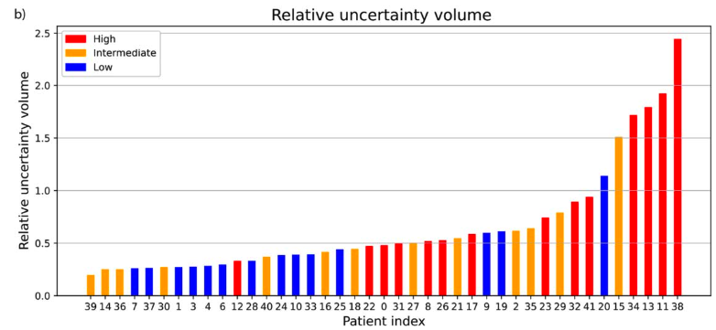
Results – Clinical validation
RUV$=\frac{Vhigh uncertainty}{Vgroundtruth}$. Identify error region
Notes:
Similarly with last figure, this metrics used RUV to identify error region. But RUV metrics only shows a moderate correlation with clinical opinion. Comparing the two figures, we can see MU outperformed RUV in distinguishing high-uncertainty cases.

Slide 11
Results – Clinical validation
Notes:
The ROC curves demonstrate high AUC values, and the mean uncertainty metric showing particularly strong results.
This indicates MU can be used as an automated tool to flag cases needing manual review.

Slide 12
Discussion & Conclusion
Clinical validation:
Comparing model performance with RO preferences directly
Limitations:
Model overconfidence
- Overfitting (small sized dataset ; batch size of 1)
- Dice loss: may focus on shape similarity rather than probability accuracy
Out-of-distribution training & testing data
Notes:
This study focused on comparing the model’s performance directly to the clinical opinion, regardless of the calibration performance. A strong correlation was observed between the clinical opinion and the uncertainty metric MU
The model underestimates uncertainty for incorrect segmentations, making the uncertainty maps less reliable for clinical decision-making. Overfitting ; Deep learning models trained with Dice Loss often suffer from miscalibration, as Dice focuses on shape similarity rather than probability accuracy. The study used the Lung1 dataset, which is limited in size and diversity. It may not be adoptable to real-world data where more artifact could be observed.

