Slide 1
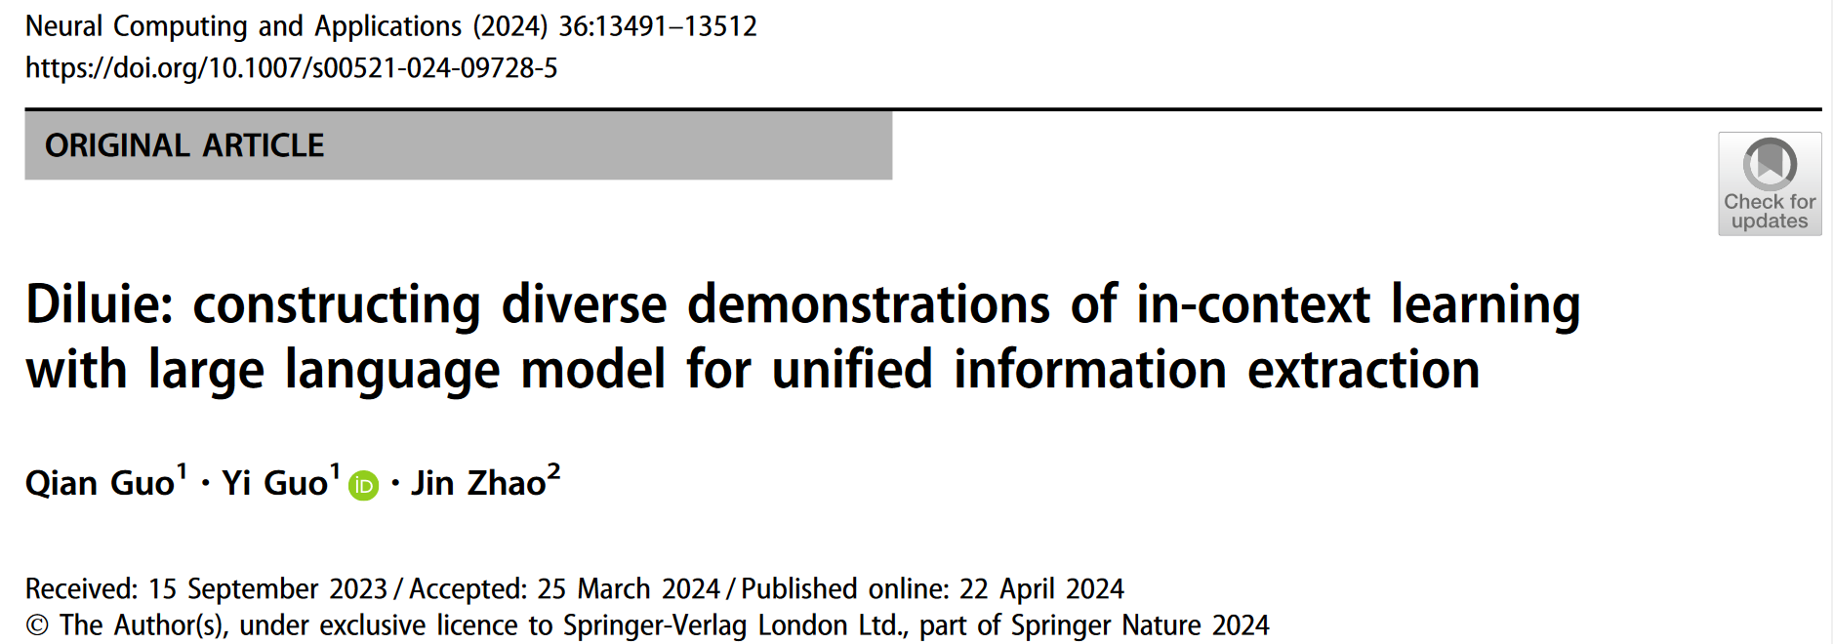
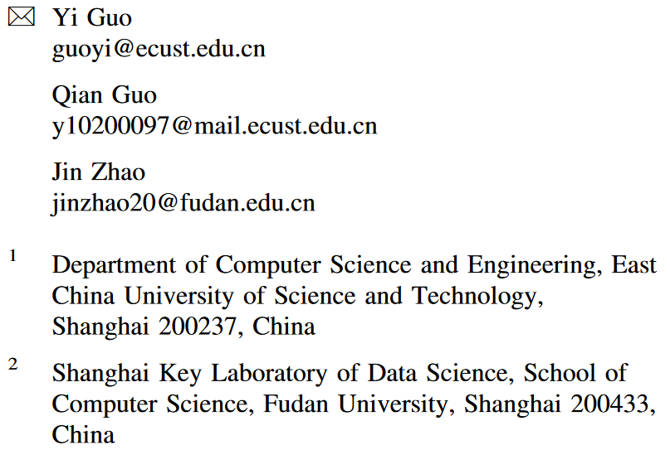
Code available: https://github.com/Phevos75/DILUIE
Prompt engineering: To create effective prompts for AI models to extract structured information.

Slide 2
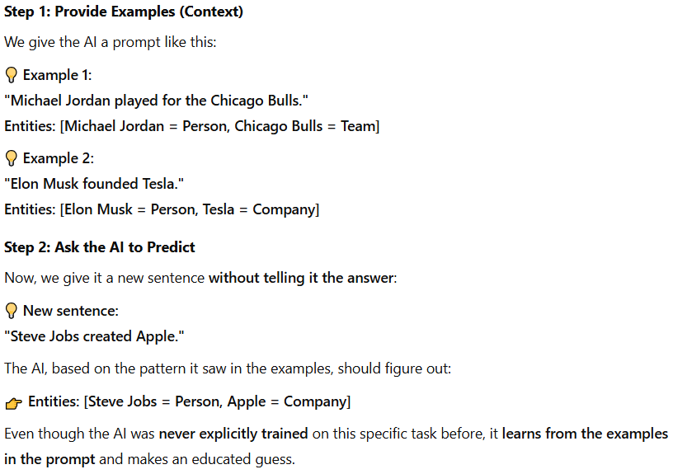
Background
What is in-context learning (ICL)?
ICL is a way for AI models to learn a new task by looking at just a few examples, without being explicitly trained on it.
Example: We want an AI to identify names and places in sentences:
Using specific demonstration examples to create a prompt, then the language model assigns the highest probability to the most precise prediction during inference time.
The advantages of ICL:
No extra training required → The AI adapts on the fly without updating its internal model.
More flexible → It can handle different tasks just by changing the examples in the prompt.
Saves time & effort → No need to fine-tune models separately for each new task.

Slide 3
Background
Current challenges for ICL
LLMs have performance gap in information extraction (IE) tasks (like names, relationships, and events).
Ex. GPT-3.5-turbo only achieves an F1 score of 18.22% on the Ontonotes dataset.
LLMs are highly dependent on manual instruction tuning, which requires expert-written examples and extensive fine-tuning.
Picking good examples for ICL is tricky — the format, selection, and order of examples affect performance a lot.
Solution: Diverse demonstrations of In-context learning with Large language models for Unified Information Extraction (DILUIE)
A unified information extraction framework to generate effective prompt with diverse demonstration examples for ICL.
The core application of DILUIE is to provide an optimized prompt that guides the LLM for better inference:
Attention extraction from raw text via EVA (Efficient attention via control VAriates) and incremental encoding;
Generating well-structured instructions via instruction tuning;
Selecting the best and diverse demonstrations.
Notes:
F1-score: a performance metric used to evaluate a model’s accuracy, especially in classification and information extraction tasks. It measures how well a model balances Precision and Recall. Closer to 1, the model is making highly accurate predictions while also capturing most of the relevant items.
Develop a framework based on LLM called

Slide 4
Problem Statement
Generation of task objective
Suppose the task objective is to predict the target variable $Yε𝓨$
$Xε𝓧$ denotes the input token sequence
The prompt text $𝒯^{e}$ is constituted of $k$demonstrations $𝒟^{k}$ and expert-written instructions $I\left( \right)$
$θ∈Θ$ denotes the latent concept variable
As instruction tuning, the $k$ demonstration examples are concatenated to instruction sequence and expressed as $C^{I}={\left[I\left(x_{i}, y_{i}\right)\right]}_{i=1}^{k}$
Given input example $X$ and specific-task instructions, how the final prediction 𝑌 is made in the ICL framework:
The posterior probability of extracting Y from X (given some context $C^{I}$) is obtained by integrating all possible topic variables $θ$ that could influence the extraction process.
$θ$ represents a hidden, underlying theme or concept:
Notes:
Suppose task object is to predict the target y from the input x. Before we do the prediction, we give well-written instructions with some good examples, concatenated as CI. Eq(1) defines the posterior probability of ... The model will calculate it by integrating all possible …

Slide 5
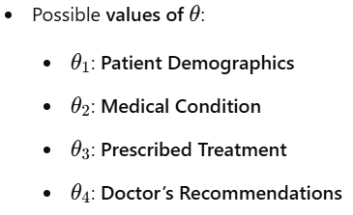
Problem Statement
Generation of task objective
Input Clinical Text (X): "A 60-year-old male patient with a history of hypertension and obesity was diagnosed with Type 2 Diabetes. The doctor prescribed Metformin and advised regular exercise and a low-carb diet."
Define the instruction $C^{I} −→Patient^{′}s Medical Details$
Define the Latent Concept Variable $θ$
Y:
Define the instruction $C^{I} −→Extract potential risk factors$
Y:

Slide 6
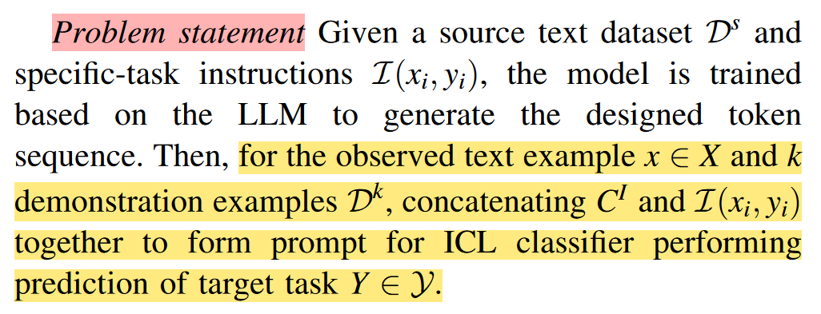
Problem Statement
Problem Statement for ICL
When given a new observed text example $Xε𝒳$, the model does not make predictions immediately. Instead, it constructs a better prompt for the ICL classifier:
Instruction: Identify Drug-Treatment Relationships.
Example 1: "Metformin is prescribed for Type 2 Diabetes." → (Drug: Metformin, Disease: Diabetes)
Example 2: "Ibuprofen helps relieve inflammation." → (Drug: Ibuprofen, Effect: Anti-inflammatory)
Target Text: "Aspirin is commonly used to reduce heart attack risk." → (???)
Final Prediction Y: (Drug: Aspirin, Effect: Reducing heart attack risk)

Slide 7
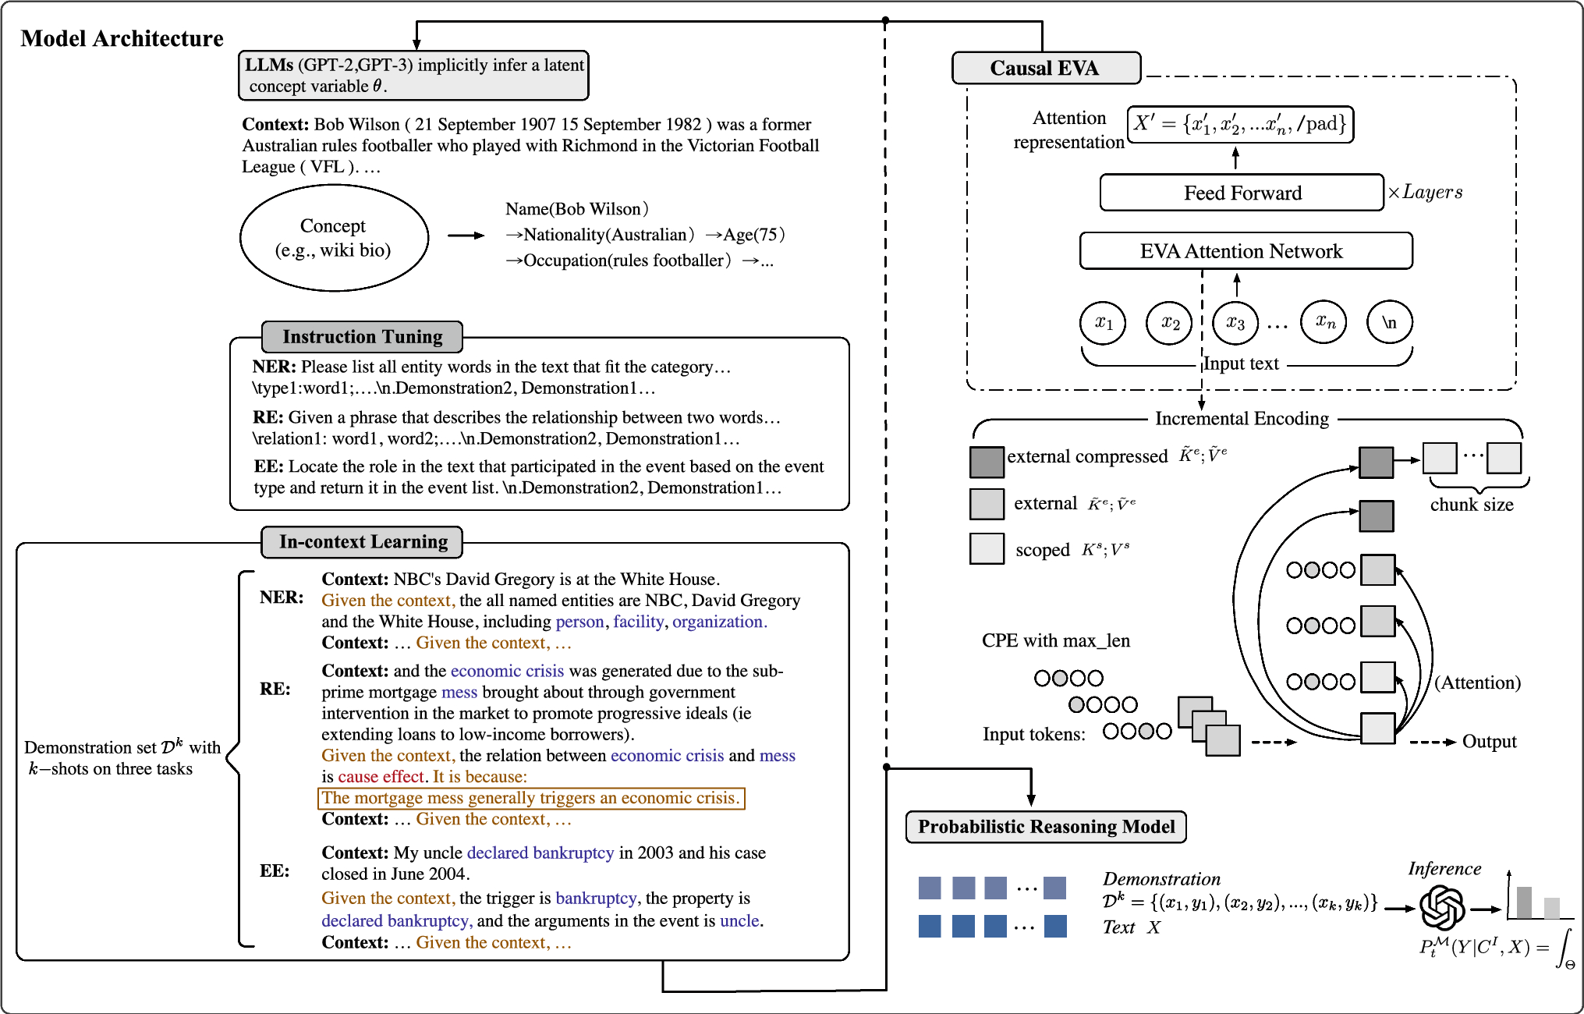
Method: DILUIE
1. Causal EVA Module
EVA (Efficient attention via control Variates) and Incremental Encoding allow DILUIE to efficiently process long sequences while capturing deep contextual relationships between words.
2. Instruction Tuning Module
Learn how to extract structured information that align with specific tasks (NER: named entity recognition, RE: relation extraction, EE: event extraction).
3. Latent Concept Variable Learning & Demonstration Selection Module
Select the most relevant and diverse examples.
Construct effective prompts to do the inference.

Slide 8
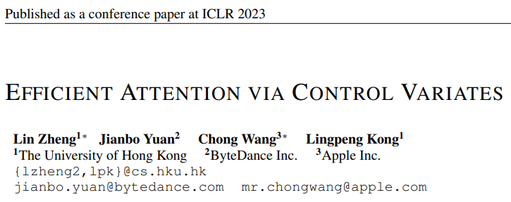
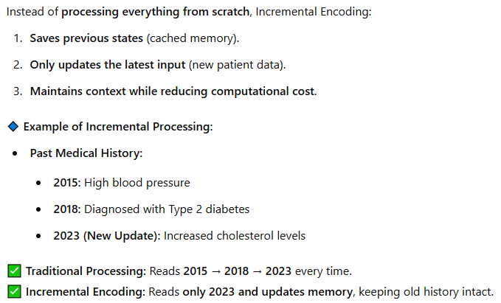
Causal EVA Module
Problem EVA Solves:
Traditional Transformer-based attention (Softmax Attention) has a major issue → Quadratic Complexity $O(n^{2})$, making computation expensive for long sequences.
How EVA works:
Chunked Attention Mechanism → Splitting Key-Value Pairs into Chunks (extract local and remote features) → This reduces memory use.
Compression Mechanism → Keeps only the important features in the remote features.
Using LARA [1] Attention to Merge Local and Remote Features → Ensures the model still understands both short-term and long-term relationships.
How incremental encoding works:
[1] Zheng L, Wang C, Kong L (2022) Linear complexity randomized self-attention mechanism. In: International conference on machine learning. PMLR, pp 27011–27041

Slide 9
Causal EVA Module
📜 Patient Report: "John Doe, a 65-year-old male, was diagnosed with non-small cell lung cancer (NSCLC). The patient underwent a CT scan, which showed a tumor in the right lower lobe. Based on tumor staging, the oncologist recommended intensity-modulated radiation therapy (IMRT) with a total dose of 60 Gy over 30 fractions. The patient is also receiving concurrent chemotherapy with cisplatin. Follow-up PET scan in three months is advised."
Step 1: Chunk Compression
Chunk 1: "John Doe, a 65-year-old male, was diagnosed with NSCLC."
Chunk 2: "The patient underwent a CT scan, which showed a tumor..."
Chunk 3: "Based on tumor staging, the oncologist recommended IMRT..."
Chunk 4: "The patient is also receiving concurrent chemotherapy with cisplatin."
Step 2: Remote Feature Compression
Diagnosis → "Non-small cell lung cancer (NSCLC)"
Treatment → "IMRT, 60 Gy, 30 fractions”
Medication → "Cisplatin (chemotherapy)"
Step 3: Incremental Encoding
When new medical information arrives, EVA only updates the cache instead of reprocessing everything.
Step 4: Fast Querying & Decision Support
A doctor or AI system can now quickly extract key details by asking:
"What is the diagnosis?" → EVA retrieves "NSCLC"
"What treatment is recommended?" → EVA retrieves "IMRT, 60 Gy, 30 fractions"
"Any follow-up instructions?" → EVA retrieves "PET scan in 3 months"

Slide 10
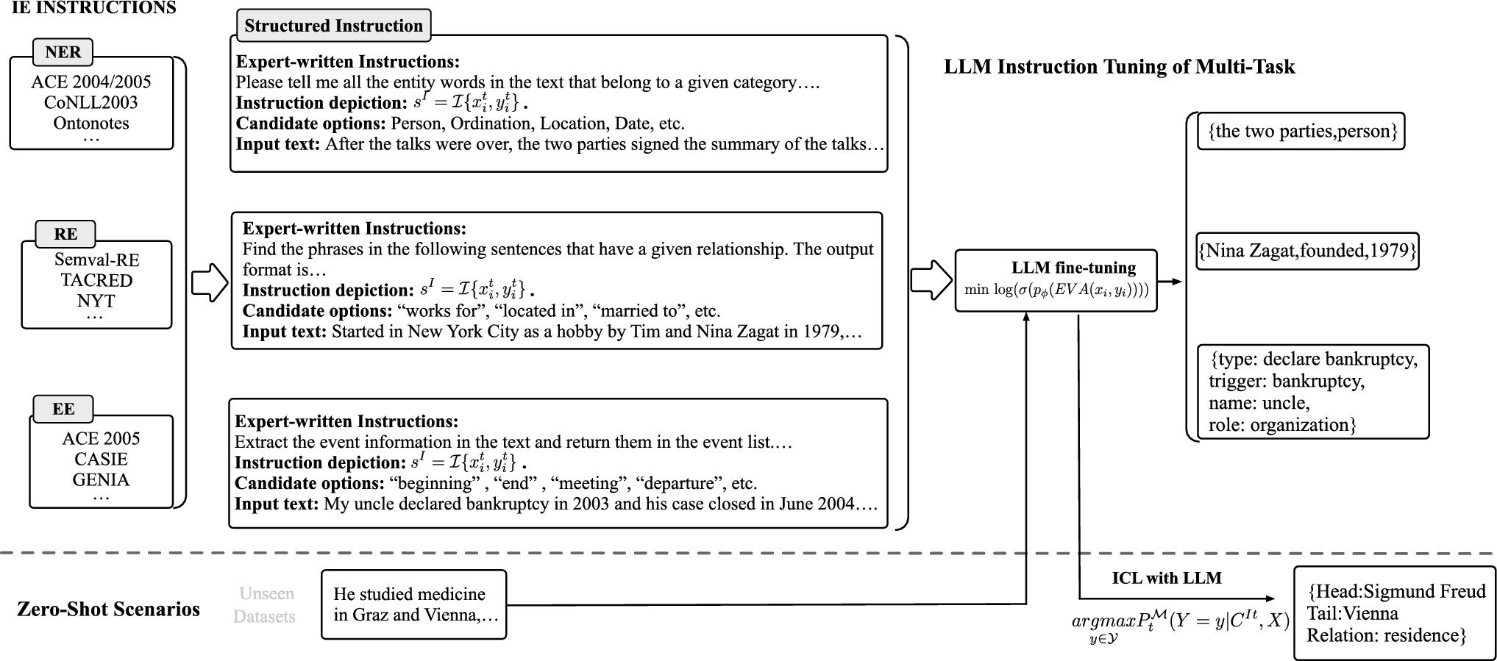
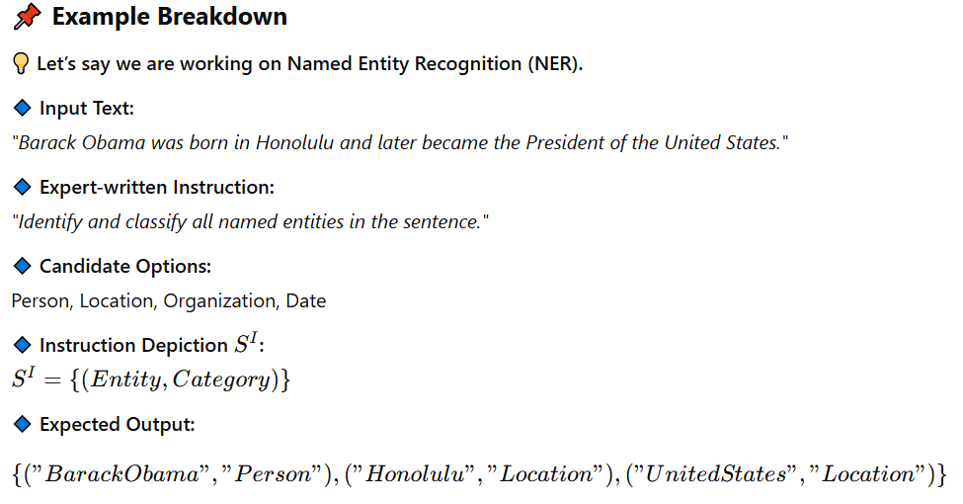
Supervised instruction tuning
named entity recognition
relation extraction
event extraction
Instruction Tuning in DILUIE is like training a student with well-structured lessons, so later, when given a test (ICL scenario), the model knows how to extract and format information correctly.

Slide 11
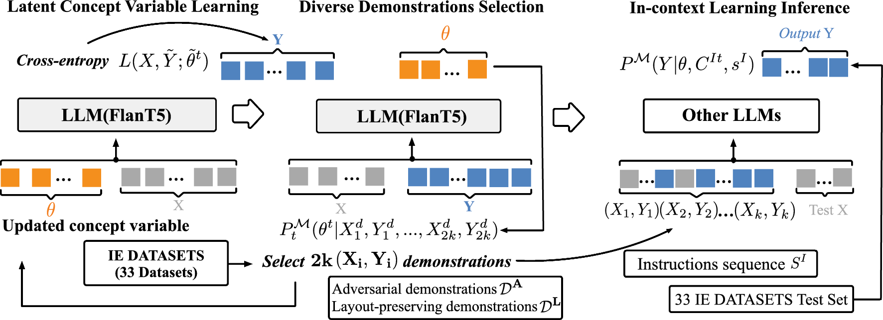
Demonstration Selection Module
Aim to select the best demonstrations for in-context learning.
Notes:
We want to select the best demonstrations for in-context learning, but before that, We need to first identify what types of concepts exist in the training dataset.

Slide 12
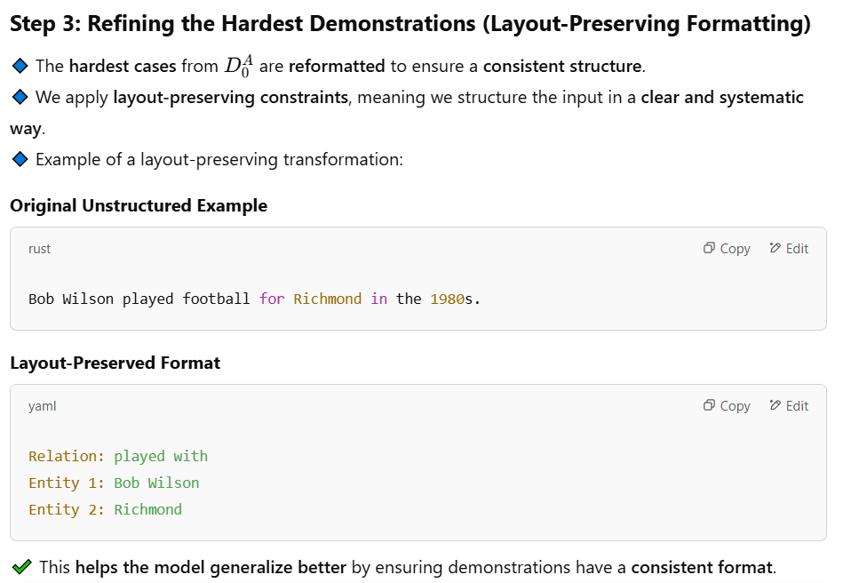
Latent Concept Variable Learning & Demonstration Selection Module

Slide 13
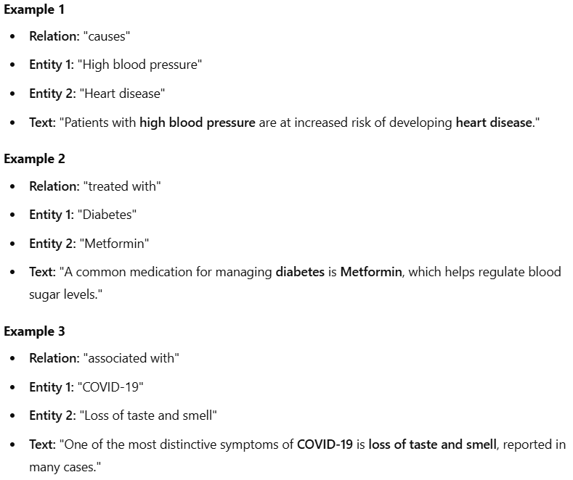
Prompt generated by DILUIE
Task is to identify relationships between diseases, symptoms, and treatments based on medical information extraction.

Slide 14
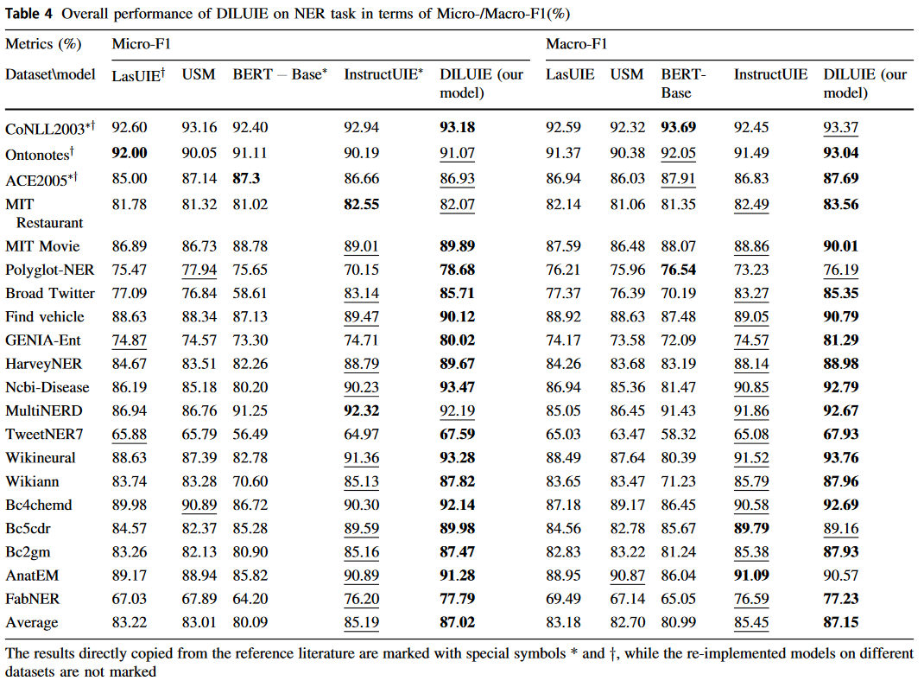
Results

Slide 15
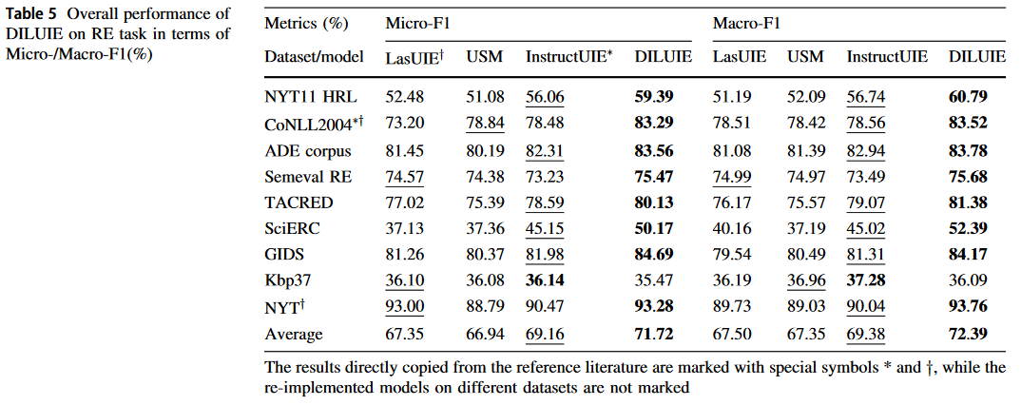
Results

Slide 16
Results

Slide 17
