Slide 1
A Conditional Point Cloud Diffusion Model for Deformable Liver Motion Tracking Via a Single Arbitrarily-Angled X-ray Projection
Jiacheng Xie, Hua-Chieh Shao, Yunxiang Li, You Zhang
Medical Artificial Intelligence and Automation (MAIA) Laboratory
Department of Radiation Oncology
Email@UTSouthwestern.edu

Slide 2
Motivation
Accurate liver motion estimation is desired in IGRT to enable precise tumor targeting during treatment.
  Challenges: Low-contrast regions, angle-dependency training
Previous work, X360¹, has solved the challenges
  Limitations:
    Inferior accuracy compared to angle-specific models
    Performance sensitive to noise
PCD-Liver: A conditional point cloud diffusion model
  Leveraging the robustness of diffusion models
[1]Shao HC, Li Y, Wang J, Jiang S, Zhang Y. Real-time liver motion estimation via deep learning-based angle-agnostic X-ray imaging. Med Phys. 2023 Nov;50(11):6649-6662. doi: 10.1002/mp.16691. Epub 2023 Sep 13. PMID: 37922461; PMCID: PMC10629841.
Notes:
However, previous works often focus on lung imaging, and struggle with low-contrast regions, such as the liver site, where small intensity differences would influence motion estimation accuracy. Furthermore, most approaches are not angle-agnostic and rely on models trained for specific beam geometries or projection angles, limiting their generalizability to diverse imaging setups.
X360 framework, which employed graph neural networks (GNNs) to track deformable liver surface motion from a single, arbitrary angle X-ray projection
Limitations: Inferior performance compared with angle-specific models, sensitive to noise
To resolve those limitations, we proposed PCD-liver, which is based on a conditional point cloud diffuision model to estimate deformable liver motion

Slide 3
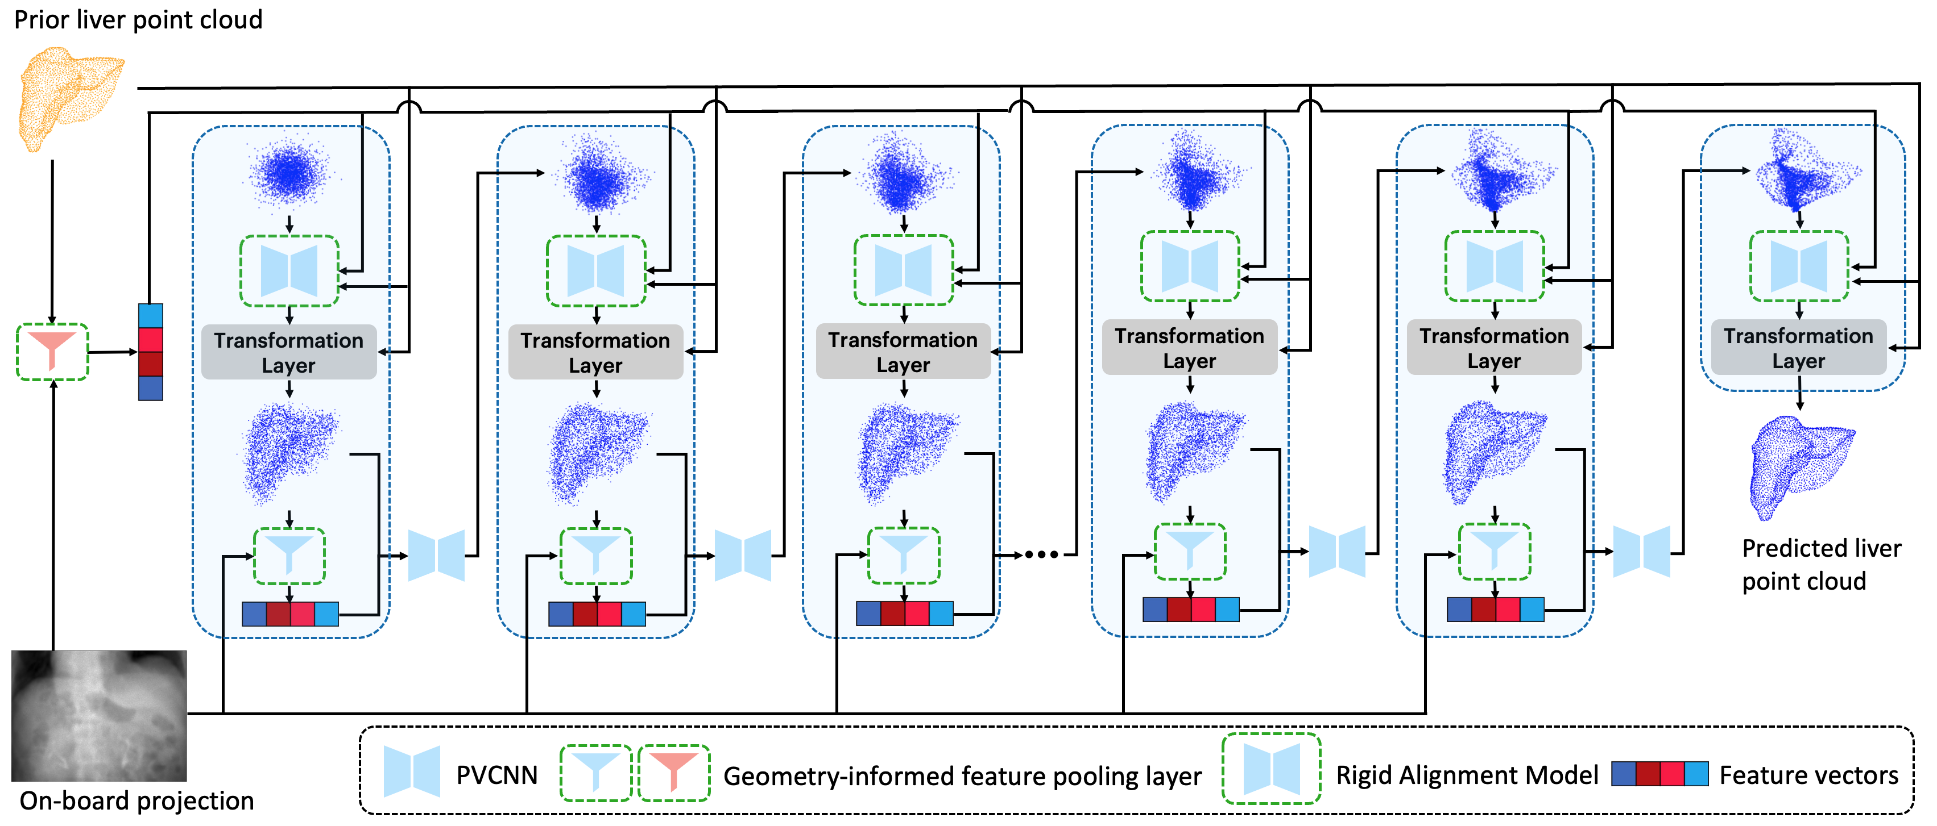
Method
Conditional point cloud diffusion model: Resolves DVF step by step
Rigid alignment model: reposition intermediate DVFs
Geometry-informed feature pooling layer: Extracts features with spatial information
Notes:
Our framework is composed of three major parts:
Starting from Gaussian noise, in each step of the diffusion model, denoted in blue dashed box, the intermediate DVFs are repositioned by the pre-trained rigid alignment model and then applied to the prior liver surface mesh to obtain an intermediate liver surface point cloud. Subsequently, in the feature pooling layer, the intermediate liver surface points are projected to a stack of 2D feature maps, yielding geometry-aware feature vectors. The feature maps are extracted from the onboard X-ray projection using a ResNet-50 that is simultaneously retrained in our network. The intermediate liver surface point cloud and feature vectors are fed into the diffusion model to produce denoised DVFs to input into the next step, forming an iterative loop. After 1000 steps, the predicted liver surface point cloud is obtained

Slide 4
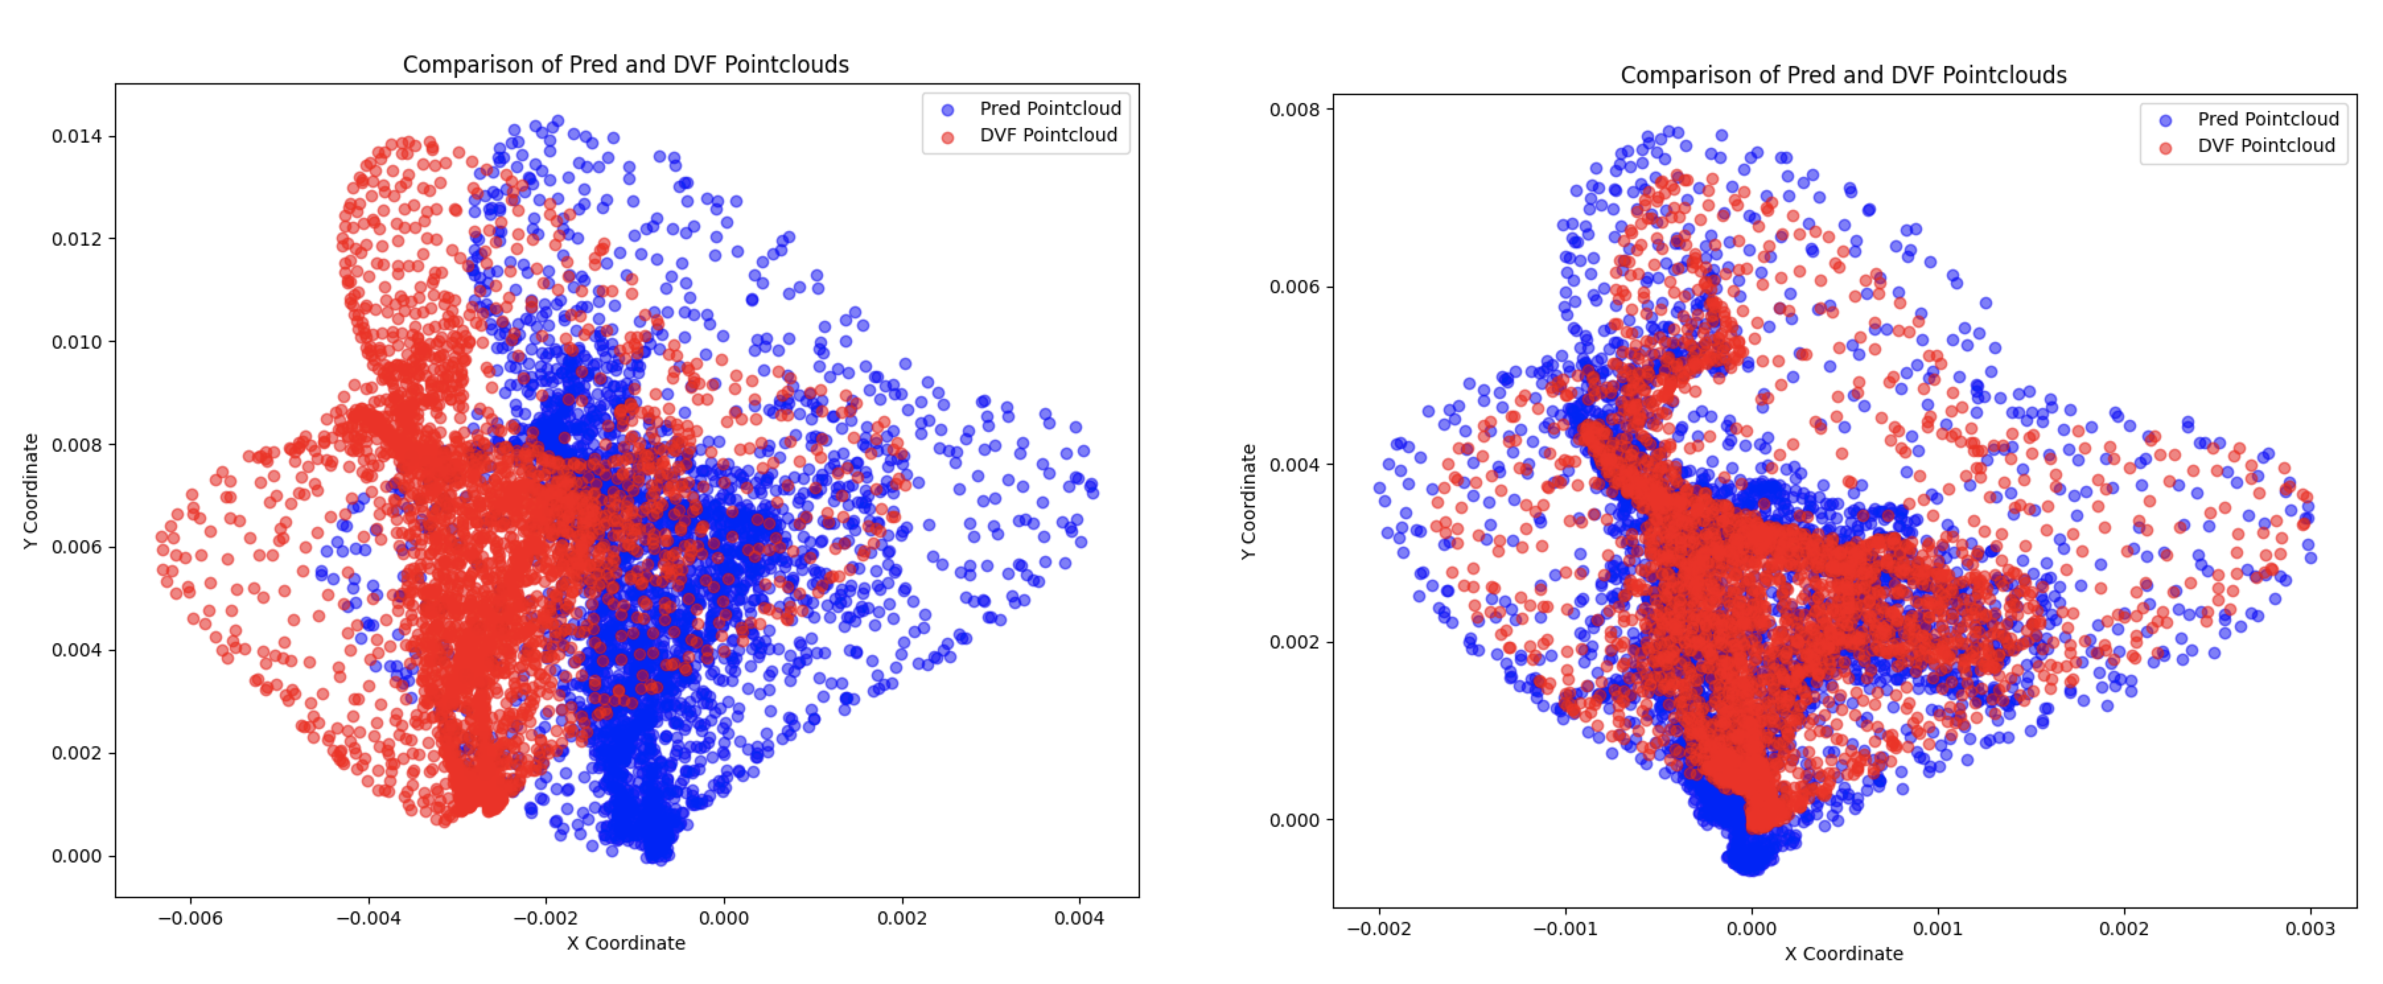
Method-Rigid alignment model
Pretrained rigid model
Point cloud diffusion model produces outputs centered near the origin (zero-mean). However, DVFs representing point cloud transformations, may not be centered close to the origin, due to inherent rigid translations
Notes:
The reson why using a rigid alignment model between the diffusion steps.
On the left, the blue predicted dvfs have a shift from the red ground truth dvf, and the predicted dvfs are tent to center near orgin. Point cloud diffusion model produces outputs centered near the origin (zero-mean). However, DVFs representing point cloud transformations, may not be centered close to the origin, Thus, we need a pretrained model to elimiate the shift. After applying the pretraiend model, the predicted dvfs are aligned witht the gt dvf

Slide 5
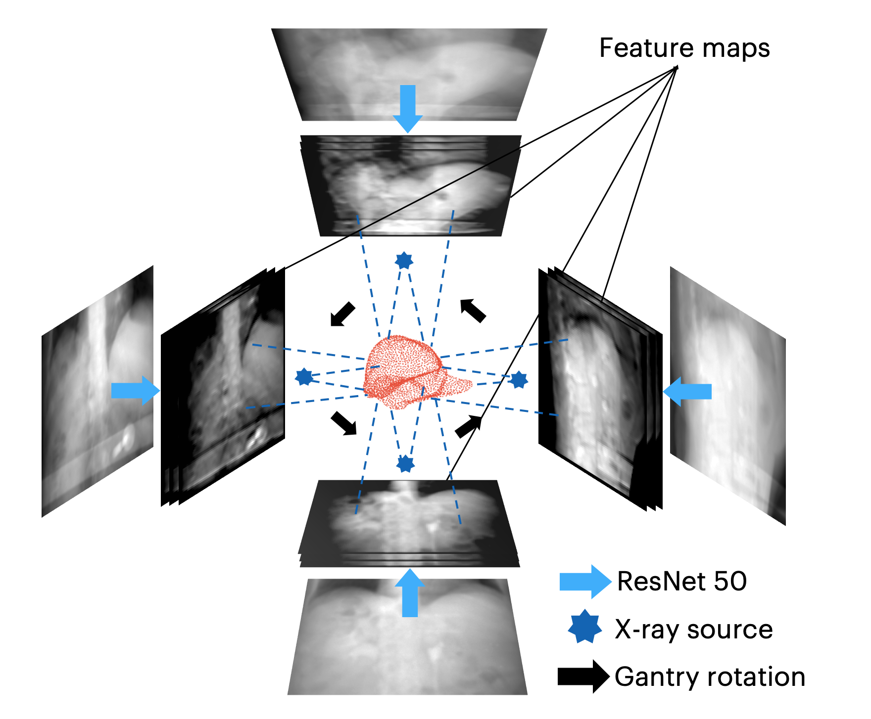
Method- Geometry-informed feature pooling layer
The geometry-informed pooling layer maps liver surface nodes onto ResNet-50 feature maps based on cone-beam geometry, extracting X-ray projection-specific features for angle-agnostic liver boundary motion inference.
Notes:
The geometry-informed perceptual feature pooling layer pools X-ray projection features by mapping liver surface nodes onto feature maps extracted from ResNet-50. To enable angle-agnostic inference of liver boundary motion, the pooling layer integrates cone-beam geometry consistent with the X-ray projection, allowing extraction of relevant features specific to the current projection angle. By uisng this layer, our model can better distingushi the angle differences from the X-ray projections

Slide 6
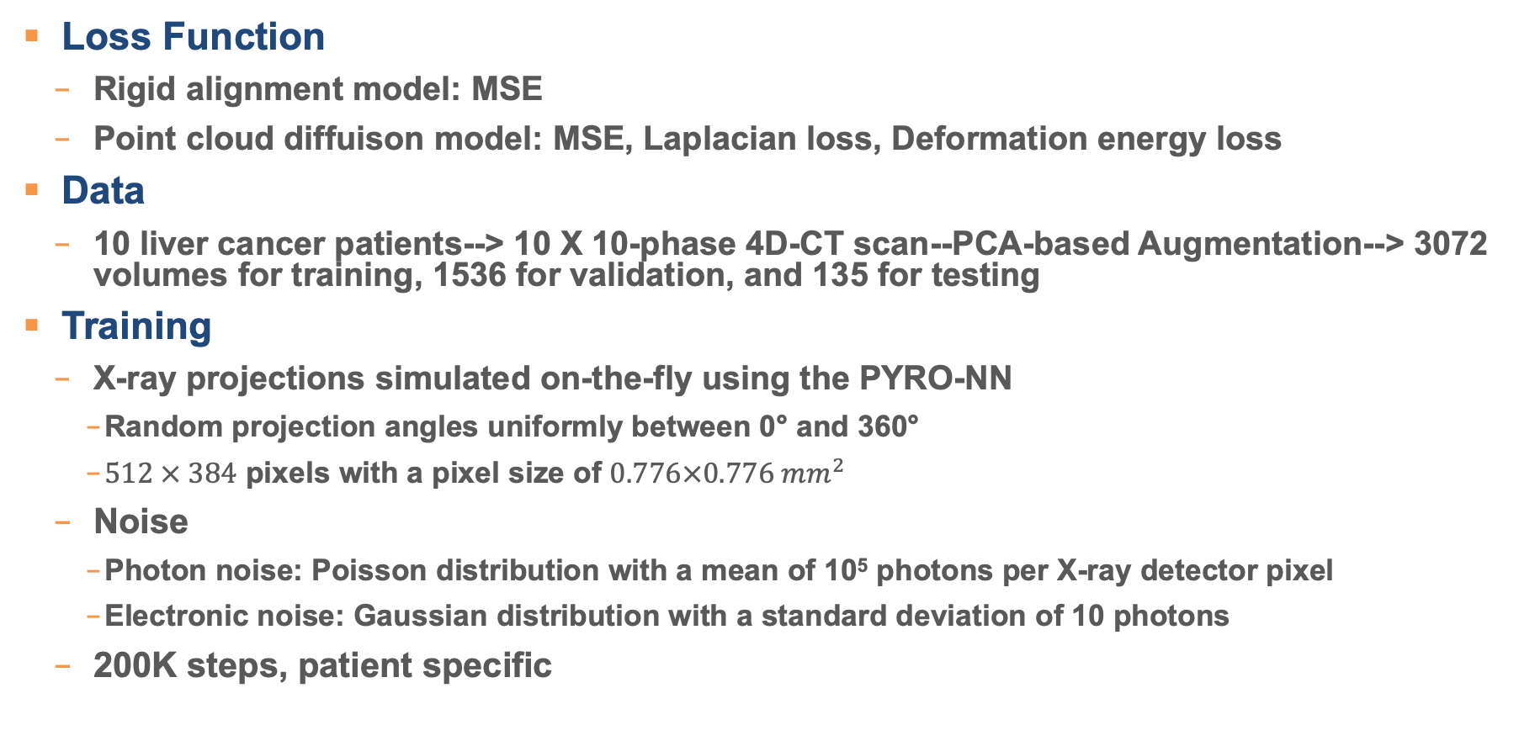
Training
Loss Function
  Rigid alignment model: MSE
  Point cloud diffuison model: MSE, Laplacian loss, Deformation energy loss
Data
  10 liver cancer patients--> 10 X 10-phase 4D-CT scan--PCA-based Augmentation--> 3072 volumes for training, 1536 for validation, and 135 for testing
Training
  X-ray projections simulated on-the-fly using the PYRO-NN
    Random projection angles uniformly between 0° and 360°
    $512 × 384$ pixels with a pixel size of $0.776×0.776 mm^{2}$
  Noise
    Photon noise: Poisson distribution with a mean of 10⁵ photons per X-ray detector pixel
    Electronic noise: Gaussian distribution with a standard deviation of 10 photons
  200K steps, patient specific
Notes:
The latter two are used to prevent large, unrealistic motion of the liver mesh, and also smooth the liver surface

Slide 7
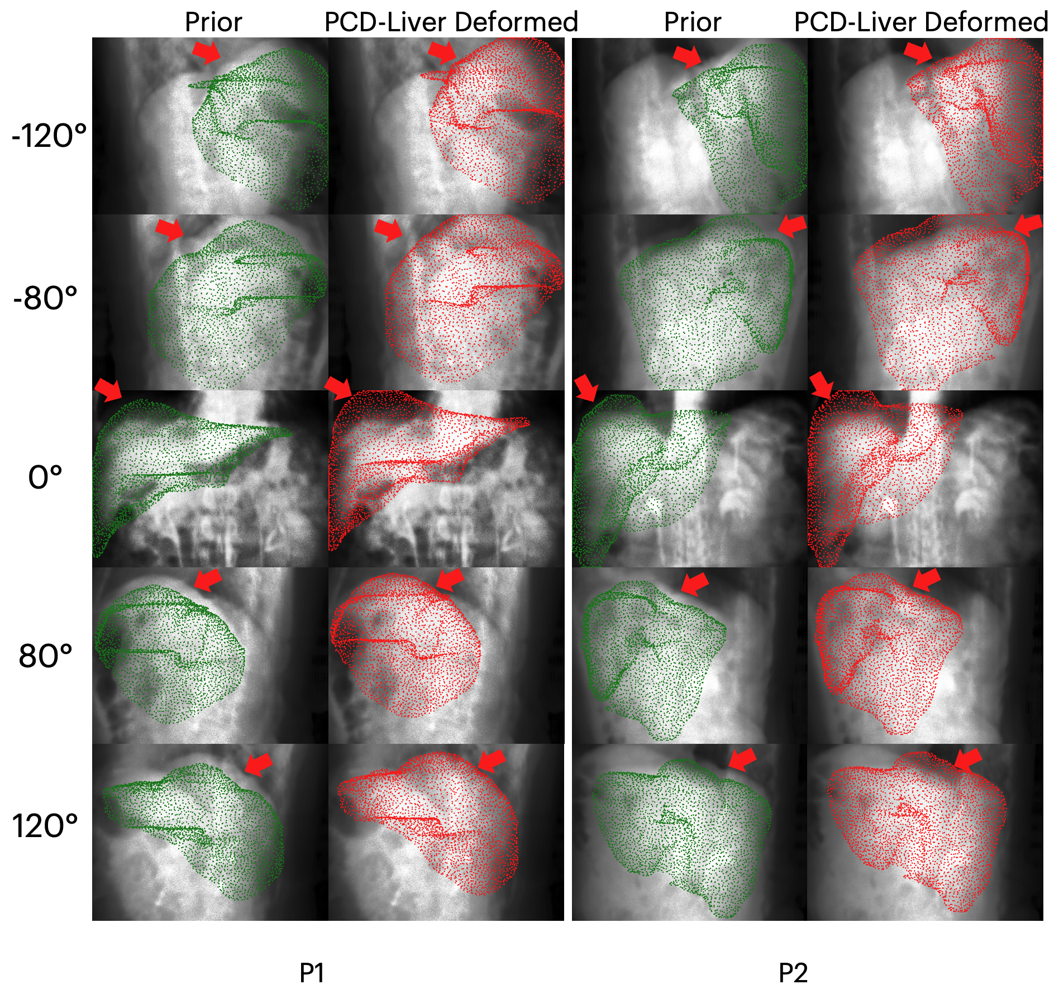
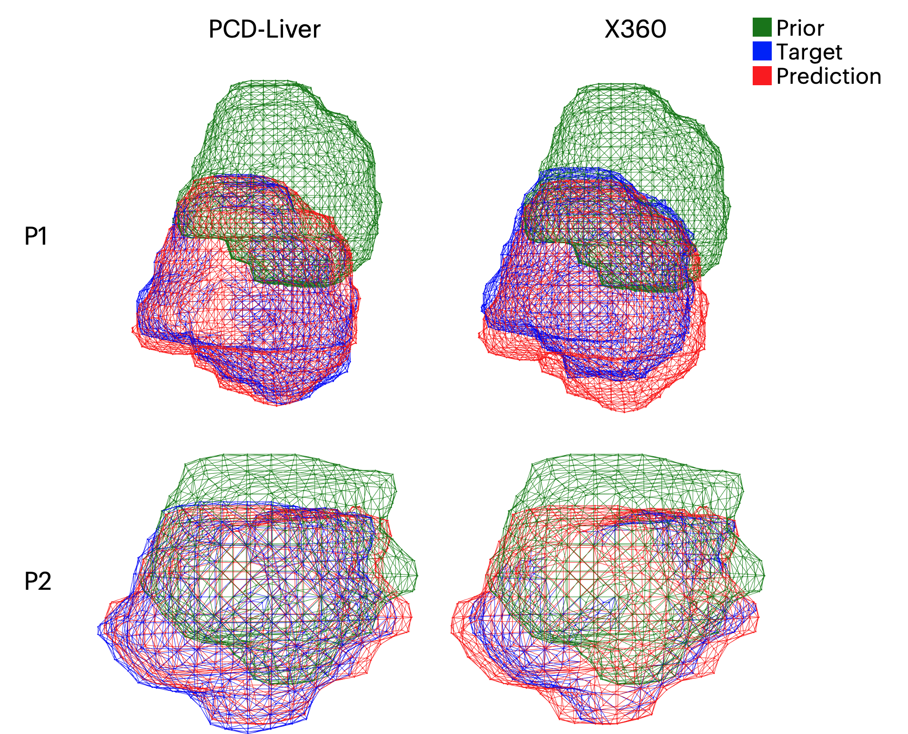
Result
Projections of liver surface point clouds onto onboard X-ray projections
Liver tumor overlays
Resolved liver mesh-->Bio model-->intra-liver DVFs
Notes:
Figure on eth left shows the projection of the prior reference liver mesh and the PCD-Liver deformed liver surface onto the X-ray projections at five different angles for two patients. In each case, the first column displays the prior reference liver surface point cloud (green), while the second column shows the PCD-Liver-deformed liver surface point cloud (red). The deformed liver clouds shows substantially improved alignment with the liver surfaces seen across different projection angles, demonstrating the model’s capability in accurately capturing liver’s deformable motion.
Figure on the right shows a comparison of the liver tumor surface meshes obtained with the deep learning-based Bio model, based on the liver boundary motion solved by PCD-Liver and X360 for two patient cases (P1 and P2), respectively. The first column displays the overlays of the prior tumor mesh (green), the target ‘ground-truth’ tumor mesh (blue), and the PCD-Liver-deformed tumor mesh (red). The second column presents the corresponding overlays for X360. The PCD-Liver model achieves better tumor localization accuracy, by aligning the predicted tumor mesh more closely with the target ‘ground- truth’ compared to X360.

Slide 8
Result
Notes:
This table quntatively show the resuts, we can see that the PCD-liver model constentely perform better than the x360 model accoss all metrics on all patient cases.

Slide 9
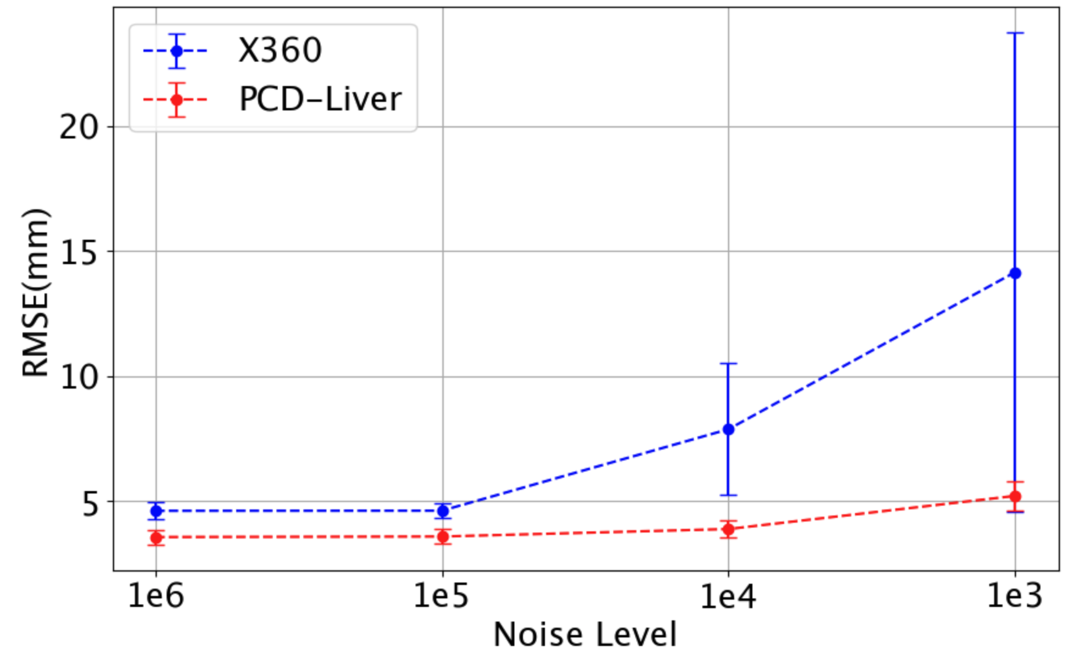
Result-Robustness
Photon noise from with mean values of 10³, 10⁴, 10⁵, and 10⁶ photons per X-ray detector pixel
Notes:
During inference, Photon noise from with mean values of 103, 104, 105, and 106 photons per X-ray detector pixel to the Xray projeciton.
Even as noise levels increase from 10⁶ to 10³ photons per pixel, PCD-Liver produces consistently stable predictions of liver boundary movement, even for the highest noise level (10³). In contrast, X360 shows substantial vunaribilty to increased noise levels, especially to the 10³ and 10⁴ noise levels which deviate from the training dataset, where noises based on a 10⁵ photons/pixel dose level were simulated (Sec. 2.4.2). This robustness is likely due to the diffusion model’s resilience to out-of-distribution data

Slide 10
Conclusion
PCD-Liver shows better performance
  Motion esimation
  Robustness
Inference time limitation
  2 mins
  Latent diffusion
Notes:
While X360 can do real-time predictions

Slide 11



