Slide 1
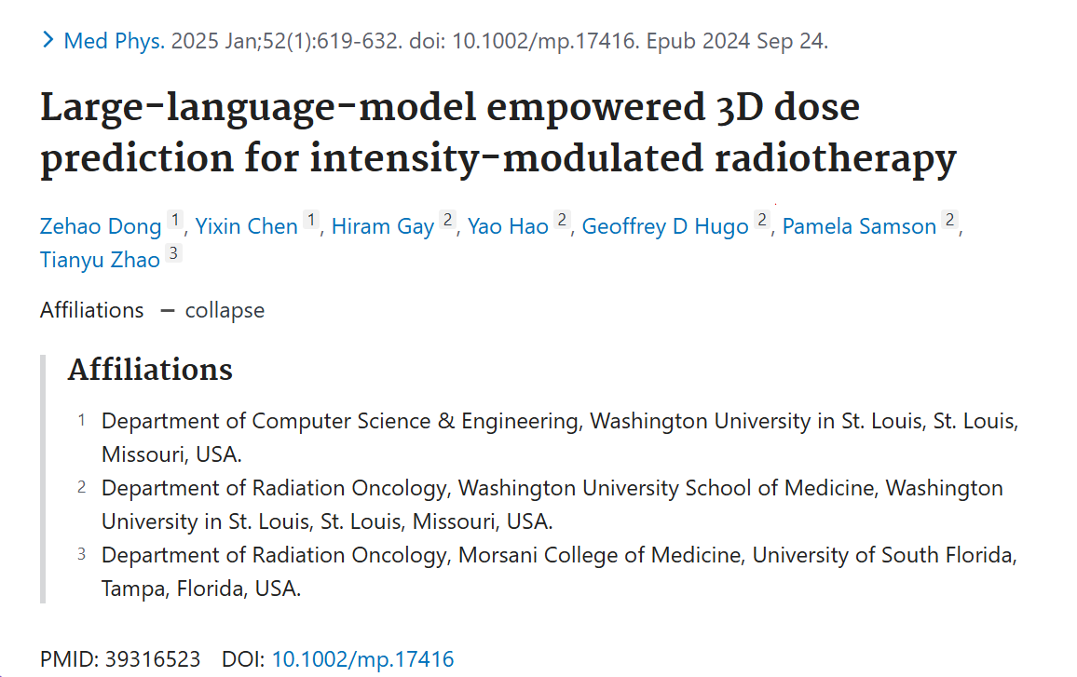
3/15 Journal Club

Slide 2
Introduction
Problem:
Traditional deep learning-based DVH prediction models are often trained based on historical data that may not fully account for a patient’s unique medical conditions and anatomy. This limits their effectiveness in creating personalized radiotherapy planning.
Purpose:
This study presents DoseGNN, a deep learning model for DVH prediction that integrates imaging data with the large-language model (LLM) to enhance treatment planning quality. Here, LLM is used to encode massive knowledge from prescriptions and interactive instructions from clinicians.
Additionally, an Online Human-AI Collaboration (OHAC) system is introduced as a practical framework for automating IMRT planning.
Notes:
Currently, most data-driven DVH prediction models are trained on historical data, which often fails to account for the unique medical conditions and anatomy of individual patients. As a result, these models struggle to generate truly personalized treatment plans, limiting their effectiveness in optimizing radiotherapy.
To address this, they introduce DoseGNN, a novel deep learning model for predicting clinically delivered doses from images for DVH prediction. DoseGNN leverages the power of LLMs to understand doctors' prescriptions and notes combines it with advanced image models like the Swin Transformer to learn image features. This fusion enhances treatment planning by tailoring predictions to each patient's specific needs more.
Additionally, thry present the Online Human-AI Collaboration (OHAC) system, a practical framework for automating IMRT planning. This system allows clinicians to interact with deep learning models through an LLM-powered interface, enabling real-time evaluations and adjustments to continuously improve the model.

Slide 3
Dataset
40 IMRT lung treatment plans with CT
Medical text data: prompt-oriented text documents of clinician's instructions and prescriptions to describe the goals of the treatment as well as the medical factors of a patient.

Slide 4
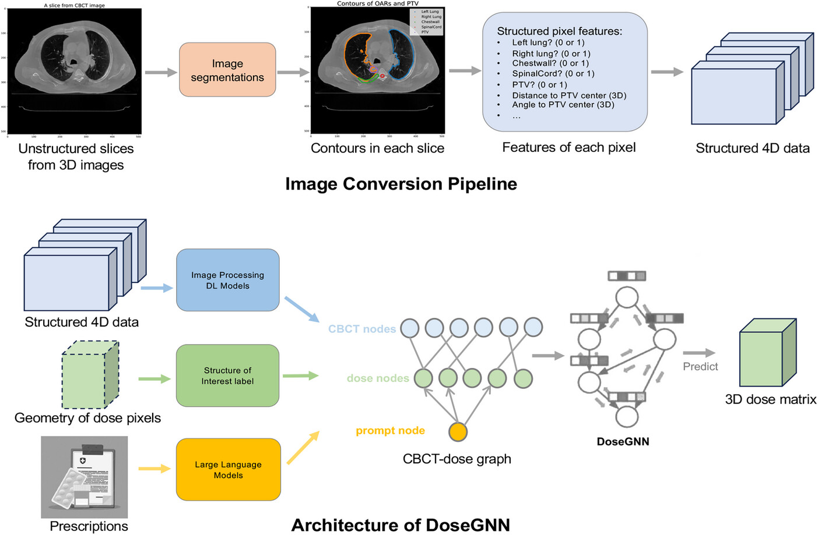
Method
ICP converts unstructured 3D images into structured 4D tensors, representing geometric information of OARs and PTV.
In DoseGNN, image processing models (like Swin Transformer) and LLMs convert the 4D tensor and medical text into node features in an image-dose graph.
A GNN is then used to predict dose values for the dose nodes.
Notes:
They propose a pipeline that converts unstructured 3D images into structured data. CT slices are used along with manual segmentations, where radiologists outline the tumor and critical structures. A binary indicator (0/1) is used to mark whether a pixel is inside the contour of an OAR or PTV. The distance and angle to the center of the PTV are then used to describe the geometric relationship between the PTV and OAR
DoseGNN takes three types of inputs. First, thry use a Swin Transformer, a hierarchical vision model, to process image data and extract meaningful features. Next, dose nodes are initialized with binary encoding to represent organs-at-risk and planning target volumes. Finally, the prompt node receives prescriptions and doctor instructions as text. We use LLMs like Sentence-BERT to convert this text into fixed-length embeddings, which are used as initial features for the prompt node. This text structured data is then connected to the dose-image graph, linking it to the dose nodes for further processing.
This is what They propose modeling the relationship between dose and image data using a dose-image graph. For each grid or pixel in the dose-image pair, they associate it with a corresponding dose/image pair
The resolution is used as the edge length, and the position is based on the grid/pixel’s geometry. In this graph, each node represents either a dose or image voxel. An edge connects a dose node and an image node if the overlap between the corresponding dose and image voxel is above a certain threshold, such as 0.3.
Finally, GNN will propagate information within this dose-image graph to achieve accurate dose prediction.

Slide 5
Method_LLM
How Are LLMs Fine-Tuned?
They use LoRA (Low-Rank Adaptation) to fine-tune Llama 2. The main Llama 2 model is frozen, and three small neural networks (MLPs) are fine-tuned separately.
What Does the Fine-Tuned Model Learn?
Whether to increase or decrease the dose for better coverage
Specific dose instructions from clinicians.
How Is This Used in DoseGNN?
The fine-tuned model’s output is converted into numerical embeddings and added as a prompt node in the graph, enabling DoseGNN to combine medical text and image data for better predictions
In the end, DoseGNN uses a homogeneous GNN to predict dose values, with node heterogeneity captured in the initial features. The DVH prediction task is framed as a node regression problem, solved using the GNN.
Notes:
They use LoRA (Low-Rank Adaptation) and freeze a specific LLM model (Llama 2). They then combine multiple MLP (Multilayer Perceptron) models for further fine-tuning.
The fine-tuning process involves predicting various aspects, such as improving or decreasing dose coverage, identifying regions of interest (e.g., OARs or PTV), and processing dose information from prescriptions.
The output from the fine-tuned LLMs (text embeddings) is used as the initial features for the prompt nodes.

Slide 6
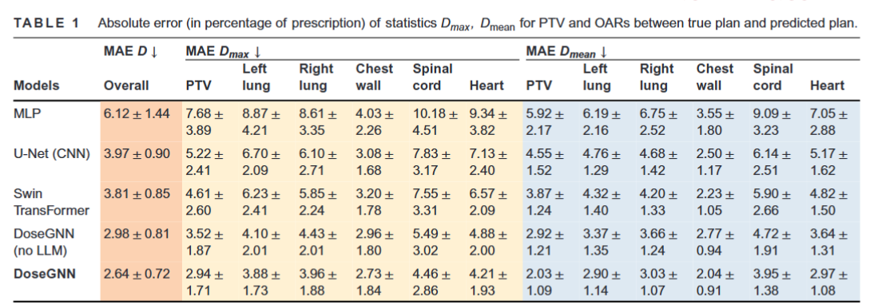
Result_PTV and OAR

Slide 7
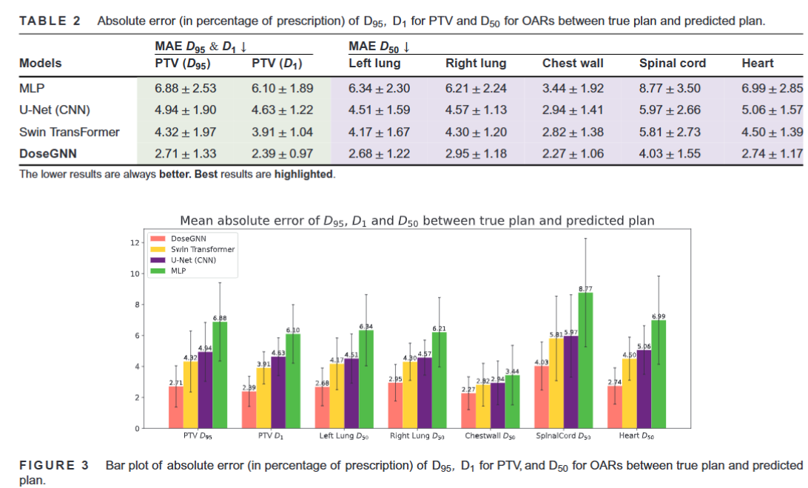
Result_ Dose coverage

Slide 8
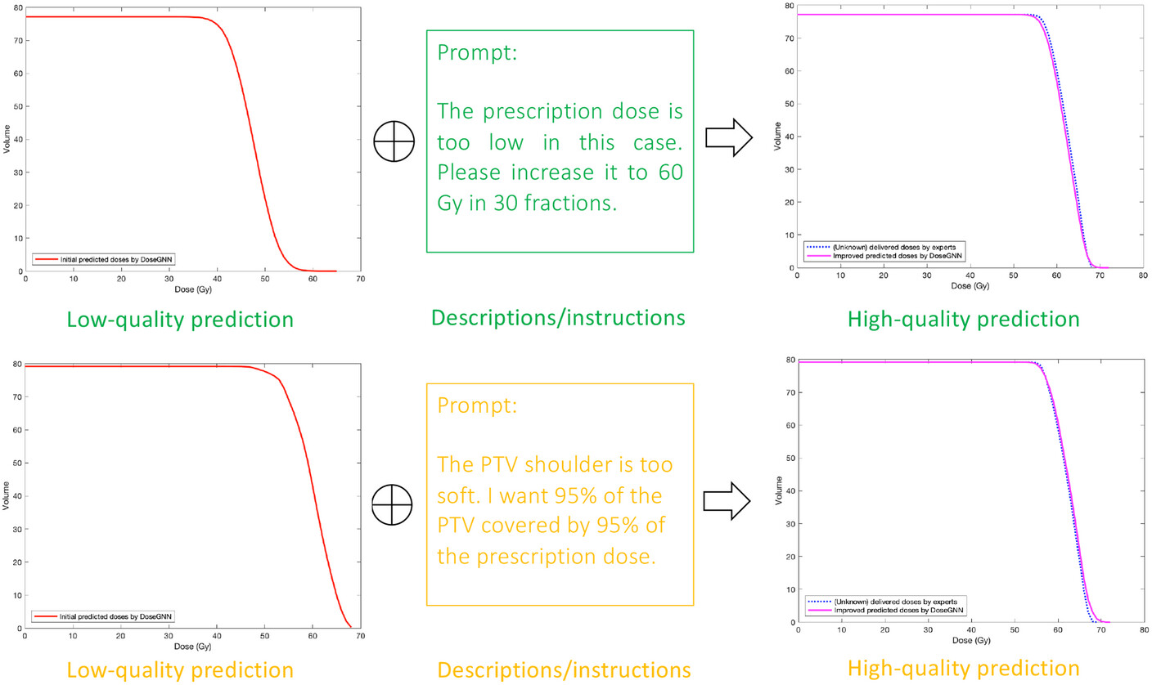
Effectiveness of LLMs
Clinicians can optimize DoseGNN outcomes with prompts/instructions. The dashed blue lines in the figure represent CDVHs from unknown delivered doses in clinical plans.
Notes:
Clinicians can actively guide the DoseGNN model using prompts to improve predictions. users can spot poor predictions and refine them using LLM-assisted intervention.

Slide 9
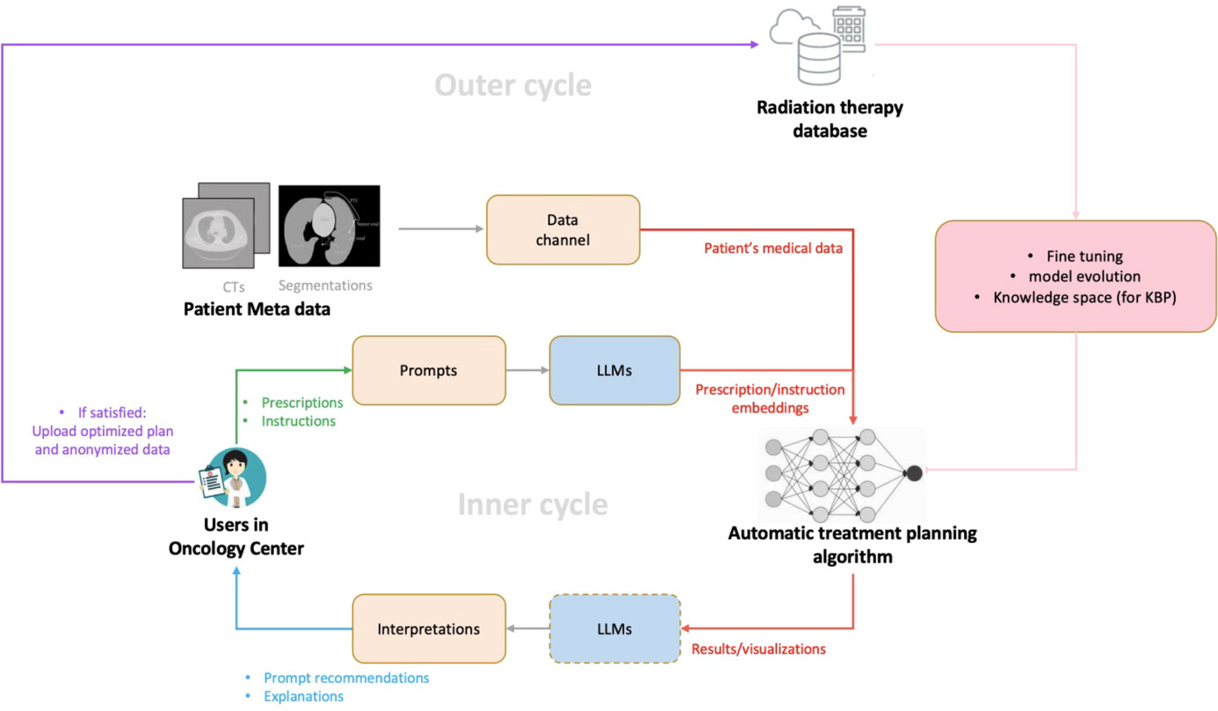
The Online Human-AI Collaboration System addresses the shortage of high-quality IMRT treatment plans by integrating clinician expertise into AI-driven automatic treatment planning, improving model training and optimization.
OHAC proposal
Notes:
Innere circle LLMs enhance automation algorithms by interpreting clinician inputs, enabling iterative plan improvements. This platform-user collaborative system ensures personalized, high-quality radiotherapy while continuously advancing AI-driven automation.
Move to the outer loop One of the biggest challenges in AI-driven radiotherapy is the limited number of high-quality treatment plans for training. Without diverse, well-optimized plans, AI models struggle to generalize effectively across different patients. The OHAC System tackles this problem by seamlessly integrating clinician expertise into AI training and optimization.
This system will allows clinicians from cancer centers to interact with the same deep learning models through an interface powered by LLM to facilitate the collection of evaluation and alternations(s) suggested by clinicians. The modified plans provided by clinicians will serve as high-quality input for continuous training and improvement of the deep learning model.
.
______________________________________________________________________________________________________________________

Slide 10
Conclusion
DoseGNN can achieve the most accurate prediction of the clinically delivered dose and significantly outperforms existing state-of-the-art deep learning models.
LLMs-based interaction can effectively enhance the performance of treatment planning algorithms and provide highly personalized treatment planning by incorporating clinician's instructions/prescriptions.

