Slide 1
Dynamic reconstruction and motion estimation framework for cardiorespiratory
motion-resolved real-time volumetric MR imaging (DREME-MR)
Hua-Chieh Shao
Supervisor: Dr. You Zhang

Slide 2
Background – Real-time imaging and motion tracking
For thoracic and abdominal patients, variations in target position and shape caused by anatomical motion is a major source of uncertainties in radiotherapy.
Real-time imaging provides instantaneous anatomical information for image guidance and treatment adaptation.
Previously, we have developed a joint dynamic reconstruction and motion estimation (DREME) framework for real-time CBCT imaging and motion tracking via a single arbitrarily-angled x-ray projection.

Slide 3
Background – Dual-task learning of DREME and DREME-MR
DREME:
Derives a data-driven motion model based on a standard pre-treatment scan.
Dynamic CBCT ($\sim$15 frames/s) provides richer motion information and captures irregular motion.
We extended DREME to dynamic MRI reconstruction and MR-guided real-time imaging (DREME-MR).
Given DREME-MR’s high spatiotemporal resolution, we extended DREME-MR’s motion model to include cardiac motion.

Slide 4
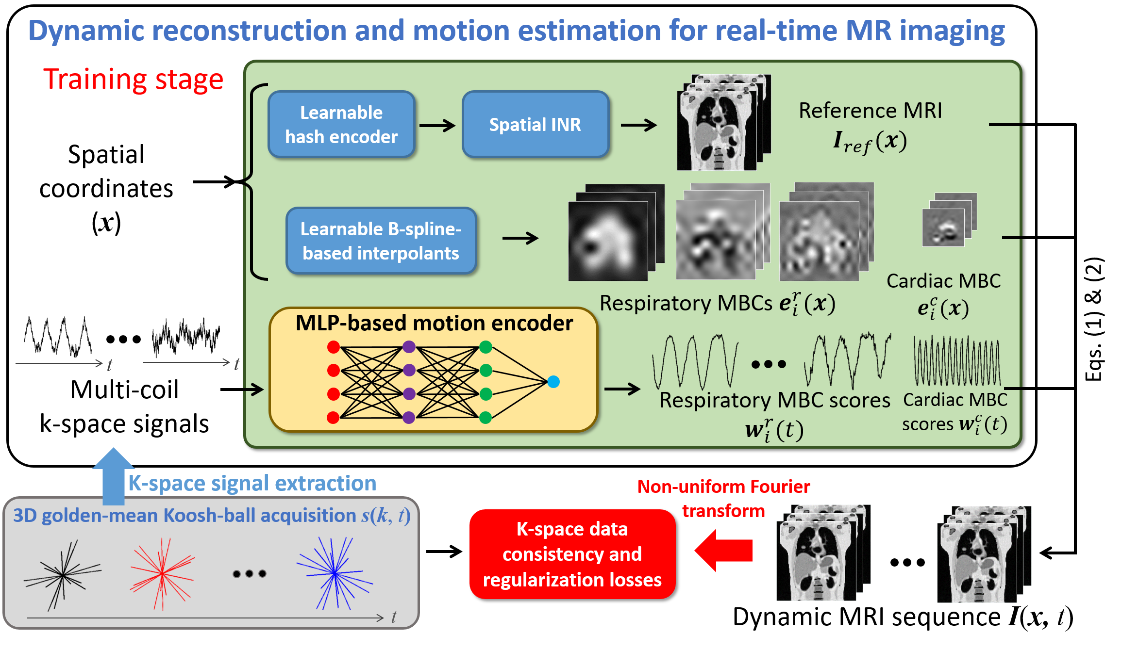
Method – DREME-MR workflow
Joint reconstruction and deformable registration algorithm:
Low-rank motion model:
Sequential deformable registration for cardiorespiratory motion:

Slide 5
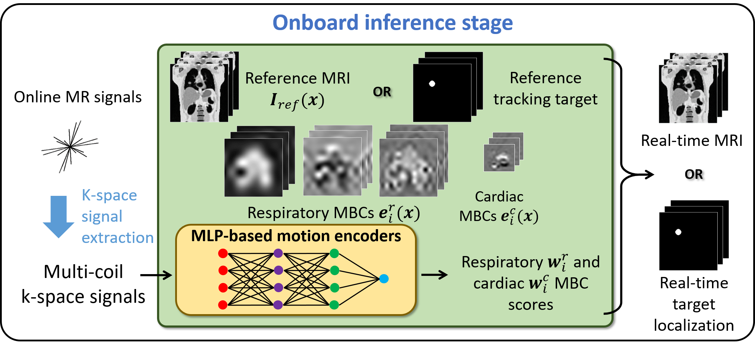
Method – DREME-MR real-time imaging and motion tracking
Latency = acquisition time $\sim$150 ms + Inference time < 10 ms

Slide 6
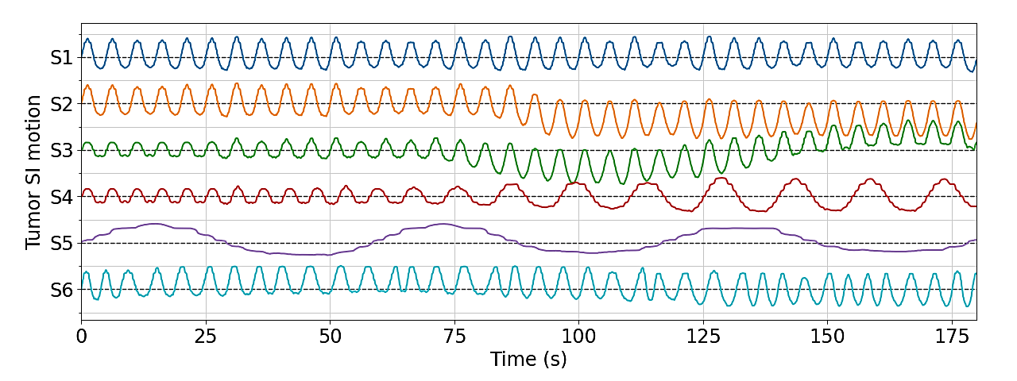
Materials and evaluation
XCAT simulation study
Six motion scenarios were simulated, featuring variations in motion amplitude, frequency, and pattern.
Cross-scenario testing (lung tumor and left ventricle).
Healthy human study

Slide 7
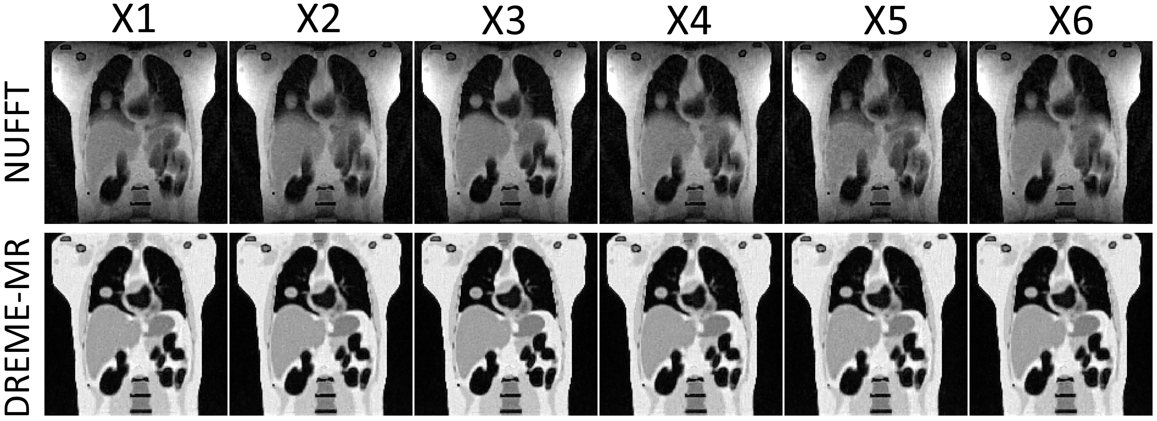
Results – XCAT reference-frame MRI

Slide 8
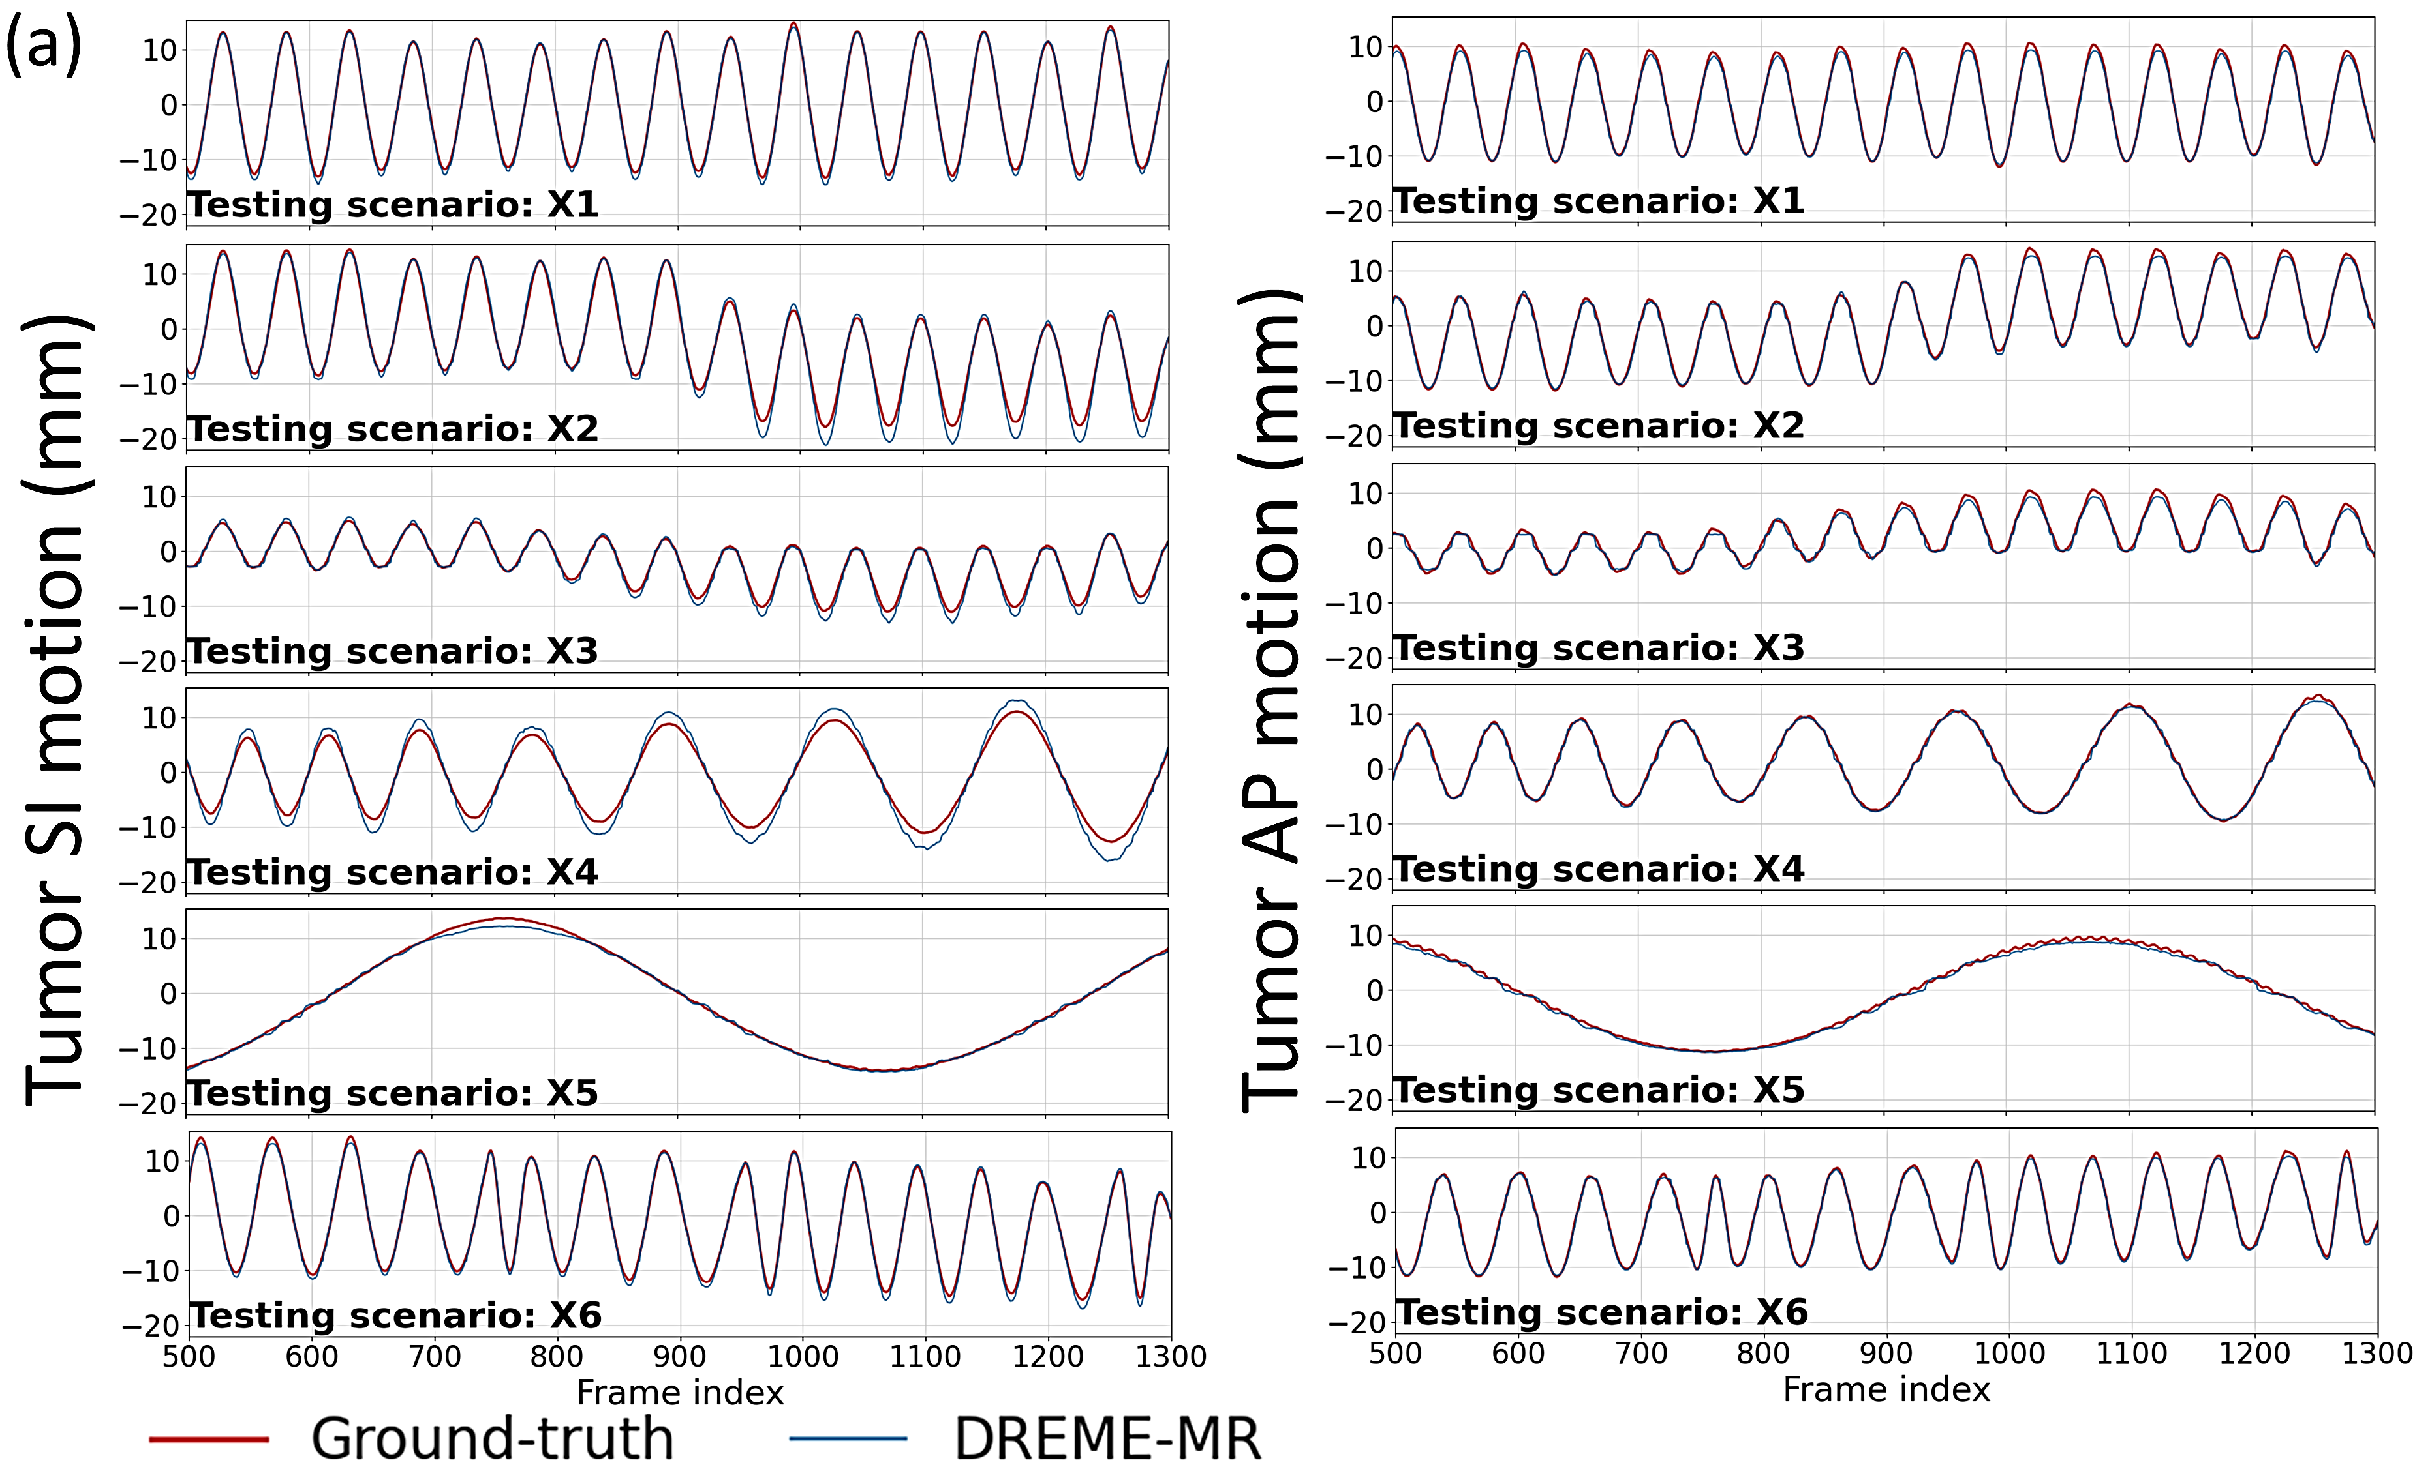
Results – XCAT lung tumor tracking accuracy
Training scenario: X1

Slide 9
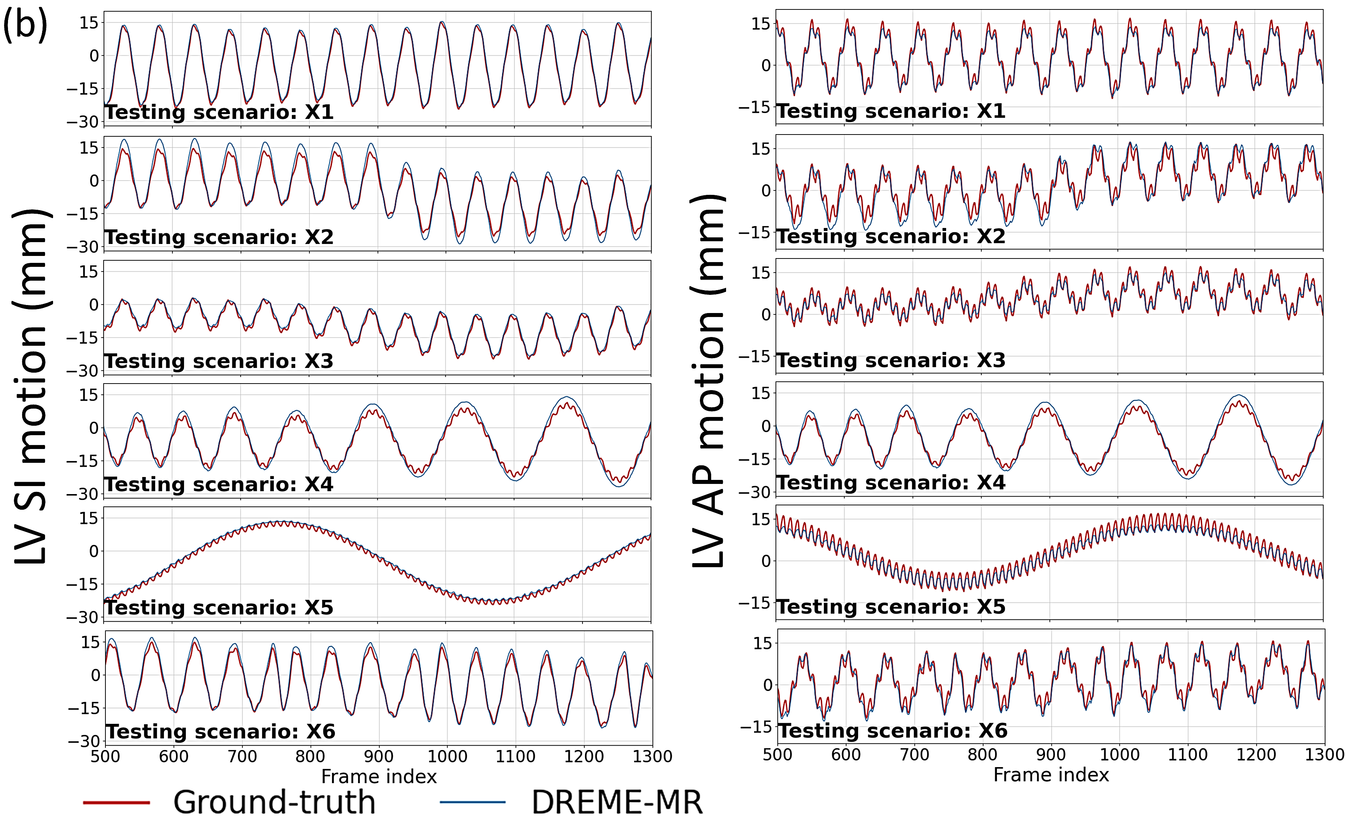
Results – XCAT left ventricle tracking accuracy
Training scenario: X1

Slide 10
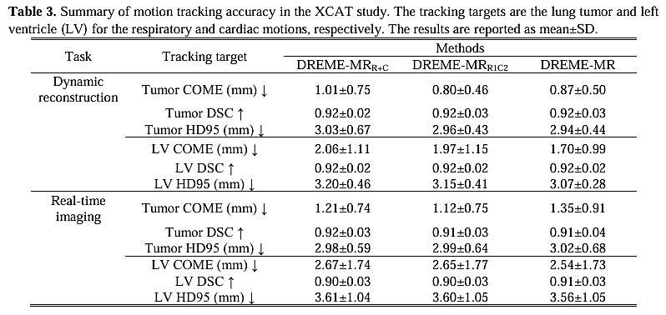
Results – XCAT motion tracking accuracy

Slide 11
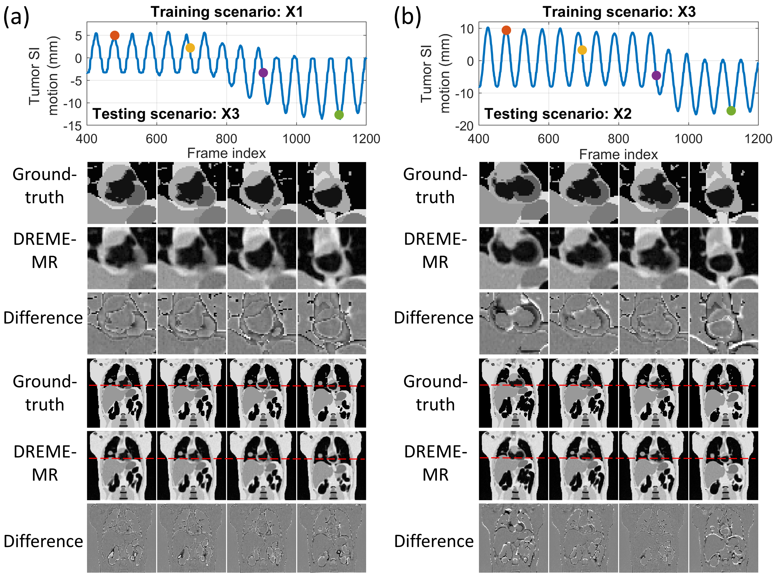
Results – XCAT real-time imaging

Slide 12
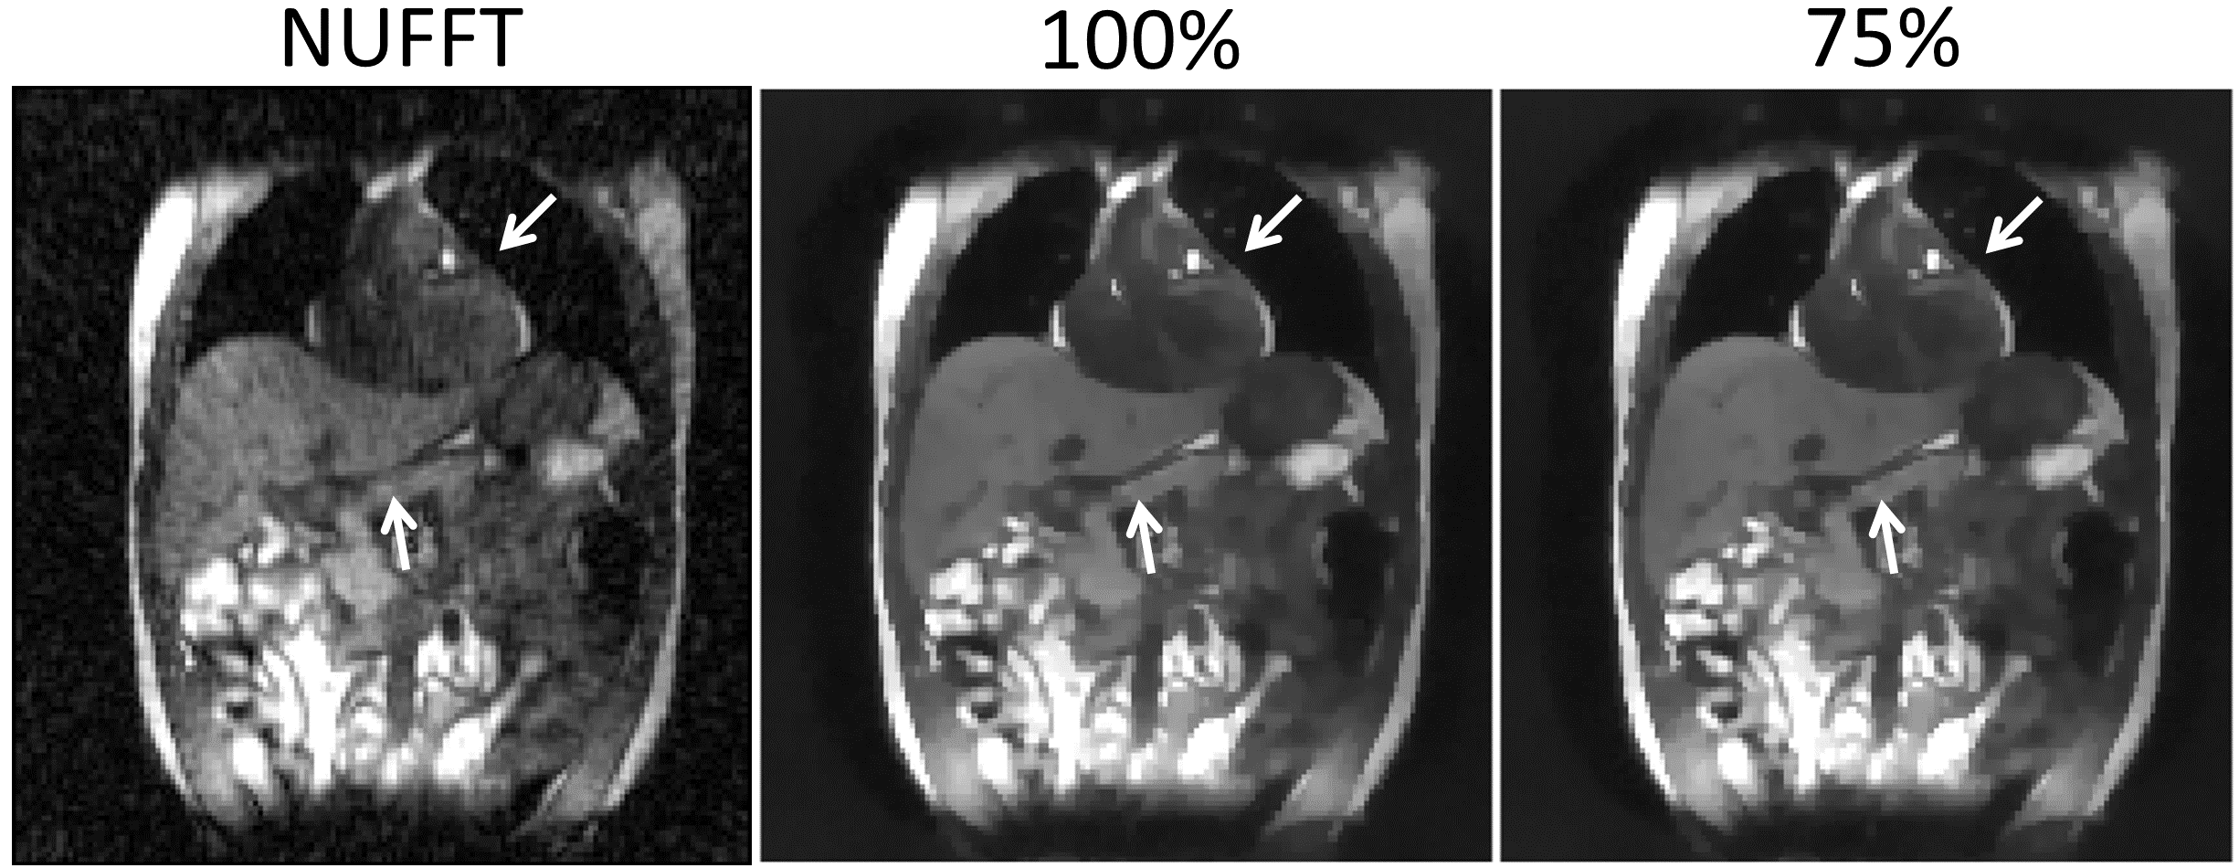
Results – Healthy human subject

Slide 13
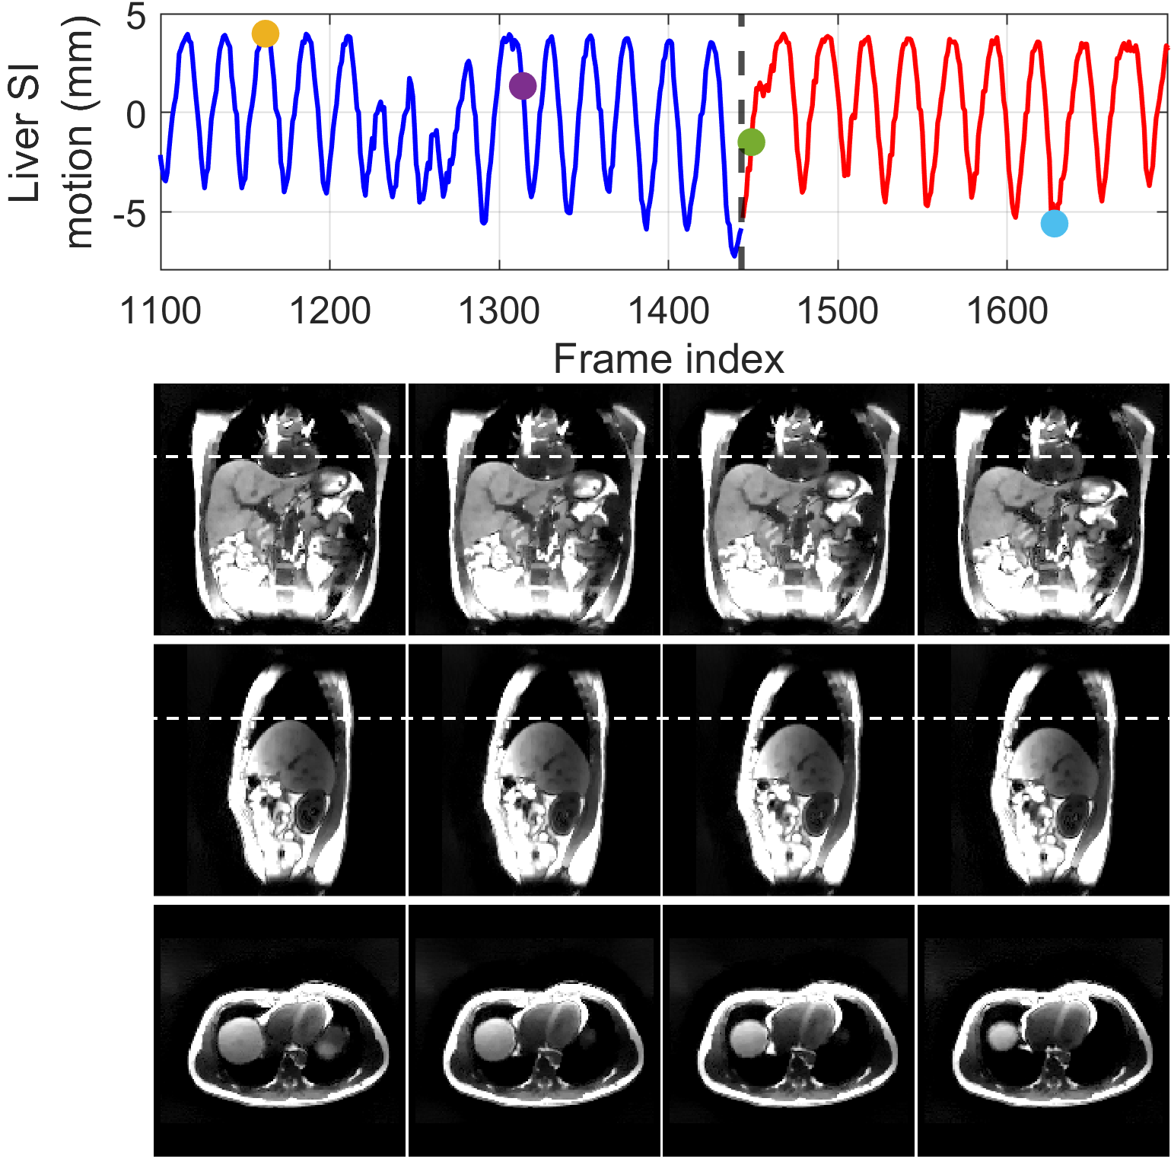
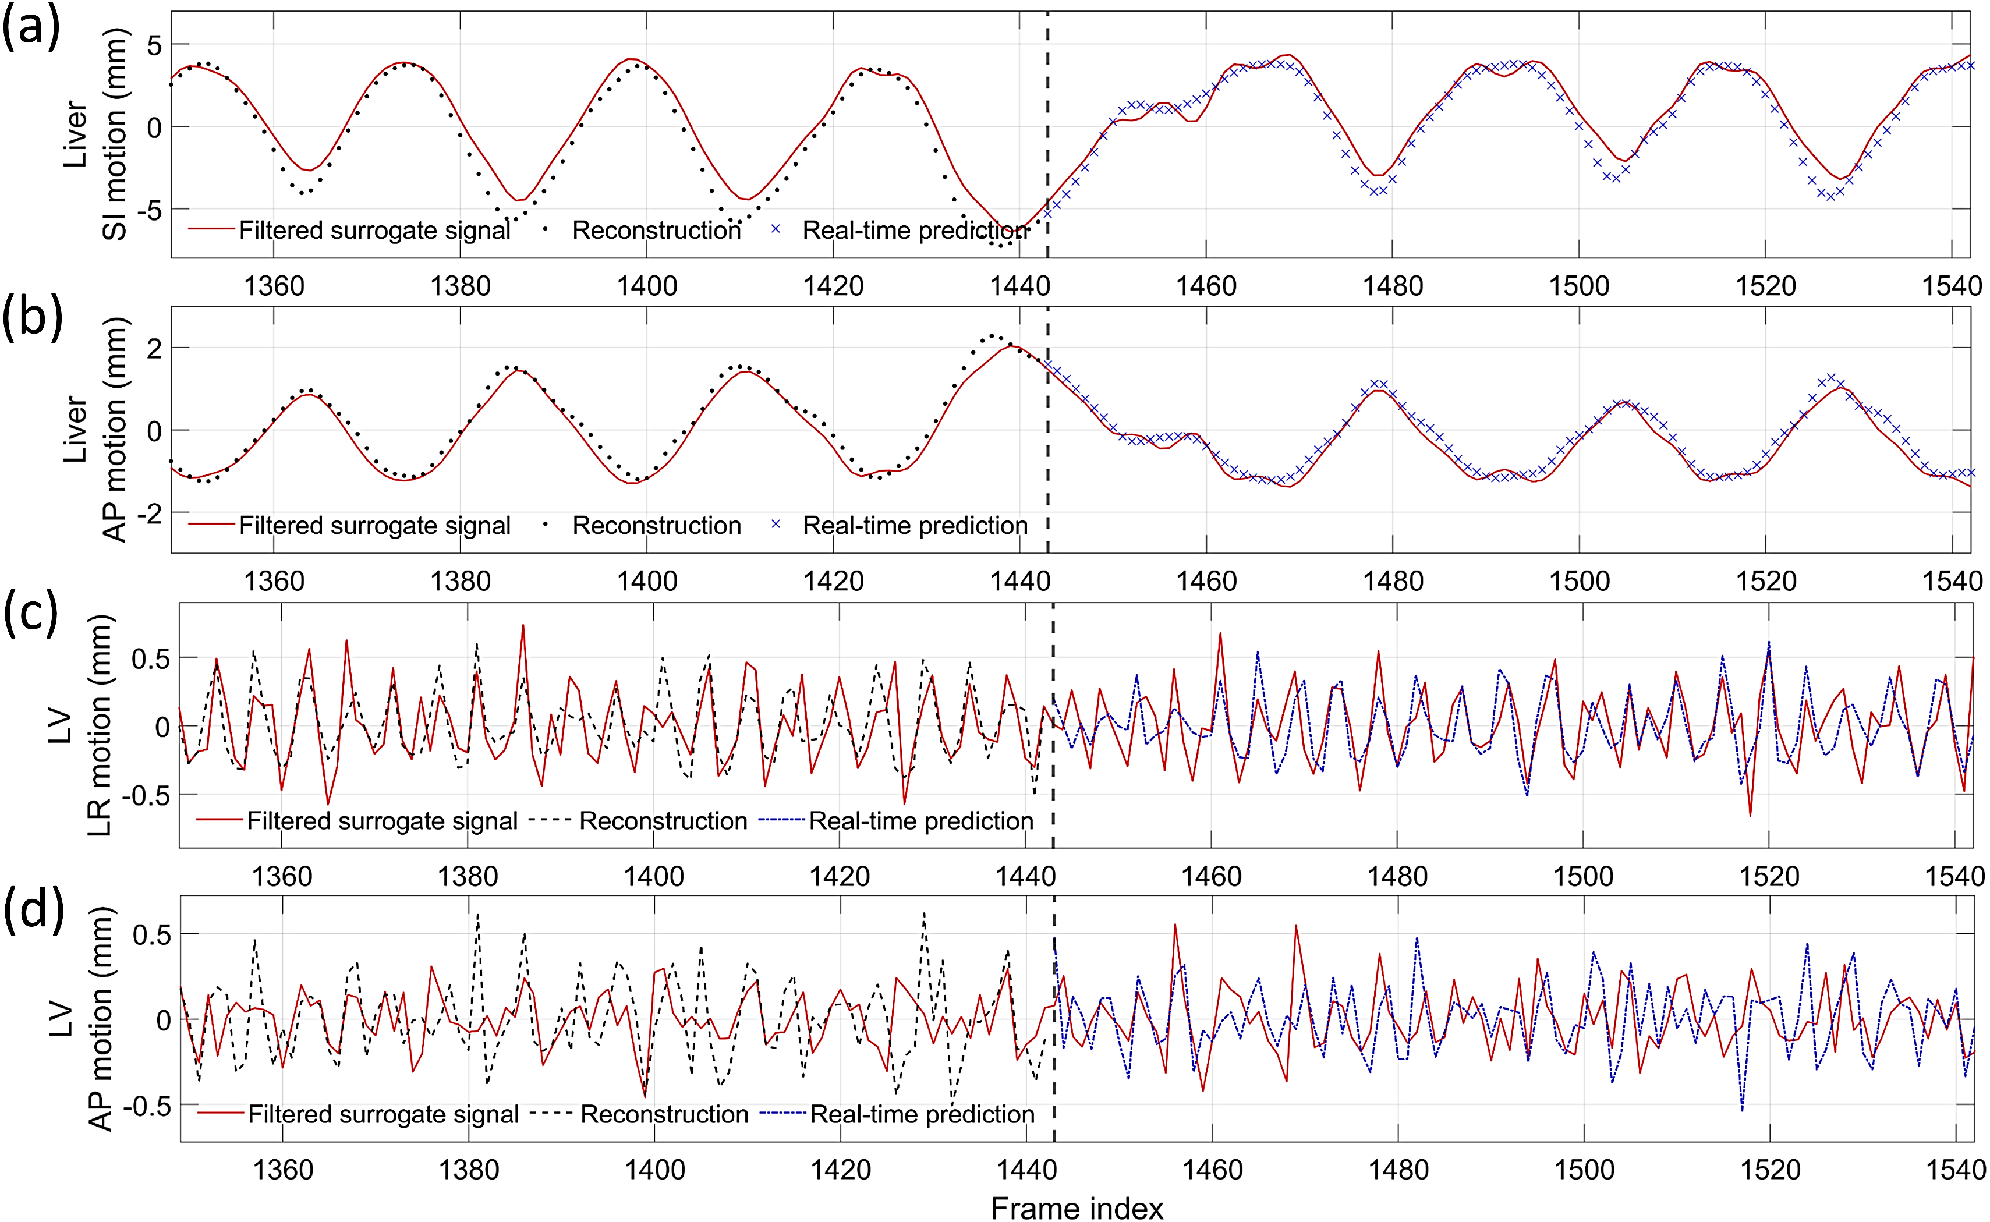
Results – Healthy human subject
Dynamic reconstruction ←
→ Real-time imaging

Slide 14
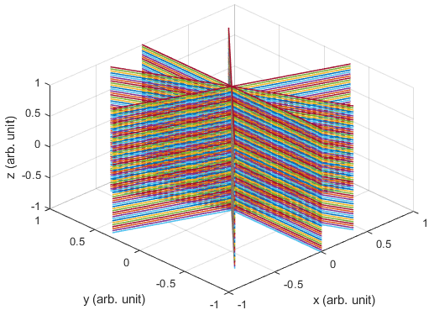
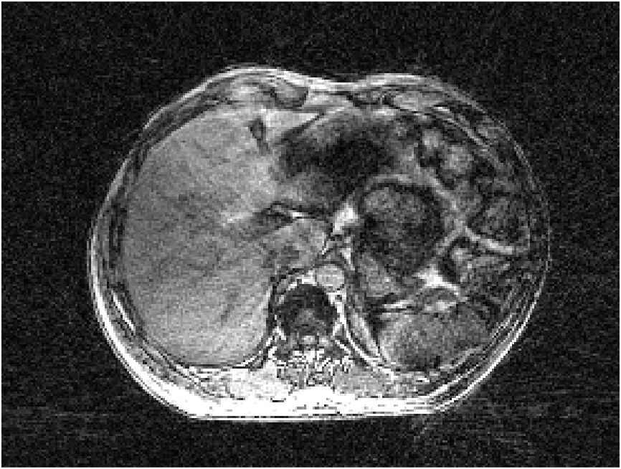
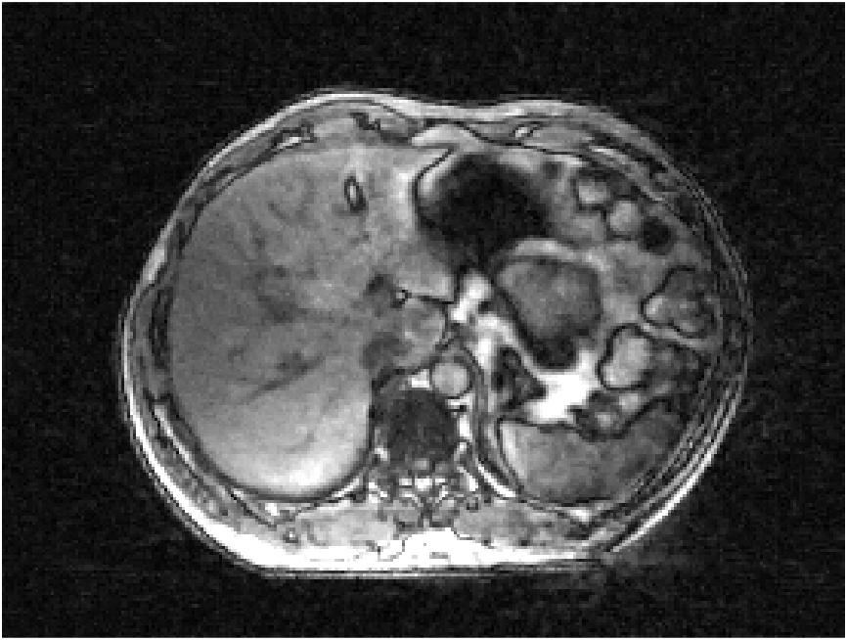
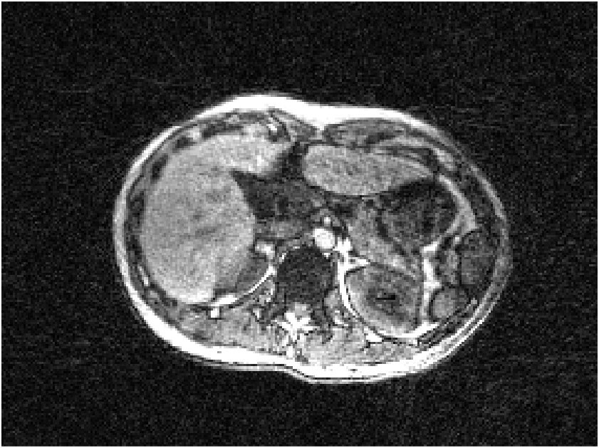
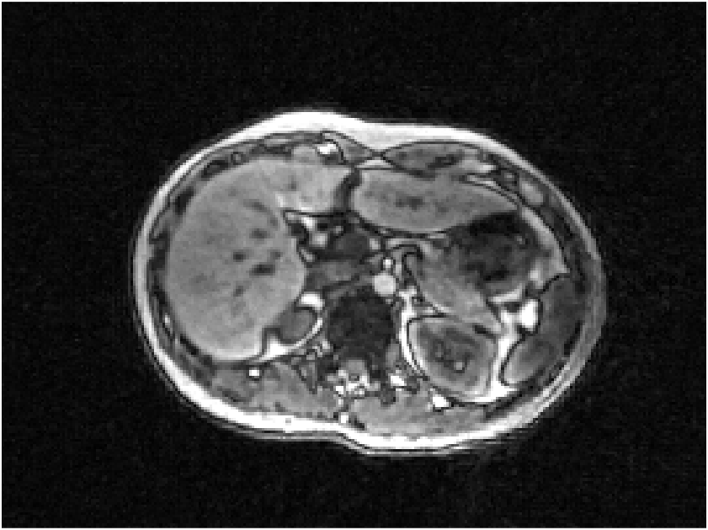
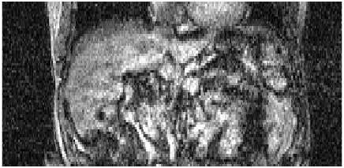
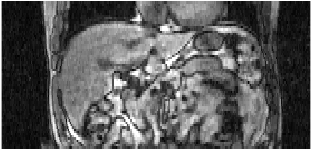
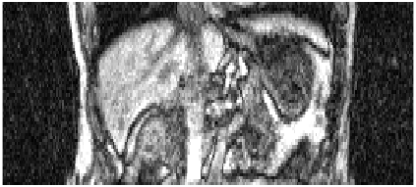
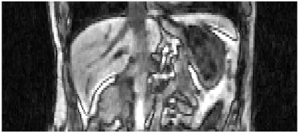
Results – Volunteer scan on Unity scanner
Volunteer 1
Volunteer 2
NUFFT
DREME-MR
NUFFT
DREME-MR

Slide 15
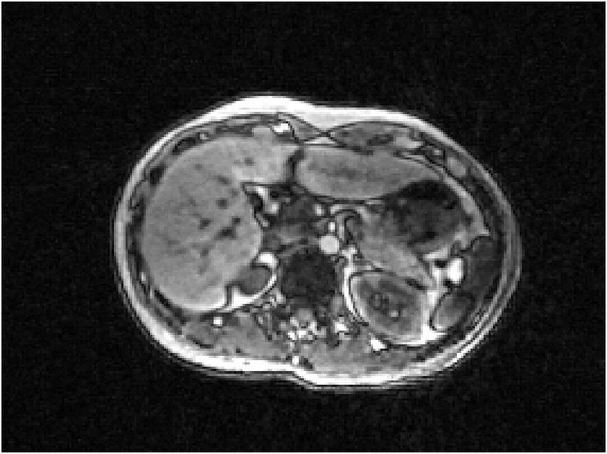
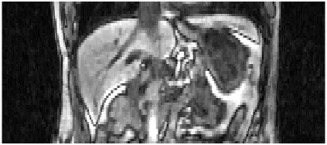
Results – Volunteer scan
Scan 1
Scan 2
Real-time prediction
Dynamic MRI reconstruction
Difference image

