Slide 1
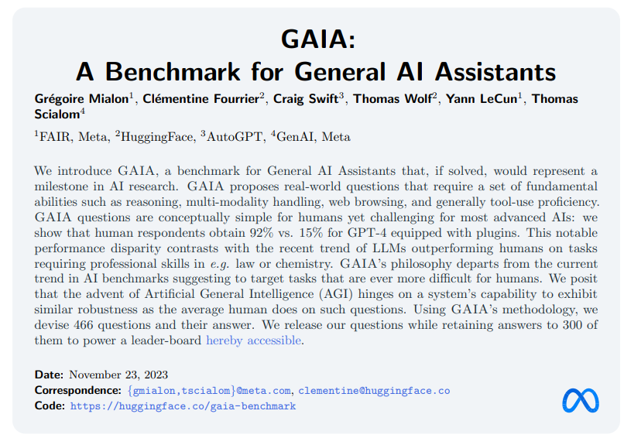

Slide 2
Current limitations of general AI benchmarks
Current benchmarks are quickly saturated by LLMs
Current benchmarks focus on tasks hard for human
Some tasks are hard to evaluate by human
Model-based evaluation doesn’t work for best models
Some daily tasks of human remain unsolved by AI
Reasoning is not evaluated by current benchmarks

Slide 3
GAIA is a general AI assistant benchmark
Alternatively to tasks that are harder for humans, AI systems could be asked to solve conceptually simple tasks yet that require accurate execution of complex sequences of actions, with large combinatorial spaces.
Real-world and challenging questions
Easy interpretability through conceptually simple tasks
Non-gameability.
Simplicity of use.
Even equipped with tools, GPT4 does not exceed a 30% success rate for the easiest of our tasks, and 0% for the hardest.

Slide 4
Sample GAIA questions

Slide 5
Questions overview

Slide 6
GPT example

Slide 7
LLM overall performance

Slide 8
Current leaderboard

Slide 9
Discussion
The capabilities of models closed behind APIs might change over time
Making GAIA evolve year-by-year through the removal of broken questions and the addition of new ones might be an important
GAIA considers the system as a whole and does not attribute errors to sub-parts
Solving GAIA requires full automation since no approximation is allowed in the answer.
Limitations: In its current form, GAIA does not evaluate the trace leading to the answer; two rounds of annotations are required; Lack of linguistic and cultural diversity.

