Slide 1
A Multi-Modal Deep Learning Framework for Predicting PSA Progression-Free Survival in Metastatic Prostate Cancer Using PSMA PET/CT Images
Hamid Ghaderi, Ph.D.
Postdoctoral Researcher
Medical Artificial Intelligence and Automation (MAIA) Laboratory
Department of Radiation Oncology
hamid.ghaderi@UTSouthwestern.edu

Slide 2
A Multi-Modal Deep Learning Framework for Predicting PSA Progression-Free Survival in Metastatic Prostate Cancer Using PSMA PET/CT Images
Hamid Ghaderi ^{a, b}, Chenyang Shen ^{a, b}, Wadih Issa ^{c}, Tian Zhang ^{c}, Jing Wang ^{a, b}, Daniel X. Yang ^{a, b}
ª Medical Artificial Intelligence and Automation Laboratory, Department of Radiation Oncology, University of Texas Southwestern Medical Center, Dallas, TX, USA
^{b} Department of Radiation Oncology, University of Texas Southwestern Medical Center, Dallas, TX, USA
^{c} Division of Hematology and Oncology, Department of Internal Medicine, University of Texas Southwestern, Dallas, TX, USA

Slide 3
Introduction
Metastatic prostate cancer (mPCa) is heterogeneous with a high mortality rate
Prostate-Specific Antigen Progression-Free Survival (PSA PFS) measures the time a prostate cancer patient remains without PSA level increase.
Accurate PSA PFS prediction is essential for personalized treatment strategies.
The deep learning survival prediction models utilizing positron emission tomography (PET) scan and a computed tomography (CT) scan outperform single-modality models.
Notes:
In this research we have focused on the prediction of ..
PSA PFS is defined as ..
Literature review of the survival prediction models show that

Slide 4
Introduction
Prostate-specific membrane antigen (PSMA) PET offers high-sensitivity detection of metastatic lesions.
Deep learning-based prediction of PSA PFS using PSMA PET/CT images is quite new.
We developed a deep learning framework integrates PSMA PET/CT images and clinical features for PSA PFS prediction.
We used PSMA PET/CT images cropped around the lesions rather than whole-body images.
Notes:
As for the metastatic prostate cancer, PSMA PET images enhance the detection of metastatic lesions with greater sensitivity.
Prediction of PSA PFS using deep learning models with PSMA PET/CT images as input is quite new and has not been adequately addressed.
So, in this work, we developed a multi-modal deep learning model.
Furthermore, we used … to enhance feature extraction and reduce background noise.

Slide 5
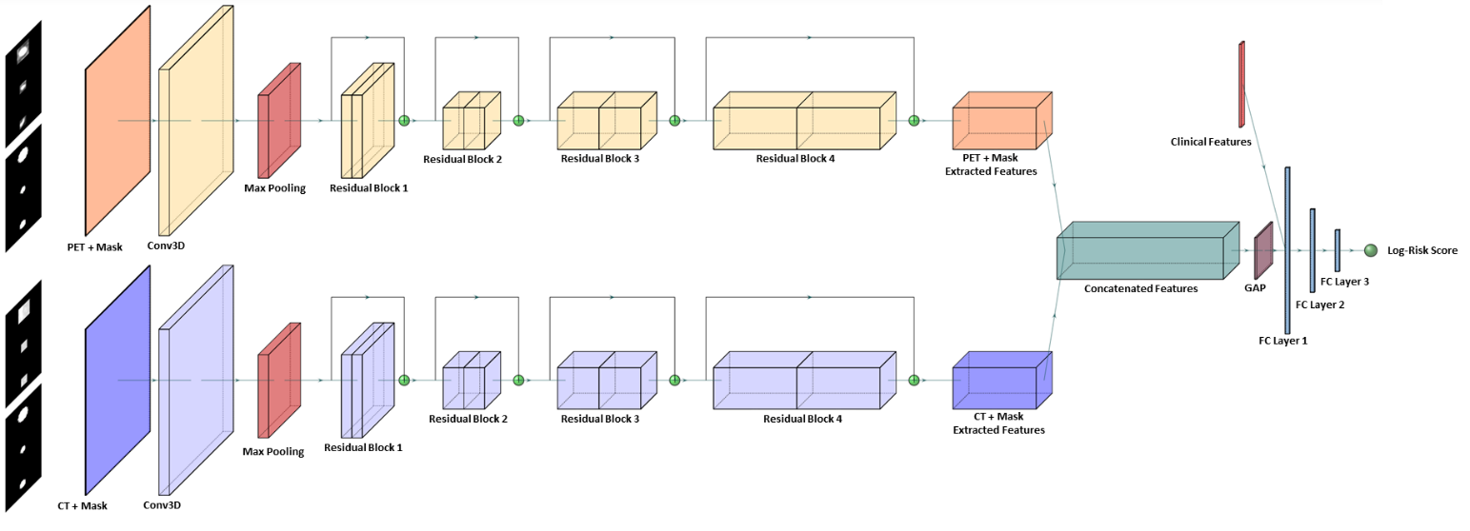
Model Architecture
Notes:
Our model is based on ResNet architecture that is known for its use of residual blocks with skip connections that address the vanishing gradient problem in deep networks.
Our ResNet-based survival prediction model has two imaging modalities, namely PET and CT where each modality processes the given image along with its respective lesion bounding box mask.
The PET and mask images are concatenated along the channel dimension and passed through a 3D ResNet model for feature extraction.
A similar process is applied to the CT and mask images using the same ResNet architecture.
Following feature extraction, the model concatenates feature vectors from both modalities. Then, to preserve essential information while reducing spatial dimensions, a GAP layer is applied. The resulting feature vector is then concatenated with the clinical features and passed through three fully connected layers, where the first two layers employ ReLU activation functions, and the final layer outputs a single numerical prediction representing log-risk score.

Slide 6
Datasets
Collected Data:
PSMA PET, CT, Mask images as well as clinical features from 99 patients diagnosed with metastatic prostate cancer
20 patients are uncensored; they have experienced PSA progression
79 patients are censored
Inclusion Criteria:
Patients who underwent a PSMA PET/CT scan around the time of systemic therapy initiation
Exclusion Criteria:
Patients with missing either PSMA PET or CT scan
Data Composition in Five-Fold Cross-Validation:
Training Fold: 80% of samples
Validation Fold: 20% of samples (80% censored and 20% uncensored)
Notes:
We trained the model through 5-fold cross-validation and didn’t use a separate test set. Instead, we tested the model with the entire samples in the dataset.
We made sure to include the same portion of censored and uncensored samples in each validation fold considering the size of censord and uncosored samples in our dataset.

Slide 7
Data Preprocessing
Clinical Features Preprocessing:
Impute missing data with k-nearest neighbors.
Convert categorical variables using one-hot encoding.
Normalize variables to a 0–1 range.
Image Resampling and Normalization:
Resample PET, CT, and masks to target size (256, 256, 256) and target spacing (1, 1, 1).
Normalize PET using 2nd/98th percentile intensities.
Normalize CT using a fixed transformation formula: (CT Value - CT Value of Air)/1000.
Notes:
Before training the model, all images and clinical features underwent data preprocessing.
For clinical features, we used …
For images, we resamples pet, ct, and mask images so that they have the same size and spacing.
For normalizing pet images, we used their the 2nd and 98th percentile intensities and for normalizing CT images we used a fix transformation formula to scale them to a range around 0 and 1

Slide 8
Lesion Identification and Adaptive Cropping
Identify lesions via connected component analysis on masks.
Compute lesion centers and dimensions.
Crop images using a volume box twice the size of lesion mask.
Pad crops to the maximum crop size across patients.
Concatenate crops along the depth dimension.
Pad to achieve uniform global size.
Notes:
We used a connected component analysis to detect the lesions. And then cropped the lesions with a crop volume box twice the size of the lesion to ensure that the entire lesion and its sounding context is captured.
For lesions of each patient, we padded each crop to the size of the largest crop across the patients. And then concatenated the crops along the depth dimension. And since the number of lesions is different across the patients, we padded the the the concatenated crops to achieve a uniform global size.

Slide 9
Data Augmentation
Augment per-lesion basis to enhance diversity and address class imbalance.
Apply random affine transformations with rotations up to 90° and translations up to 10 voxels.
Flip images randomly along all three spatial axes.
Inject random Gaussian noise to PET and CT channels.
Augment uncensored samples five times more than censored ones.
Notes:
We used off-line data augmentation to increase the size of the dataset and balance the number of censored and uncensored samples. In this regard, we used random office transformations, random flip and random noise.
Also, considering the size of the censored and uncensored samples in the dataset, we augmented uncensored samples five times more than censored samples.

Slide 10
Training Procedure
Adam optimizer
Initial learning rate of 10⁻⁴ and dynamic learning rate scheduling.
Dropout rate of 0.3 in the fully connected layers
Apply L1 regularization with a λ value of 10⁻⁴
Train the model on an NVIDIA A100 GPU for 300 epochs

Slide 11
Performance (C-Index) Comparison of Models Trained with Different Loss Functions
Notes:
We test three different loss function, including ..
CoxPH loss: Optimizes log-partial likelihood to rank patient risks while accounting for censoring.
Pairwise ranking loss: Compares patient pairs to ensure shorter survival times correspond to higher predicted risks.
Hybrid CoxPH and C-MSE loss: Integrates risk ranking with a censored MSE penalty to align predictions with observed survival times.
And use C-index to compare the performance of the models.
the model trainied using CoxPH Loss got the highest validation c-index across all 5-folds of cross validation. So we used this loss function in the rest of our analysis.

Slide 12
Performance (C-Index) Comparison of Survival Prediction Models with Different ResNet Backbones
Notes:
To evaluate the impact of network depth on survival prediction performance, we trained the model using three different ResNet backbones: ResNet-10, ResNet-18, and ResNet-34. For each backbone, we assessed two configurations: one using only imaging data and another incorporating both imaging and clinical features.
Across all model configurations, ResNet-18-based models achieved the highest overall performance. Notably, the ResNet-18 model incorporating clinical features consistently outperformed its image-only counterpart, reaching the highest observed C-index of 0.94 in Fold 5

Slide 13
Performance (C-index) Comparison of Clinical Features Only, Image-Based, and Hybrid Models
Notes:
To assess the predictive capacity of imaging data and clinical features, we compared three models: (1) a Cox proportional hazards model based only on clinical features, (2) an image-based deep learning model without clinical features, and (3) an image-based deep learning model that incorporates clinical features.
The Cox proportional hazards model using only clinical features demonstrated the lowest predictive performance across all five folds. This result indicates that while clinical variables provide prognostic information, their predictive capacity is limited when used alone. On the other hand, the image-based deep learning model incorporating both imaging and clinical features consistently outperformed both models, which emphasizes the benefit of incorporating clinical features into the image-based deep learning framework to enhance prognostic accuracy.

Slide 14
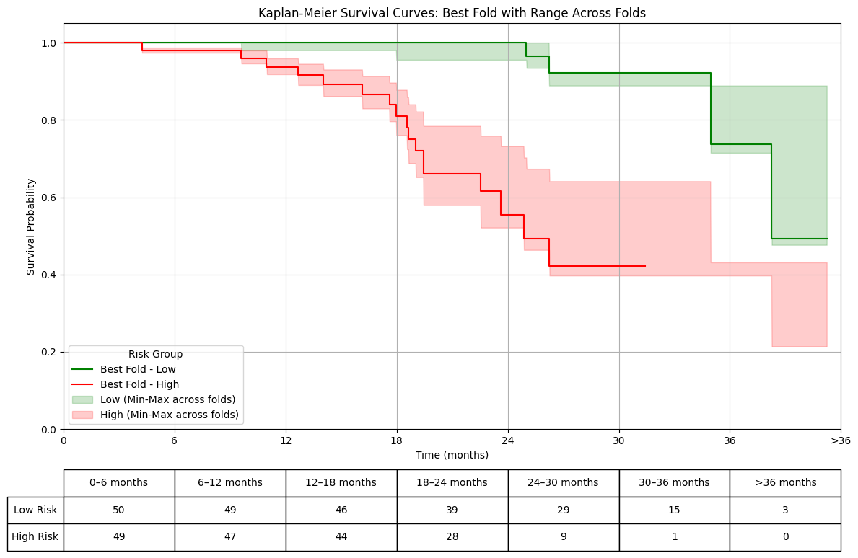
Kaplan-Meier Survival Analysis and Risk Stratification
Notes:
we stratified patients into low-risk and high-risk groups based on the median risk score cutoff and performed performed Kaplan-Meier (KM) survival analysis. These curves demonstrate a clear separation between the Low risk and high-risk groups, with the high-risk group exhibiting significantly worse survival probability compared to the low-risk group

Slide 15
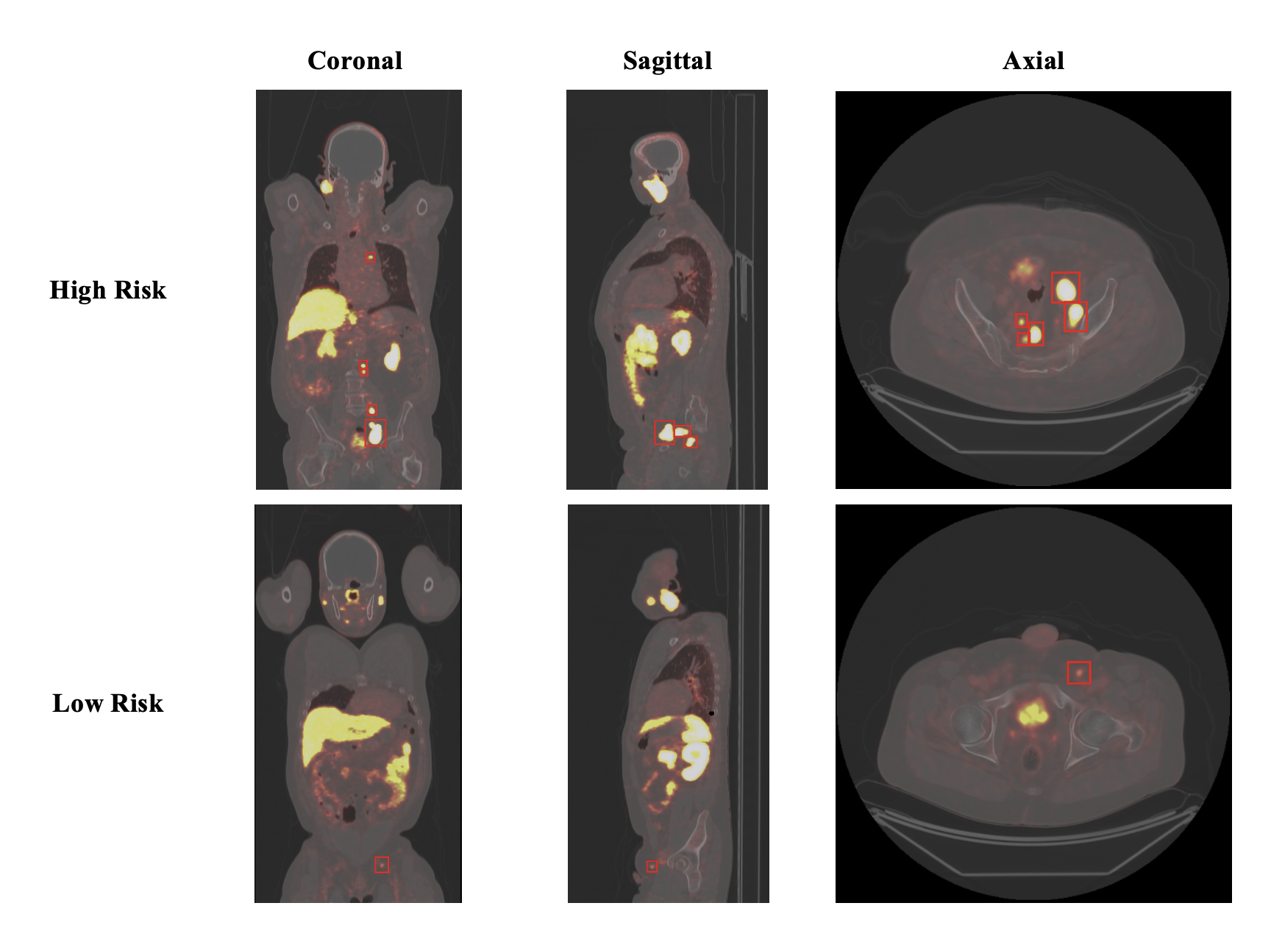
Representative Whole-Body PSMA PET/CT Images with Lesion Annotations for High-Risk and Low-Risk Patients
Notes:
Here you see the PSMA PET/CT images of two representative patients. One from high-risk category and the other one from low-risk category, with red bounding boxes highlighting detected lesions.
As you can see the high-risk patient exhibits more and larger lesions with high metabolic activity, which is consistent with an aggressive disease phenotype and shorter PSA PFS values.
In contrast, the low-risk patient presents with fewer and smaller metastatic lesions, which are more localized compared to those in the high-risk group. They also have relatively lower SUV max values which is consistent with less a aggressive disease phenotype and longer PSA PFS values.

Slide 16
Future Research Directions/Next Steps
Increase the number of uncensored samples.
Utilize larger, multi-center datasets.
Perform external validation.
Compare performance with alternative deep learning backbones, such as ViT.

Slide 17
