Slide 1
Image Processing GNN: Breaking Rigidity in Super-Resolution
Yuchuan Tian, Hanting Chen, Yunhe Wang
National Key Lab of General AI, Peking University
Huawei Noah’s Ark Lab

Slide 2
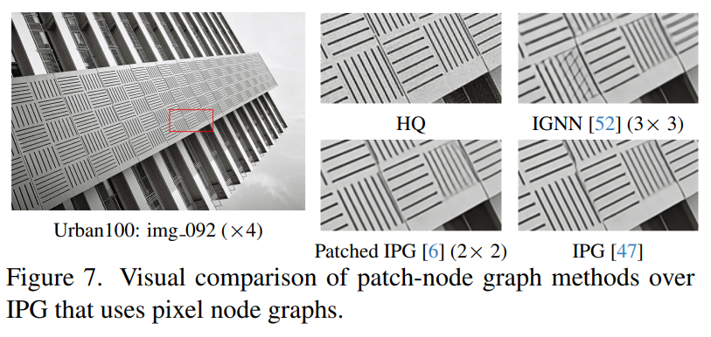
Overview
Super Resolution (SR)
Reconstruct high-resolution images from low-resolution ones
Problem with other models
Pixels are treated in a rigid structure
Pixels get information from a fixed number of pixels within a fixed neighborhood
i.e. convolution, self-attention
Other solutions
Enlarging self-attention grid, using striped global attention windows
Try to overcome rigidity
But: large computational burden
Graph based methods
Graphs constructed from image patch nodes
Overlook lopsided nature of SR

Slide 3
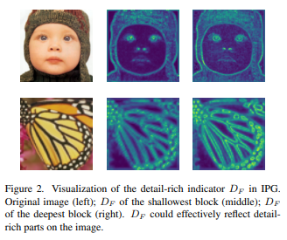
SR with flexibility
Nature of SR:
Unbalanced among different image regions
Only portion of high frequency pixels need reconstruction
Other parts need minimal restoration
Other IR methods
Rigid, treating all parts/pixels of an image equally
i.e. k-nearest neighbors, 3x3 grids
Image Processing GNN (IPG)
Degree + Spatial flexibility
Detail rich nodes $→$ more connections

Slide 4
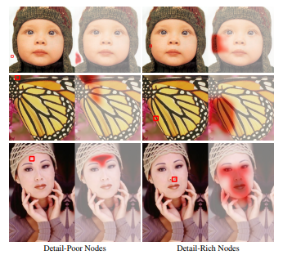
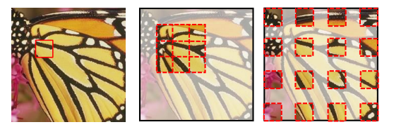
Image Processing GNN
Graph construction
Degree Flexibility
Detail-rich indicator $→$ number of connections
Pixel nodes
Space Flexibility
Local graphs
Connections based on local sampling
Global graphs
Connections based on global sampling
Graph Aggregation
Edge conditioned communication between nodes
Detail-rich indicator, $D_{F}$
Node
Local Sampling
Global Sampling

Slide 5
IPG Architecture
Local and Global graphs alternate sequentially in GALs
Image reconstructed through pixel-shuffle upsampler

Slide 6
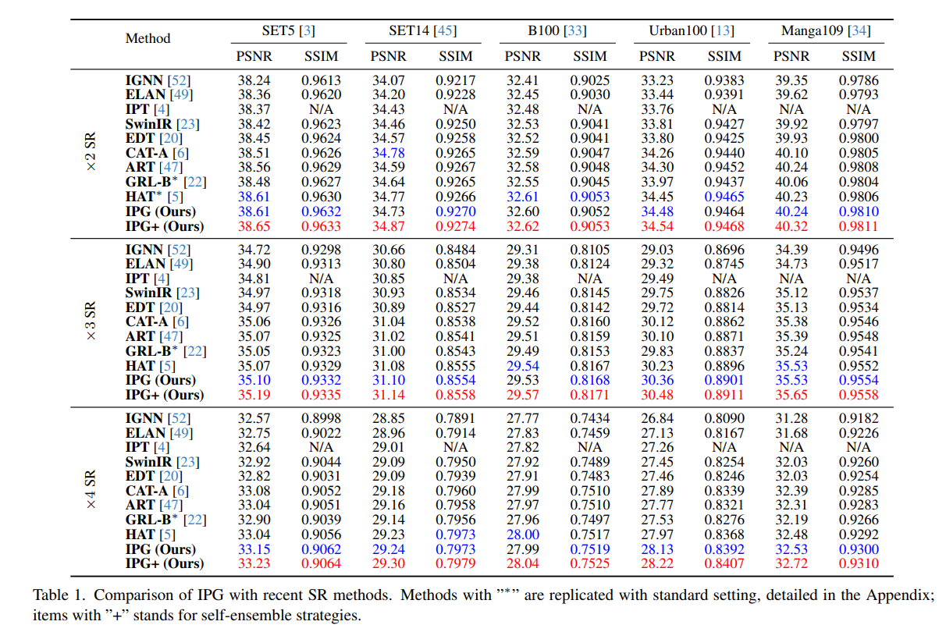
Results
Compare IPG model with other SR methods
xN SR $→$ resolution increase
x2 $→$ double image size

Slide 7
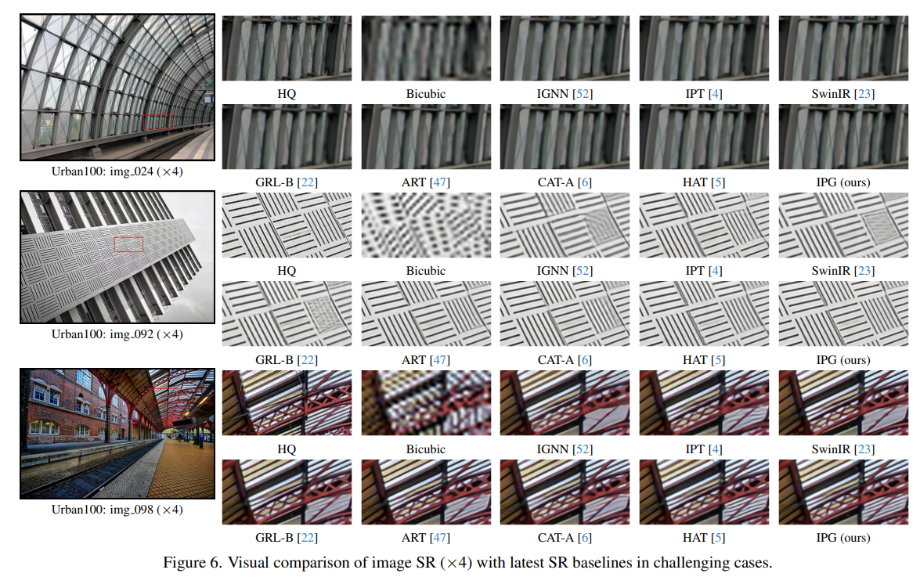
Visual Results
SR x4

Slide 8
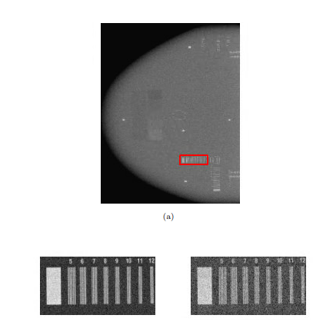
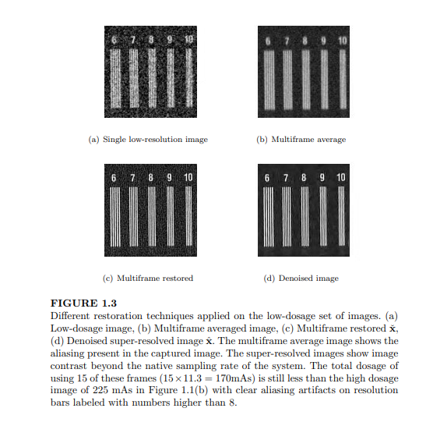
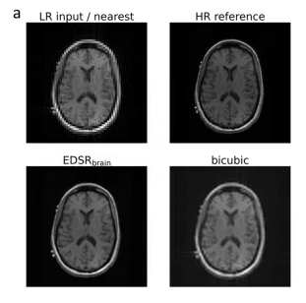
Medical Applications
Increase image resolution without increased dose
SR in adaptive MRI-guided radiation therapy
Increased spatial resolution without compromising temporal resolution
High dose
Low dose

Slide 9
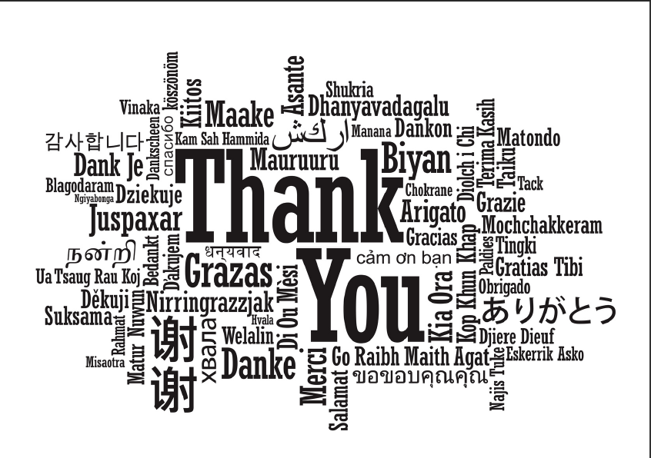
Acknowledgement
MAIA Lab

