Slide 1
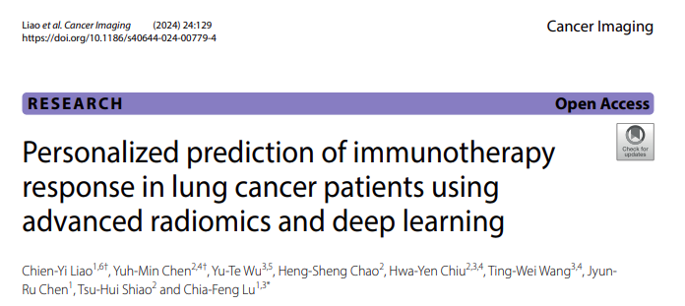
MAIA Journal Club

Slide 2
Background
Immunotherapy (IO), particularly immune checkpoint inhibitors (ICIs), has improved survival for lung cancer (LC) but is not effective for all patients.
PD-L1 predicts ICI response but is limited by tumor variability and genetic interactions.
Many patients with low PD-L1 still benefit from combination therapy, while those with high PD-L1 often show limited response to ICIs alone.
Advanced computation methods can extract key tumor and vascular features from CT scans to assess treatment response.
A more accurate prediction tool can help select suitable patients.

Slide 3
Aims
Predicting progress-free survival (PFS) after IO of advance LC patients.
Optimize resources, improve efficiency, and enhance patient outcomes.
Save money, save time and save patients.

Slide 4
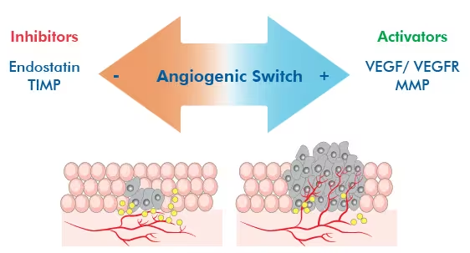
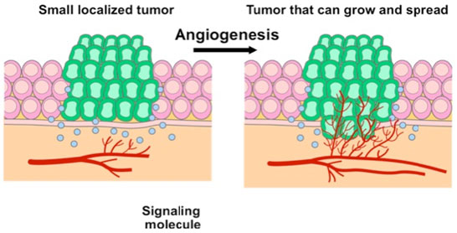
Tumor-associated vasculature
A tumor will initiate the rapid formation of new blood vessels from preexisting vessels in its surrounding peritumoral environment. This newly formed vessel network, known as the tumor-associated vasculature (TAV).
https://cisncancer.org/research/what_we_know/advances/angiogenesis.html
https://www.novusbio.com/research-areas/cancer/angiogenesis

Slide 5
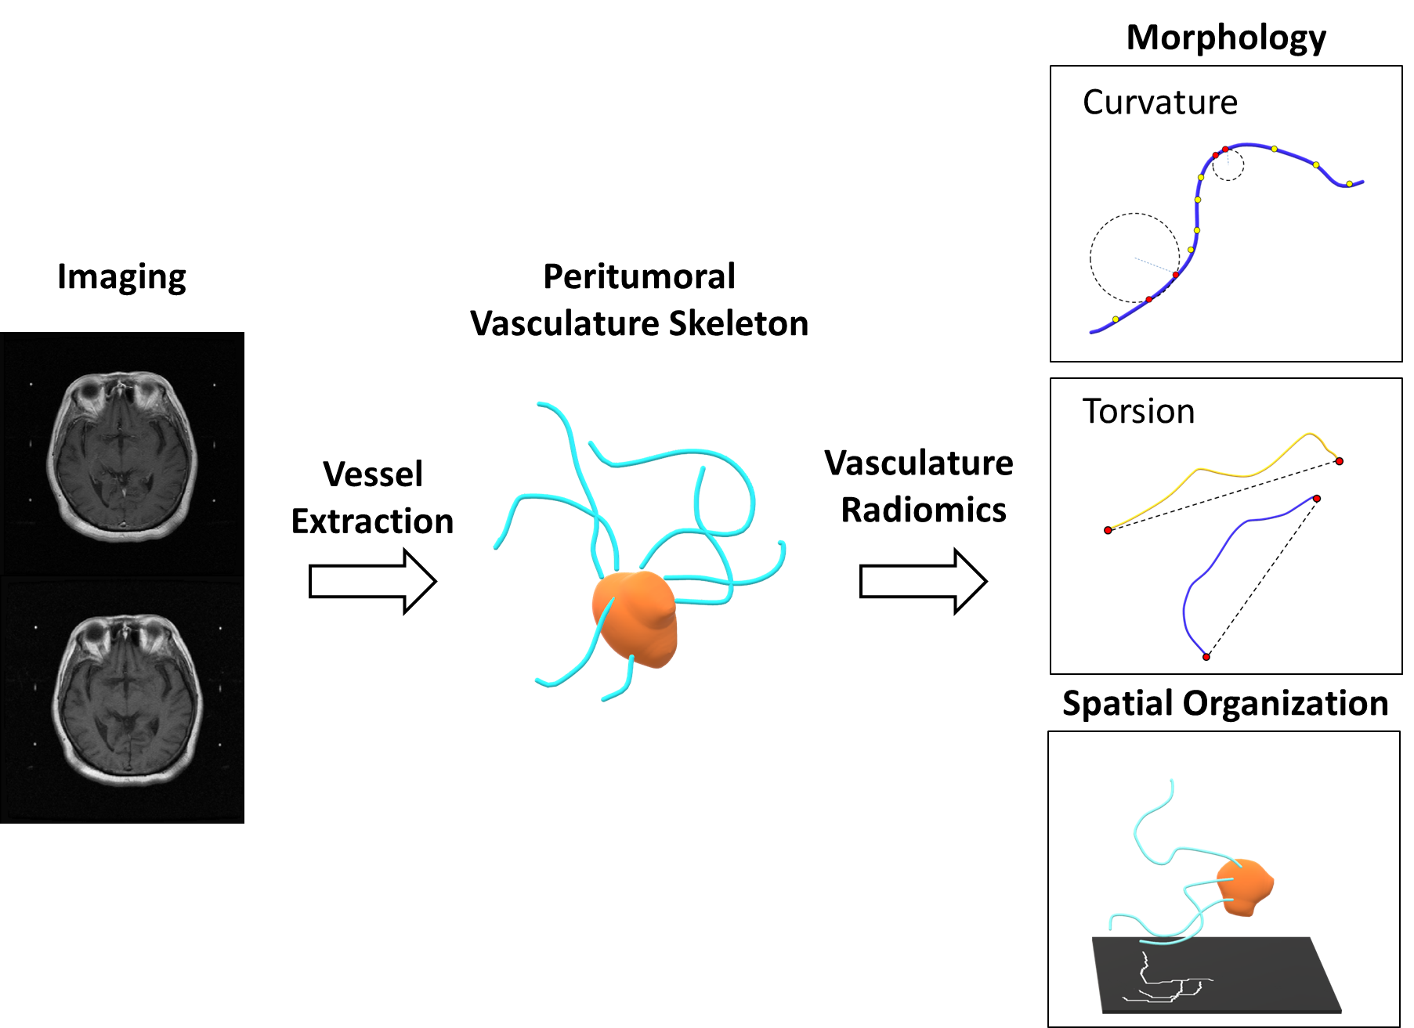
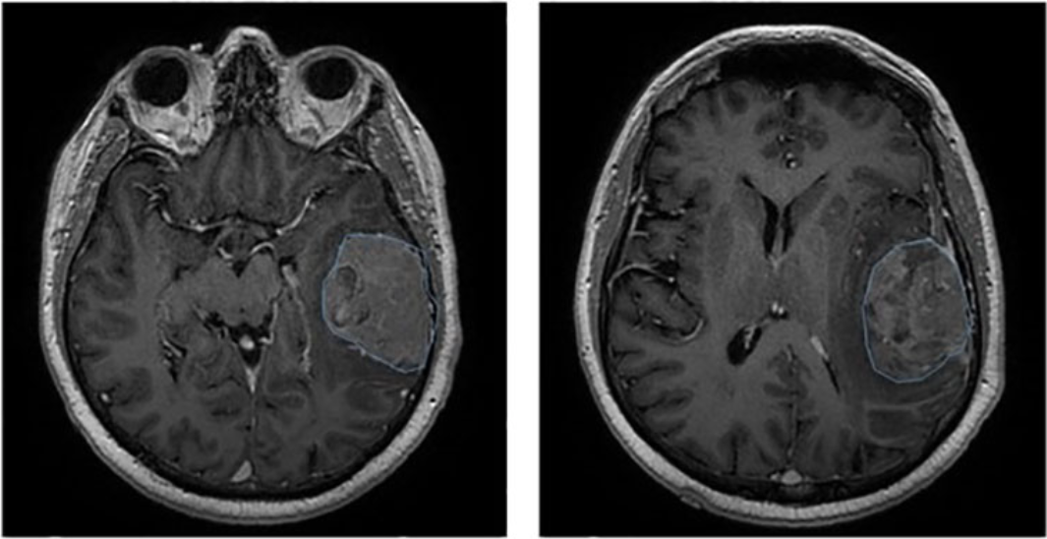
Semantic Radiomic Features
Conventional Patterns
Peritumoral Vasculature Radiomics (QTAV)
Imaging
Feature Extraction

Slide 6
Study Design and Patient Inclusion
Retrospective study
Data collected from 212 LC patients treated with IO between 2016 and 2020,
with monthly follow-ups.
Final cohort: 206 patients met inclusion criteria:
1. Histological diagnosis of LC.
2. Staging based on AJCC guidelines.
3. No other neoplastic diseases.
4. Complete clinical data (e.g., smoking status, ECOG PS, IO drugs, EGFR mutation).
5. High-quality contrast-enhanced chest CT data.

Slide 7
CT Image and Follow-up
CT scanners from 5 manufacturers: GE, Hitachi, Siemens, Toshiba, Philips.
Slice thickness: 1.0–5.0 mm; pixel spacing: 0.5–1.2 mm. Matrix size: 512 × 512 pixels, gray-scale resolution: 16-bit. Peak tube voltage: 120 kVp with automatic dose modulation.
Follow-up: Disease progression: tumor growth, new metastasis, or death.
Follow-ups included vital signs, blood tests, and CT scans as needed.
Data censoring documented for patients with incomplete follow-ups.

Slide 8
Intratumoral Radiomics Analysis
Used two window settings for accurate tumor delineation:
Soft tissue window (Width: 350, Level: 50) – distinguishes tumors from collapsed lungs and fluid.
Lung window (Width: 1500, Level: -600) – defines tumor borders.
For multiple tumors, only the primary tumor was selected as ROI.

Slide 9
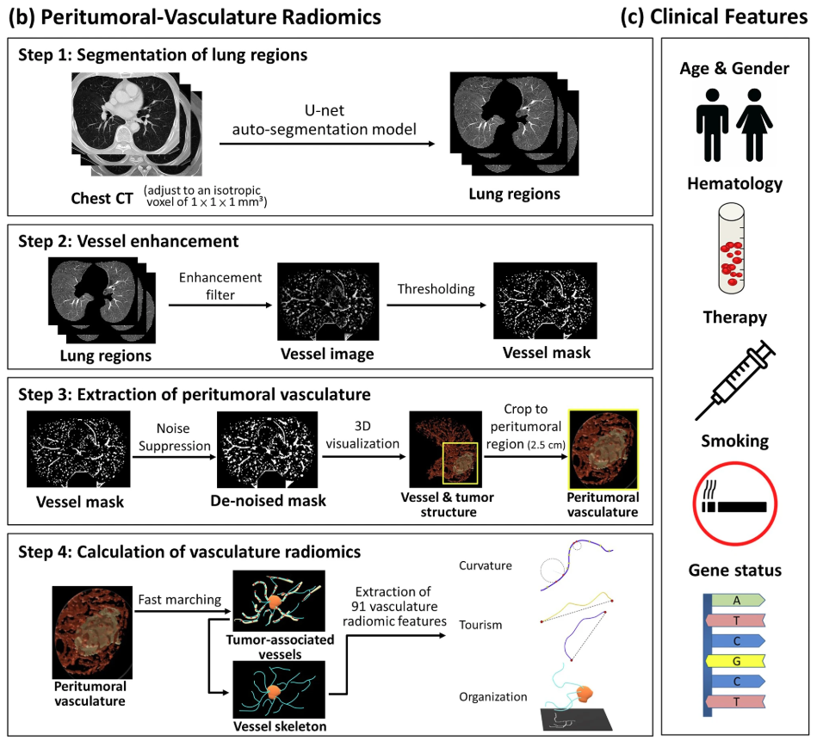
Peritumor and Clinical Features
Peritumoral Vasculature Features
Lung and Vessel Segmentation
Peritumoral Analysis
Feature Computation
Data Refinement:
Outlier-prone features (>20%) removed.
Clinical Features
Integrated with clinical data (e.g., age, gene, hematology, tumor stage).

Slide 10
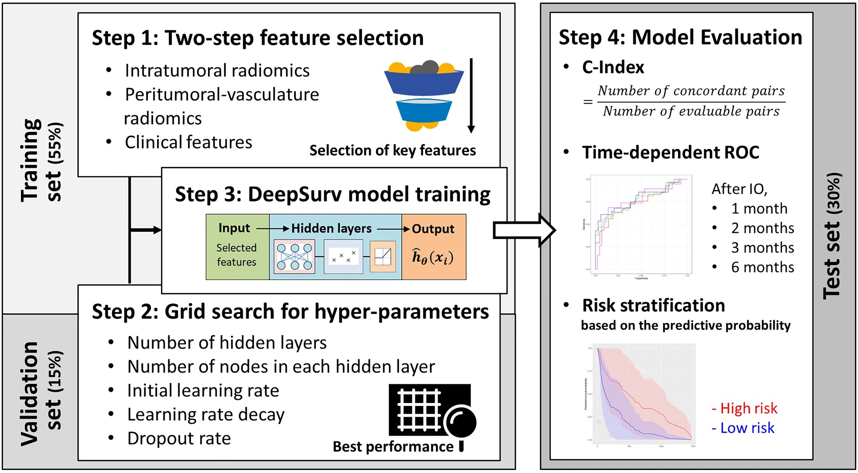
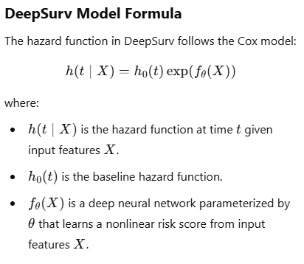
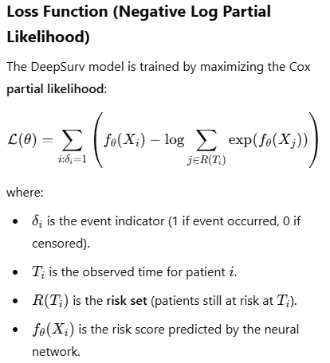
Feature Selection and Modeling

Slide 11
Prediction performance of DeepSurv models
a: Clinical features
b: Clinical + intratumoral features
c: Clinical + intratumoral + peritumoral features

Slide 12
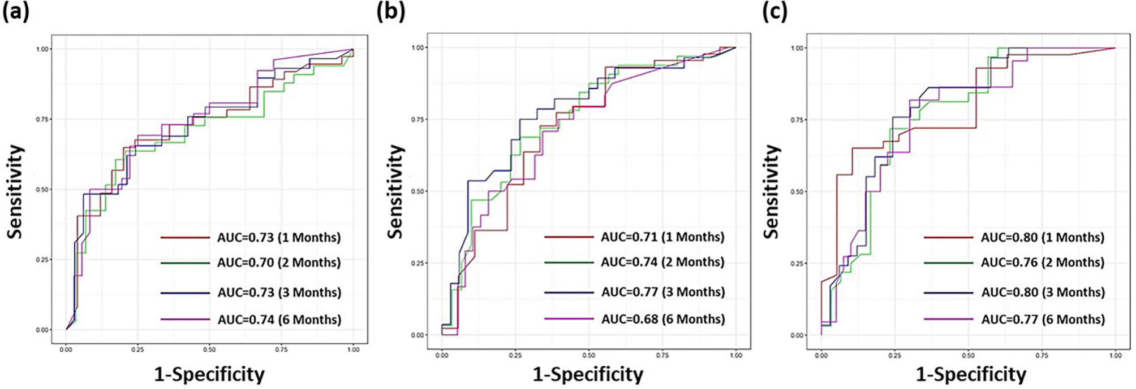
Time-dependent prediction results for progression-free survival
a: Clinical features
b: Clinical + intratumoral features
c: Clinical + intratumoral + peritumoral features

Slide 13
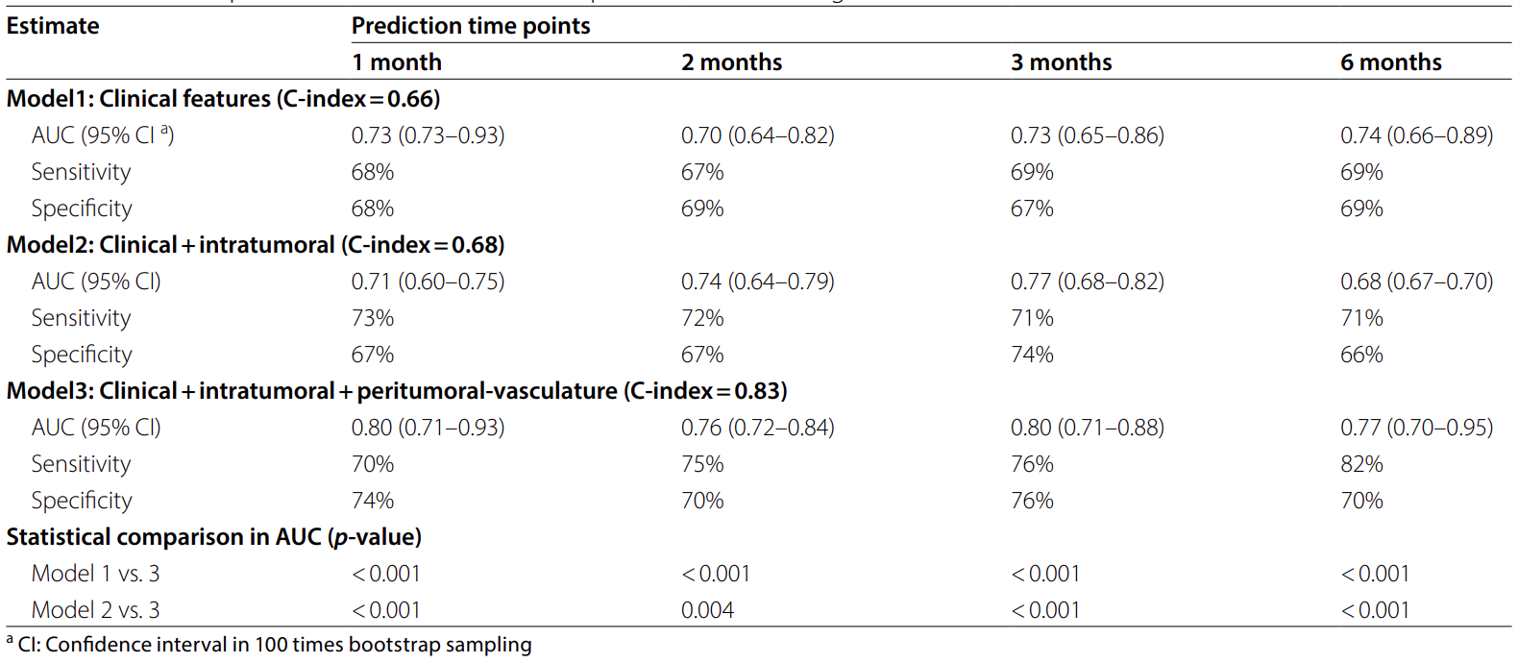
Prediction performance and statistical comparisons of PFS

Slide 14
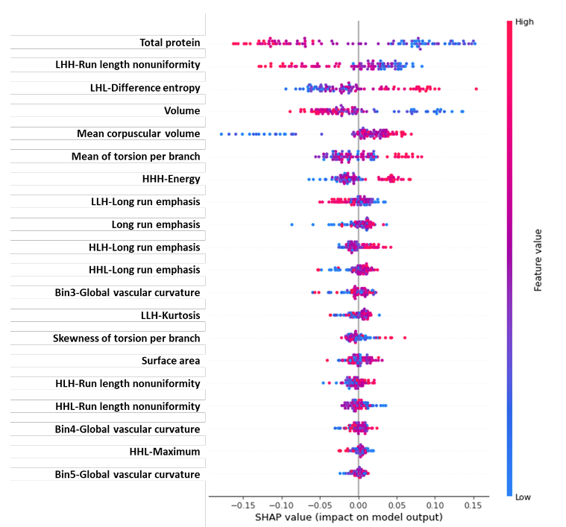
Visualization of feature importance using SHAP analysis.
Key features
Blood Biomarkers
Total Protein:
Lower levels indicate poor prognosis and reduced tolerance to IO.
Mean Corpuscular Volume (MCV):
Elevated MCV linked to folate deficiency, impacting DNA repair and IO response.
Tumor Volume
Larger tumors are associated with increased global heterogeneity and hypoxia, leading to IO resistance.
Radiomics Features
Intratumoral:
Highlights texture irregularities and complexity (e.g., Run Length Nonuniformity, Difference Entropy).
Peritumoral Vessels:
Features like torsion and vascular curvature are associated with IO resistance.

Slide 15
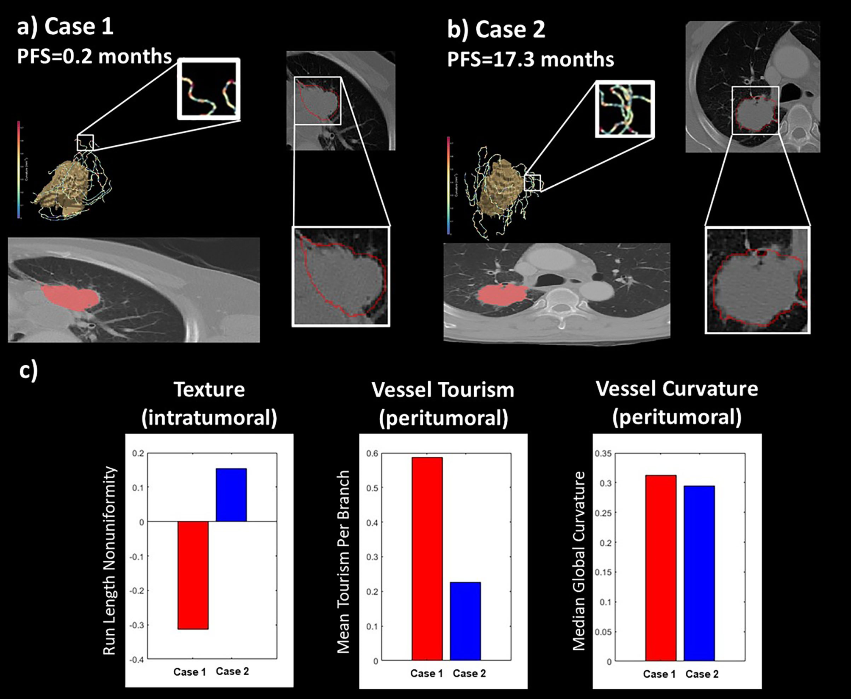
Representative cases for the IO outcome prediction
IO outcome depends on tumor and vascular characteristics.
Poor prognosis: Irregular tumor texture, twisted vessels, limited blood supply.
Better prognosis: Uniform tumor, well-organized vasculature.
Vessel structure may impact IO effectiveness and drug delivery.

Slide 16
Discussion
Clinical Predictors:
High MCV and low total protein were strongly associated with poor PFS after IO treatment.
Radiomics Predictors:
Intratumoral heterogeneity and tumor volume correlates with hypoxia and treatment resistance.
Peritumoral vascular torsion and curvature were linked to IO resistance.
DeepSurv Model Performance:
Achieved high accuracy in PFS prediction (C-index = 0.83).
Integrated radiomics, clinical, and hematologic features demonstrated significant improvement over traditional approaches.

Slide 17
Limitations
Data:
Not first-line dataset
Most of the patients > Stage 4 (Median PFS=3 months)
Patient Heterogeneity
Competing Risks:
Mortality may influence PFS analysis, impacting interpretability
Standardization:
Lack of standardized protocols for peritumoral-vasculature radiomics (Vessel extraction) may affect reproducibility.

Slide 18
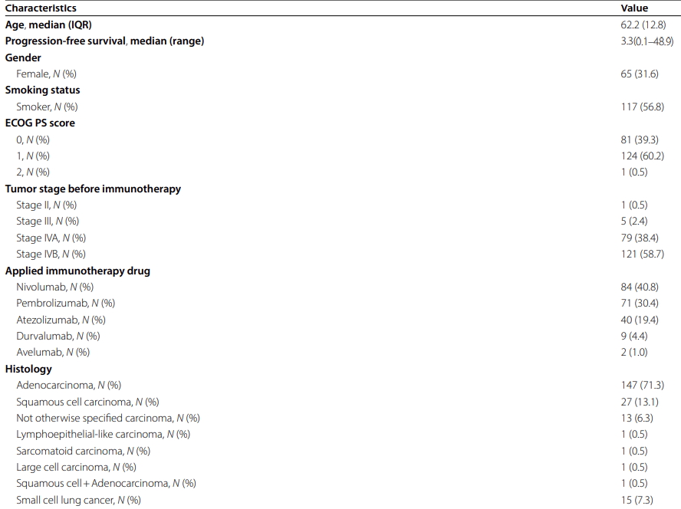
Limitations
Data:
Not first-line dataset
Most of the patients > Stage 4 (Median PFS=3 months)
Patient Heterogeneity
Competing Risks:
Mortality may influence PFS analysis, impacting interpretability
Standardization:
Lack of standardized protocols for peritumoral-vasculature radiomics may affect reproducibility.

Slide 19
Limitations
Data:
Not first-line dataset
Most of the patients > Stage 4 (Median PFS=3 months)
Patient Heterogeneity
Competing Risks:
Mortality may influence PFS analysis, impacting interpretability
Standardization:
Lack of standardized protocols for peritumoral-vasculature radiomics may affect reproducibility.

