Slide 1
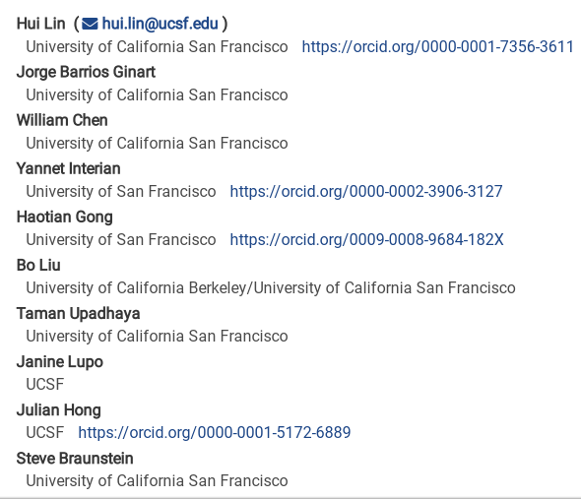
OncoBERT: Building an Interpretable Transfer Learning Bidirectional Encoder Representations from Transformers Framework for Longitudinal Survival Prediction of Cancer Patients
Arxiv paper posted Date: 2023

Slide 2
Motivation
How to use longitudinal clinical notes for overall survival prediction:
aggregating EHR notes for each patient from the time of diagnosis to the initial outcome evaluation timepoint, progressively incorporating new notes for up to one year, which allows us to capture the evolving nature of cancer prognostication
Interpretability
a novel method for BERT interpretability analysis, which extracts top-ranked clinical notes that contribute significantly to the model's predictions.

Slide 3
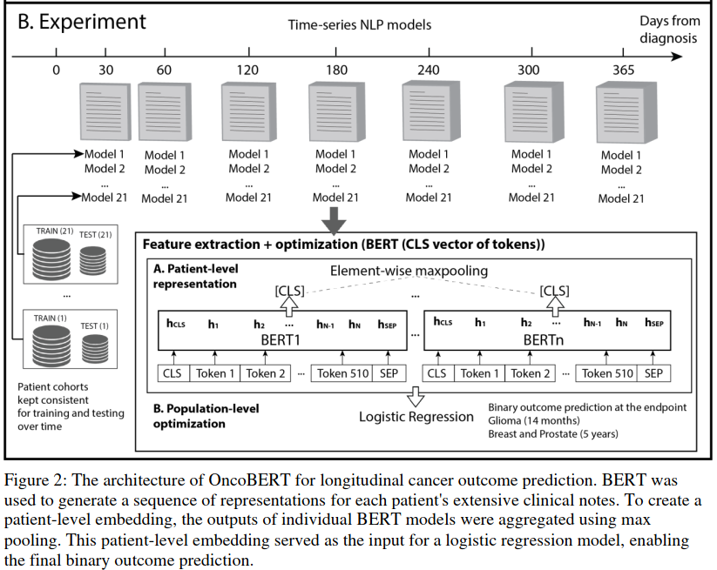
Methods
ClinicalBERT:
BERT language model fine-tuned over a large-scale critical care notes MIMIC-III
texts (512 tokens), which were segmented by the WordPiece algorithm with a vocabulary of > 30k tokens
Embedding of Multiple notes → one patient level embedding:
Condense this series of segment representations into a singular entity: max-pooling, which selects the element-wise maximum value across all notes
CLS: comprehensive representation of the entire input, Classification Token (CLS), which was designed for classification tasks in BERT
21 times: The patient cohort was stratified into training and testing pairs a total of 21 times, ensuring the mitigation of potential impacts from data splitting

Slide 4
Methods
At different time points (30, 60, 120… days), all previous notes were used as input of BERT
Different number of notes, at different time points
CLS: comprehensive representation of the entire input, Classification Token (CLS), which was designed for classification tasks in BERT
21 times: The patient cohort was stratified into training and testing pairs a total of 21 times, ensuring the mitigation of potential impacts from data splitting

Slide 5
Data
glioma, breast, and prostate cancer
Binary: 0 as deceased, 1 as survived
survival threshold for the classification problem (14 months for glioma, 5 years for breast and prostate cancer)
Censored data were excluded (Patients who had not achieved the predefined survival threshold at the time of data collection and remained alive were excluded from the study)
Patients with less than three notes in the EHR from the date of diagnosis to the first timepoint of survival analysis (30 days for glioma and breast, 60 days for prostate) were not eligible
Notes from departments of radiology, pathology, medical oncology and radiation oncology

Slide 6
Baseline for comparison
Term Frequency - Inverse Document Frequency (TF-IDF)
Term Frequency (TF): TF measures how frequently a term appears in a document.
Inverse Document Frequency (IDF): IDF measures how important a term is across the entire corpus.
TF-IDF Score
product of TF and IDF: TF-IDF=TF×IDF
Purpose: Balances the frequency of a term in a document with its rarity across the corpus, highlighting terms that are significant in specific documents.
Staging/grading based survival prediction

Slide 7
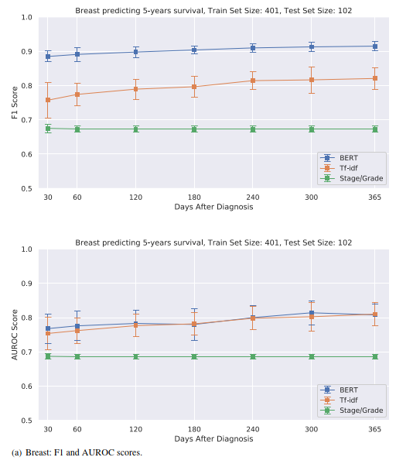
Results
Breast cancer survival
In breast cancer, OncoBERT registered an average F1 score of 0.9 while TF-IDF scored 0.8, with marginal superiority in AUROC compared to TF-IDF.

Slide 8
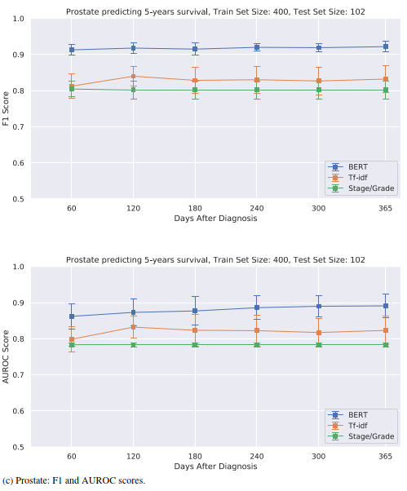
Results
Prostate cancer survival
For prostate cancer, OncoBERT’s average F1 and AUROC were 0.92 and 0.88, outpacing TF-IDF's 0.83 and
0.82, respectively.

Slide 9
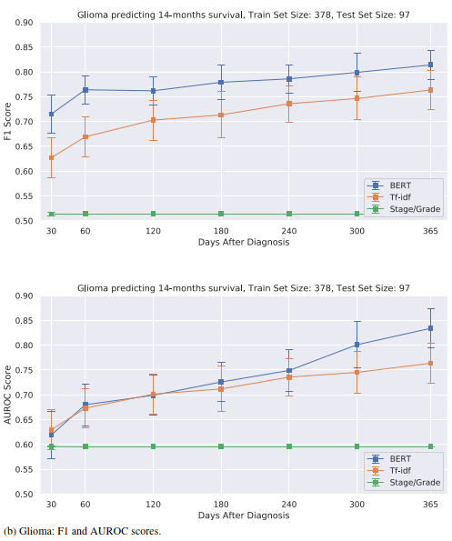
Results
Glioma survival
In glioma, OncoBERT achieved an average F1 score of 0.77 and an AUROC of 0.78, surpassing TF-IDF's 0.71 and 0.74,

Slide 10
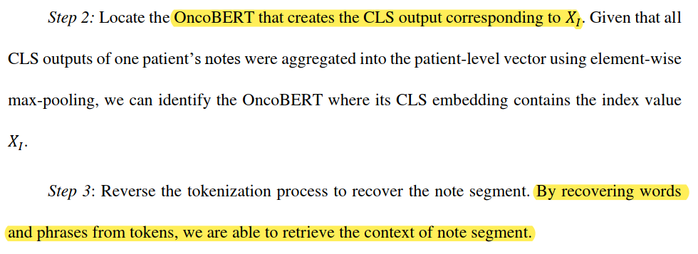
Key notes extraction and interpretability analysis
Which feature: X_{I}
X_{I} from which CLS vector
CLS vector from which note segment

Slide 11
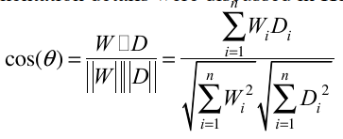
Key notes extraction and interpretability analysis
Analyzing the keynotes
Qualitative grading (physician):
The clinical relevance of each note segment was graded by one physician
a 3-point scale as follows: 1 - not clinically relevant, 2 - inscrutable, 3 - clinically relevant to the outcome
Quantitative analysis:
we extracted keywords from each note segment by calculating the cosine similarity between the note segment embedding and the word embedding
W: the word embedding
𝐷: note segment embedding, represent the overall embedding of the entire segment of interest

Slide 12
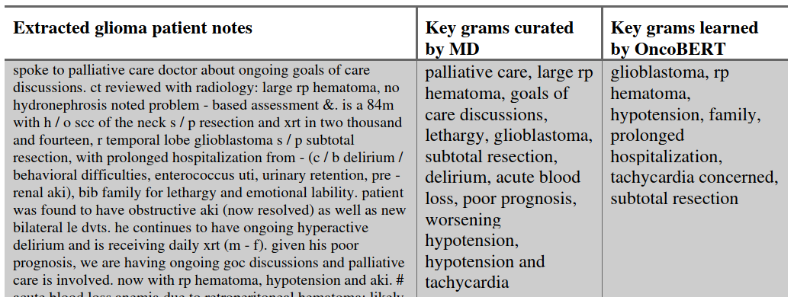
Key notes extraction and interpretability analysis
Example #1 from glioma cohorts, key terms from physician and cosine similarity score (OncoBERT).

Slide 13
Key notes extraction and interpretability analysis
Example #2 from glioma cohorts, key terms from physician and cosine similarity score (OncoBERT).

Slide 14
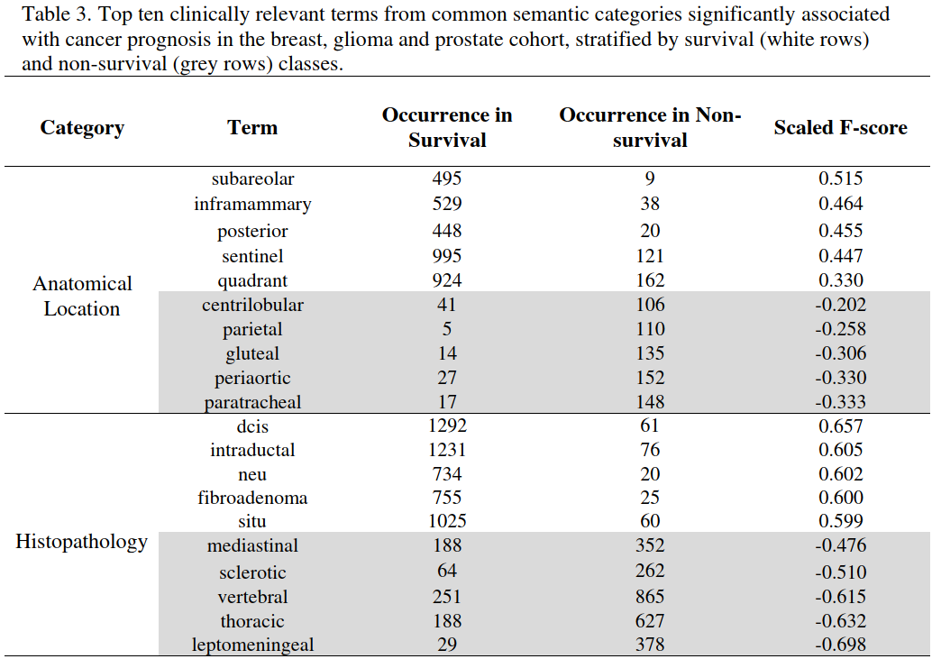
Key notes extraction and interpretability analysis

Slide 15
Summary and limitation
Summary:
Specifically, we found the pre-trained language model, ClinicalBERT, a transformer model pre-trained on clinical notes, was the most effective in predicting survival outcomes for cancer patients
By leveraging BERT's attention mechanism, we can identify which parts of the note contribute most to the prediction, allowing clinicians to understand why a particular patient may be at higher risk or have a different prognosis.
Limitations:
ClinicalBERT used in our study was not specifically trained on oncology-specific vocabulary and data. This may have limited the model's ability to accurately identify and extract relevant information specific to cancer prognosis
Multi-institutional studies needed
Binary prediction with a predefined time points (14 months for glioma, 5 years for breast and prostate cancer).

Slide 16
Acknowledgement
MAIA Lab

