Slide 1
ChatGPT for CTV contour QA in prostate cancer
Beiqian Qi
Graduate Student Researcher
Medical Artificial Intelligence and Automation (MAIA) Laboratory
Department of Radiation Oncology
Beiqian.Qi@UTSouthwestern.edu

Slide 2
Introduction
Aim: Use ChatGPT to facilitate the contour quality assurance (QA), which could be later integrated into clinical workflow AI agent.
Methods
A 3D UNet for CTV delineation.
Training data: 100 CT images and CTV for prostate cancer
Preprocess: The CT image is cropped to contain only prostate closely of 64*64*32.
Accuracy: The average Dice score is 0.8065 for the experiment data.

Slide 3
Method
ChatGPT-4o
System message: Define the task for ChatGPT
You are an expert physician in prostate cancer treatment. You will be given the CT image with CTV and organs at risk (OAR) delineation. The OAR are accurate and CTV delineation is predicted by a deep learning model.
Following the guideline on clinical target volume (CTV) delineation for primary radiation therapy of localized prostate cancer, you task is to evaluate the CTV contour and give improvement suggestions.
Here is the guideline:
Lateral border: after correct delineation of the rectum, the thickness of the musculus levator ani can be defined; the same thickness of the levator ani muscle defined at the level of the rectum can be extrapolated over the full length of the prostate. This forms the lateral border of the prostate.
Anterior border: include the anterior fascia and exclude the fat area in front of the anterior fascia unless protrusion of the prostate is visible on CT.
Posterior border: anterior border of the rectum.
The predicted CTV contour is red; and rectum contour is blue. The other OARs are also showed on the image, bladder is contoured by yellow lines and femur is contoured by green lines.

Slide 4
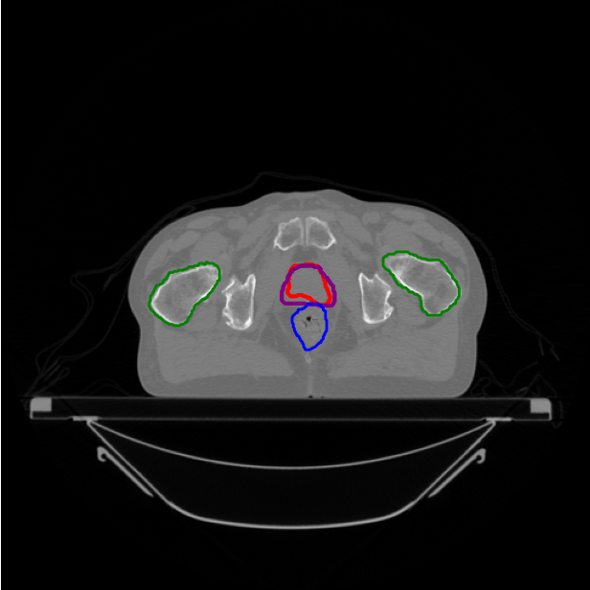
Method
User message: User’s requirement
Please evaluate the delineation quality of prostate contour and give suggestions on improvement.
The middle CT slice. (.png figure)
Totally 89 CT images are available.
Six cases are evaluated:
Three cases with highest Dice scores:
0.9096, 0.8957, 0.8822
Three cases with lowest Dice scores:
0.7065, 0.7137, 0.7268

Slide 5
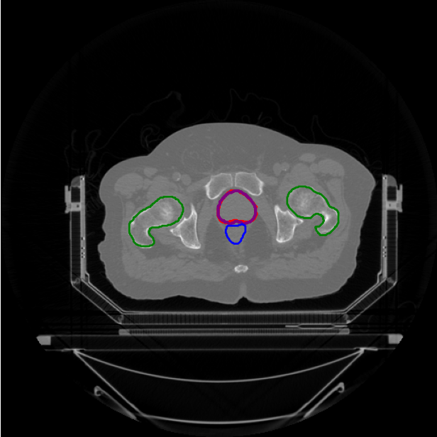
75.png
Dice Score = 0.9096
Upon evaluating the provided CT image with delineated contours, here are the observations and suggestions for improvement based on the guideline:
1. **Lateral Border**:
- The CTV contour appears to extend laterally beyond the anticipated boundary of the prostate. Considering the guideline, the thickness of the musculus levator ani should form the lateral border of the prostate.
- **Improvement Suggestion**: Retract the CTV contour laterally to align with the anticipated thickness of the levator ani muscle, ensuring consistency with the rectal level thickness.
2. **Anterior Border**:
- The anterior border of the CTV should include the anterior fascia while excluding the fat area unless there is a visible protrusion of the prostate.
- **Improvement Suggestion**: Review the anterior extent of the CTV and make sure that it does not include any fat tissue anterior to the prostate unless there is a notable protrusion. (No conclusion.)

Slide 6
3. **Posterior Border**:
- The posterior border of the CTV should align with the anterior border of the rectum.
- **Improvement Suggestion**: The current posterior boundary of the CTV seems to meet this guideline. No adjustments are needed in this area.
**Specific Recommendations**:
- **Lateral Adjustment**: On the lateral sides, ensure the boundary closely follows the outline of the levator ani muscle, pulling the CTV inwards where it may overextend.
- **Anterior Adjustment**: Double-check the anterior aspect for any unnecessary inclusion of fat tissue and modify to only cover the prostate organ up to the anterior fascia.
In summary, adjusting the lateral and possibly anterior borders to strictly adhere to the musculus levator ani's thickness and anterior fascia without including unnecessary fat tissue will enhance the accuracy of the CTV delineation in accordance with the clinical guidelines.

Slide 7
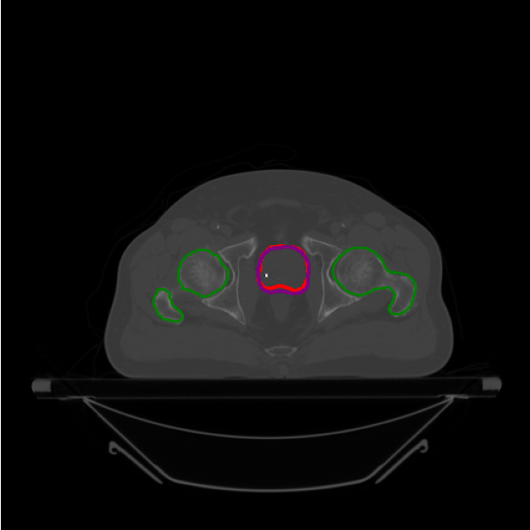
59.png
Dice Score = 0.8957
Upon evaluating the CTV contour delineated in red and comparing it with the anatomical landmarks from the guidelines provided, the following observations and suggestions are made:
1. **Lateral Border**:
- The delineation appears to appropriately follow the presumed musculus levator ani thickness.
- Ensure that the lateral edges are consistent throughout the length of the prostate. Verify other slices if necessary to ensure uniformity.
2. **Anterior Border**:
- The delineation seems to include the anterior fascia, but it is important to make sure that this border distinctly excludes the fat area in front of the fascia unless there is a clear protrusion.
- Carefully check and correct if any portion of the fat is included erroneously.

Slide 8
3. **Posterior Border**:
- The posterior border of the predicted CTV contour is appropriately delineated against the anterior border of the rectum as shown in blue.
4. **General Observations**:
- The contour generally seems to be well delineated, but a cross-verification with adjacent slices is crucial to ensure consistency.
- Checking for any deformation or irregularity in the shape of the CTV in relation to anatomical boundaries in the superior and inferior neighboring slices would confirm the accuracy.
Suggestions for improvement:
1. Verify the series of CT images across the entire length of the prostate to ensure that the lateral, anterior, and posterior borders consistently follow the anatomical landmarks provided in the guidelines.
2. Specifically, scrutinize the anterior contour to ensure that no adipose tissue is included unless a protrusion is clearly identified.
3. A thorough review slice-by-slice to confirm no deviations in the contour boundaries will be beneficial.
4. Minor adjustments can be manually made if any regions are over- or under-contoured to align perfectly with the guidelines described.
Overall, the delineation appears quite accurate but warrants a detailed review with the mentioned considerations to ensure optimized and precise CTV contouring.

Slide 9
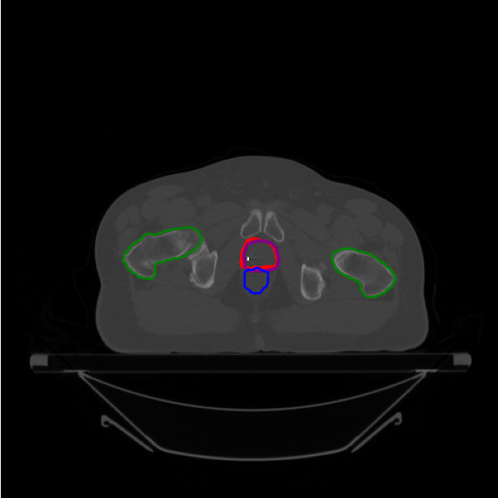
29.png
Dice Score = 0.8822
The delineation of the predicted CTV contour (red line) shows that there is room for improvement based on the guidelines: 1. **Lateral Borders:** - As the musculus levator ani is clearly visible and can be defined, the thickness of this muscle should be taken into account. In this image, the contour seems to be within the expected lateral borders as extrapolated from the identification of the musculus levator ani, so this aspect of the contour appears accurate. 2. **Anterior Border:** - It is important to include the anterior fascia and exclude the fat area in front of it unless there is visible protrusion of the prostate in the CT image. Here, it seems the contour correctly includes the anterior fascia and does not encroach too far into the fat area anteriorly, maintaining the proper boundary of the prostate CTV anteriorly.

Slide 10
3. **Posterior Border:** - The posterior border of the prostate CTV should be aligned with the anterior border of the rectum (blue line). The current contour appears to slightly overlap or be very close to overlapping with the rectal contour in certain areas. It's essential to ensure that the CTV respects the anterior wall of the rectum as a hard boundary. Careful refinement is needed here to avoid any unnecessary overlap with the rectum. **Improvement Suggestions:** - **Refine the posterior border**: Adjust the posterior aspect of the CTV contour to better align with the anterior border of the rectum. This may involve slightly reducing the posterior extension of the CTV to ensure non-overlap. - **Re-examine anterior border**: Ensure the anterior border includes only the anterior fascia without moving into the fat area unless necessary. A thorough review of multiple slices will ensure consistent adjustments and adherence to the guidelines across the full volume of the prostate CTV. This slice appears fairly well-delineated with minor improvements needed, particularly posteriorly.

Slide 11
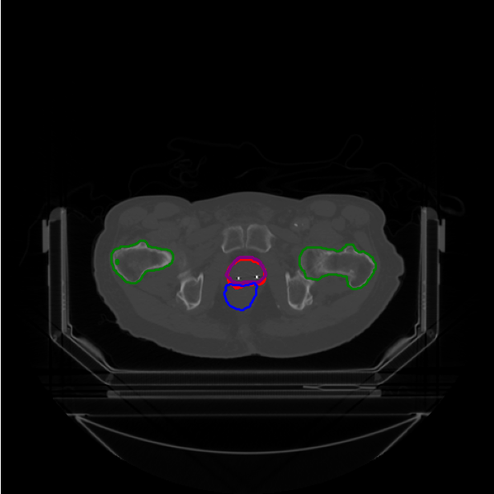
65.png
Dice Score = 0.7065
Upon evaluating the provided CT image with predicted CTV (red) and rectum contour (blue), as well as other organs at risk (OARs), here are the assessment points and suggestions for improvement:
1. **Lateral Border:** The predicted CTV appears to extend laterally beyond the thickness of the musculus levator ani. The lateral border of the prostate should match the thickness of the musculus levator ani as defined at the level of the rectum. Therefore, the lateral borders of the prostate contour at this level should be adjusted to stay within the confines of the defined musculus levator ani thickness.
2. **Anterior Border:** It is necessary to ensure that the anterior border includes the anterior fascia while excluding the fat area in front of the anterior fascia, unless a clear protrusion of the prostate is visible. From the current image, the red contour seems to include a part of the fat area which might be unnecessary. This border could be slightly adjusted to more precisely follow the anterior fascia to avoid inclusion of fatty tissue.
3. **Posterior Border:** According to the guideline, the posterior border of the prostate should be the anterior border of the rectum. The red contour here seems adequate as it aligns well with the rectal contour (blue), suggesting it is appropriately constrained by the anterior rectal wall.

Slide 12
In summary, adjustments mainly to the lateral and anterior borders of the red contour should improve its accuracy. Ensuring strict adherence to the guideline boundaries will help ensure the CTV is confined accurately to the prostate. This will minimize radiation exposure to surrounding healthy tissue while targeting the prostate effectively.
Specific improvements:
- **Lateral Borders:** Adjust to be within the thickness of musculus levator ani at the same level as the rectum.
- **Anterior Border:** Re-assess and contour to ensure only the prostate and anterior fascia are included, excluding any fat tissue unless there are clear signs of prostate protrusion.
By making these modifications, the delineation should better match the clinical criteria for effective radiation therapy planning.

Slide 13
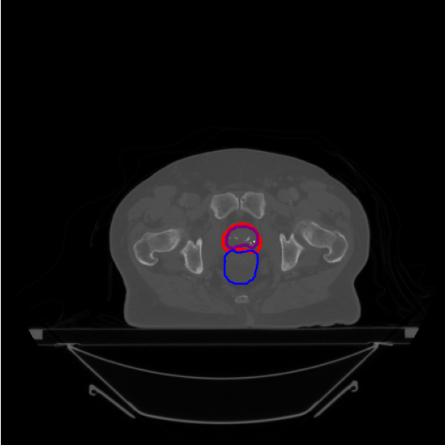
55.png
Dice Score = 0.7137
Based on the guideline provided and reviewing the CT image with the predicted CTV contour (red) and the rectum contour (blue), here are the evaluation points and suggestions for improvement:
1. **Lateral Borders:**
- The lateral borders should align with the thickness of the musculus levator ani. The predicted CTV contour seems appropriate in terms of lateral extension, following the guidelines. No significant adjustments are needed for the lateral borders.
2. **Anterior Border:**
- The anterior border of the CTV should include the anterior fascia and exclude the fat unless there is a prostate protrusion. In this case, the predicted CTV seems to include the anterior fascia but partially extends into the fat area. This may need refinement to exclude the fat region unless there is a clear prostate bulging visible.
- **Suggestion:** Narrow the anterior border to exclude the fat and follow the contour of the anterior fascia more closely.

Slide 14
3. **Posterior Border:**
- The posterior border should align with the anterior border of the rectum. The current CTV contour projects minimally into the rectum region.
- **Suggestion:** Adjust the posterior border to be exactly anterior to the rectum without extending into the blue delineation.
4. **General Shape:**
- The overall shape of the CTV resembles the prostate anatomy quite closely but could benefit from minor adjustments as indicated above to ensure adherence to the given guidelines.
5. **Verification of Contours:**
- Ensure that the CTV contour extends through the entire length of the prostate consistently at all slices of the CT scan.
By making these adjustments to the lateral, anterior, and posterior borders, the accuracy of the CTV delineation can be improved to more closely follow the clinical guidelines for effective radiation therapy planning.

Slide 15
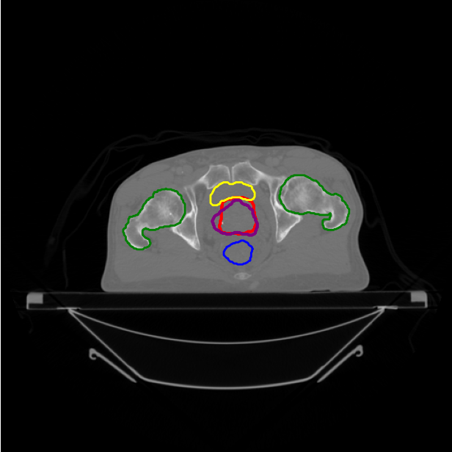
69.png
Dice Score = 0.7268
The CTV contour delineated in red generally corresponds well with anatomical landmarks for the prostate, but there are a few areas that need adjustment:
1. **Lateral Borders**:
- The contour seems to be extended laterally into the musculus levator ani and potentially beyond it. As per the guideline, the lateral borders should be delineated based on the thickness of the levator ani muscle at the level of the rectum and should be maintained consistently along the entire length of the prostate. You can compare the musculus levator ani thickness adjacent to the rectum and ensure it extends neither further laterally nor medially beyond this.
2. **Anterior Border**:
- The anterior border of the prostate defined by the red contour appears to be within appropriate limits. However, we need to confirm that the anterior fascia is included and no fat area is included unless there is a visible protrusion of the prostate. This seems to be followed properly in this image.
3. **Posterior Border**:
- The posterior border should abut the anterior border of the rectum (blue). The delineation in the current image is appropriate and follows this guideline.

Slide 16
### Suggested Improvements:
1. **Lateral Borders**:
- Adjust the contour to exclude any portions of the musculus levator ani if it is inaccurately included. Carefully trace the lateral edge to align with the musculature as observed in the slice.
2. **Consistency**:
- Ensure the adjustments are consistent throughout all image slices of the prostate, maintaining the same delineation principles based on the anatomical landmarks described in the guidelines.
These modifications will ensure the CTV is accurately delineated, minimizing unnecessary exposure of healthy tissues to radiation. Always review each slice of the delineation for consistent adherence to the guidelines.

Slide 17
Discussion
ChatGPT cannot give the improvements visually;
The evaluation accuracy does not show relation with Dice scores.
Improvements
Provide clinical delineation examples for few-shot learning and chain of thought;
Combined with MRI images to use soft tissue boundaries;
Use other models such as DeepSeek to evaluate the contour;
How to quantitatively analyze ChatGPT’s response

