Slide 1
Autonomous Radiotherapy Treatment Planning Using DOLA: A Privacy-Preserving, LLM-Based Optimization Agent
Austen Maniscalco
Ph.D. Candidate
Medical Artificial Intelligence and Automation (MAIA) Laboratory
Department of Radiation Oncology
Austen.Maniscalco@UTSouthwestern.edu

Slide 2
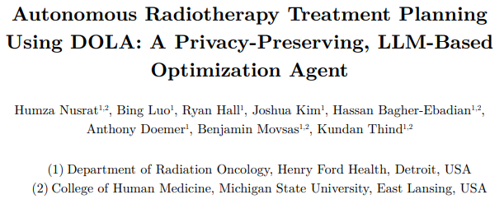
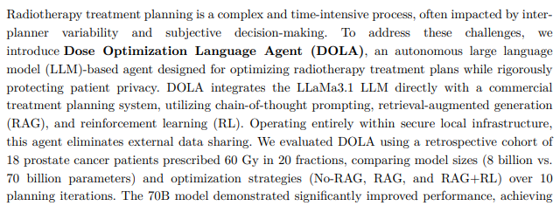
arXiv:2503.17553 [physics.med-ph] 21 Mar 2025
2

Slide 3
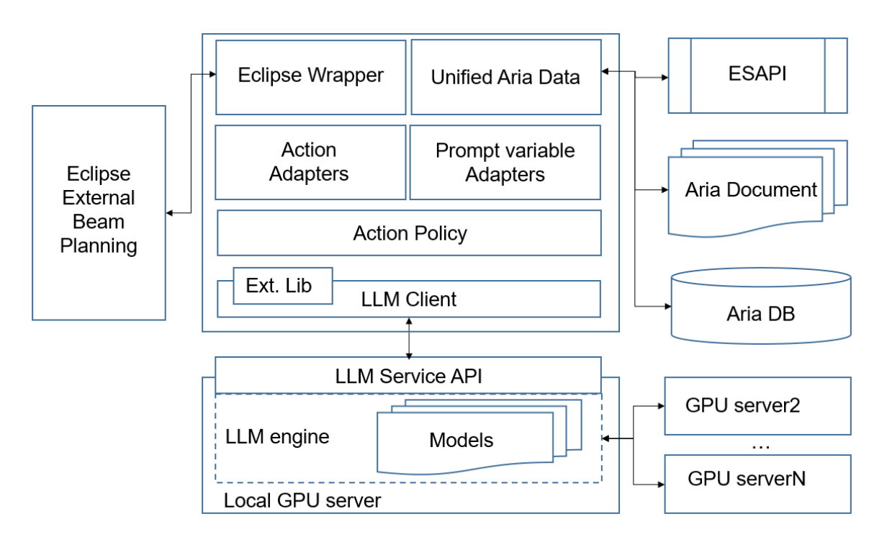
Dose Optimization Language Agent
Integrates LLaMa3.1 with the Eclipse TPS API
Autonomously optimizes radiotherapy plans
Three key technical innovations:
Chain-of-thought prompting for iterative plan refinement
Retrieval-augmented generation (RAG) to access and learn from prior planning attempts
Reinforcement learning (RL) using a reward function to guide dosimetric trade-offs
3

Slide 4
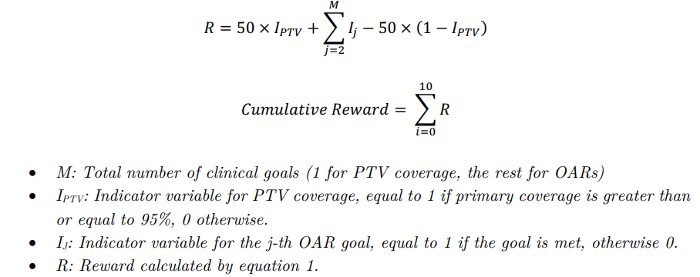
Methods
DOLA conducted a maximum of 10 iterations per treatment plan
Action sequence:
Retrieved current treatment plan PTV and OAR DVH metrics, and “RL” reward metric
When RAG was enabled, retrieved up to three prior planning attempts to inform decision making
LLM determined modifications to objective *priorities*, but not objective values
Modifications were then implemented in TPS
Plan was re-optimized & re-calculated
4

Slide 5
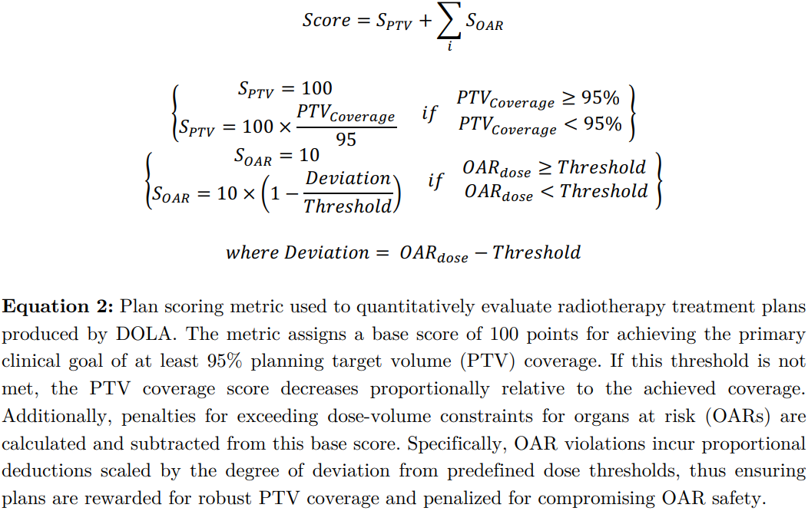
Dataset & Evaluation
18 prostate cancer patients that received 60 Gy in 20 fractions
Plan quality was scored using a metric from the PROFIT clinical trial protocol
Evaluated temperature settings ranging from 0.1-1.0
Evaluated two versions of LLaMa3.1: 8B and 70B parameters
Evaluated three optimization strategies: Baseline (No-RAG), RAG, and RAG+RL
5

Slide 6
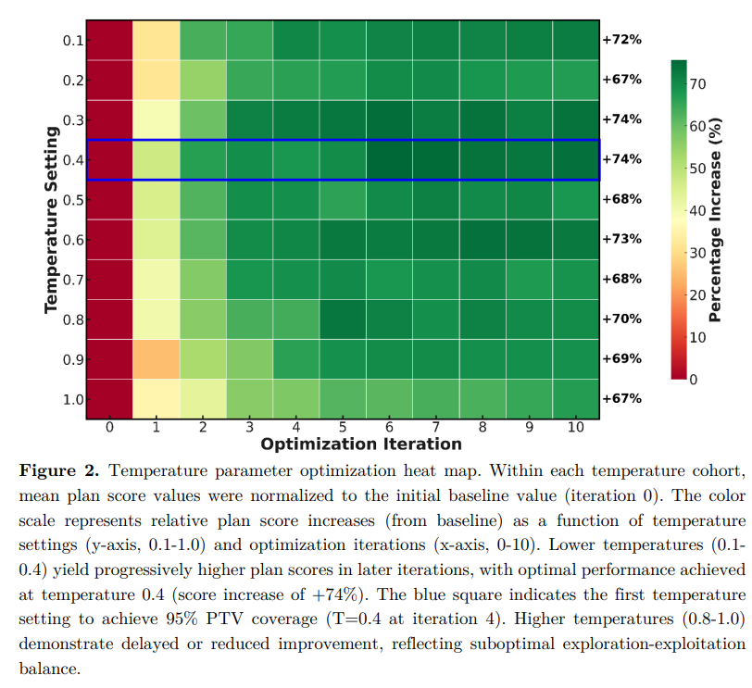
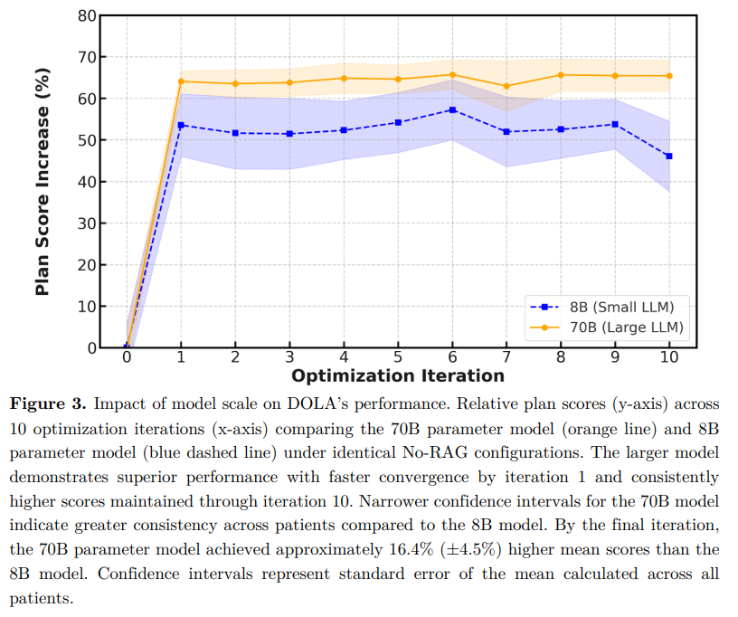
Results
6

Slide 7
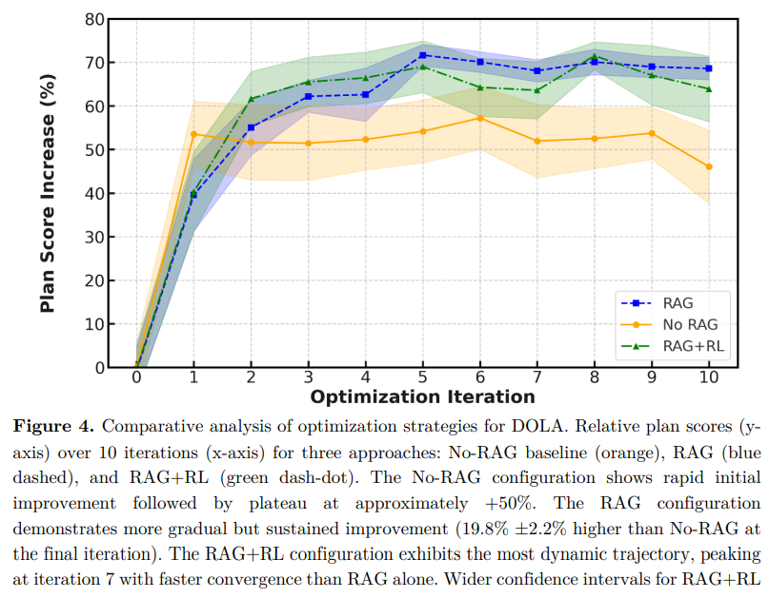
Results
7

Slide 8
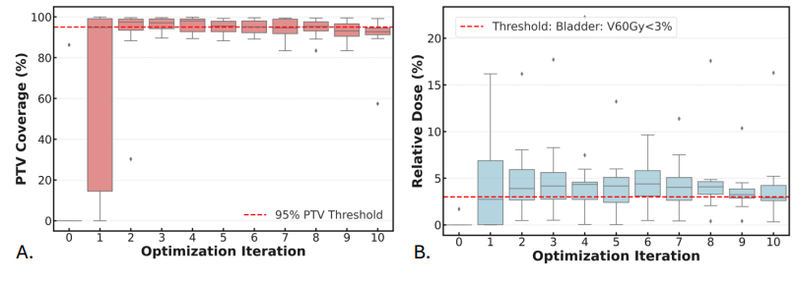
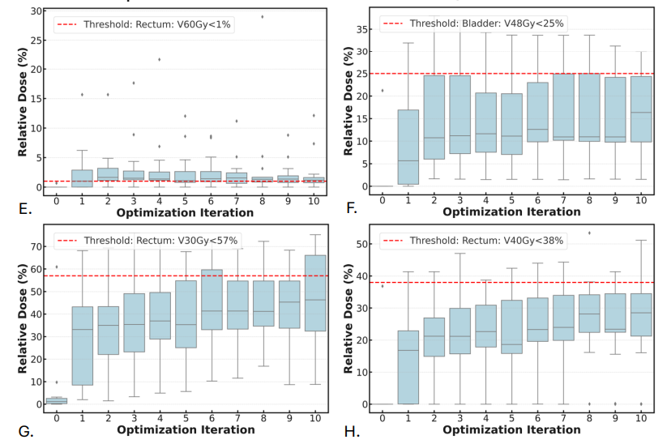
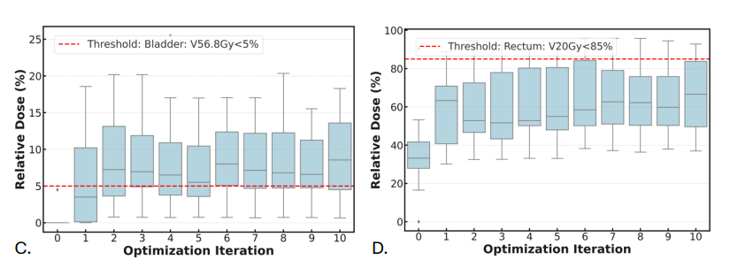
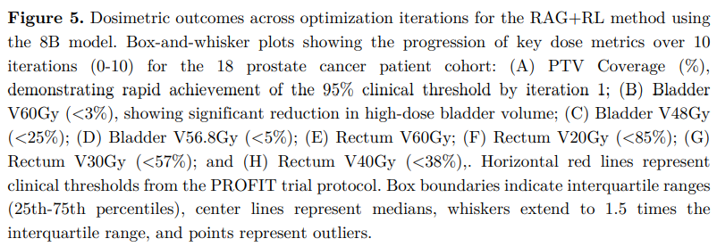
Results
8

Slide 9
Author’s Discussion Points
The integration of explainable AI within secure, privacy-focused clinical environments provides a scalable model for future research and clinical adoption.
DOLA consistently achieved adequate PTV coverage while respecting organ-at-risk constraints.
The rapid improvement in plan quality from iteration 0 to iteration 1, followed by more gradual refinement in subsequent iterations, mirrors the prioritization approach used by expert human planners.
70B parameter model had “16.4%” higher final scores compared to 8B model. Larger models may benefit from improved reasoning capabilities, contextual understanding, and pattern recognition.
RAG improved final plan quality by “11.8%”
Limitations
Small dataset, only one disease site, one fractionation, and one protocol
No consideration for images, contours, or beams
“Wide confidence intervals seen in particular cases (such as RAG+RL in Figure 4) suggest potential overfitting due to our limited dataset”
Occasional organ constraint violations
9

Slide 10
Thoughts about this work
Missing information about “iteration 0”
I assume “iteration 0” means there is no dose, but they claim a 40%+ relative improvement from 0 -> 1?
I assume optimization objectives were manually pre-specified, as DOLA only modifies their priorities
Inherent bias; doesn’t really reflect the LLM taking significant action to improve the plan
The updates over iterations seem noisy and it’s unclear there is actual improvement
All improvements are “relative”, no way to actually discern the plan quality
OAR doses appear to worsen with more iterations, or flat-line if near the goal (indicating no change by LLM)
The organ constraints are very generous, such that you could probably achieve most of them with a minimally optimized plan
Lacking comparison to clinical plans
Missing information about the text prompt and its format
Changes made by the LLM were not demonstrated in any way
Missing information about time taken
Methods are not generalizable
10

Slide 11
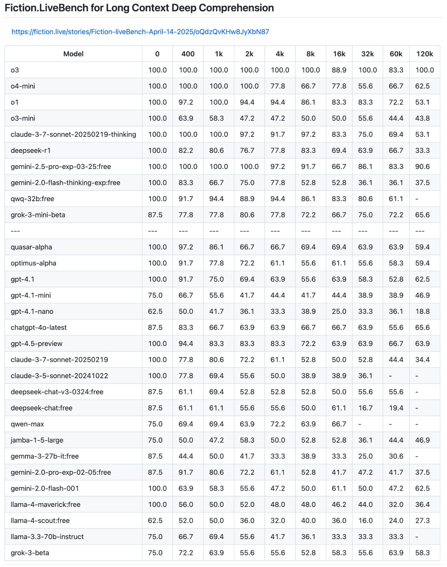
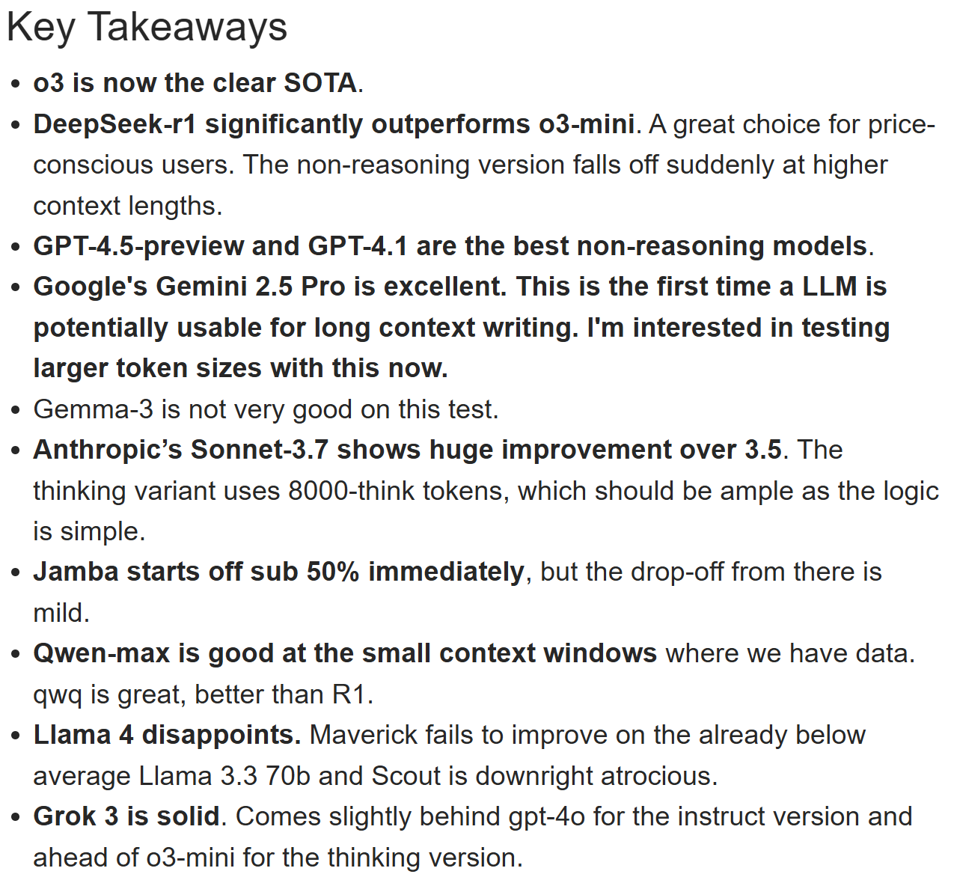
Benchmark for LLM Long Context Comprehension
11

